Slide 1
MAIN FIGURES: No evidence for a common blood microbiome based on a population study of 9,706 healthy humans Cedric C.S. Tan, Minghao Chia, Karrie K.K. Ko, Niranjan Nagarajan

Slide 2
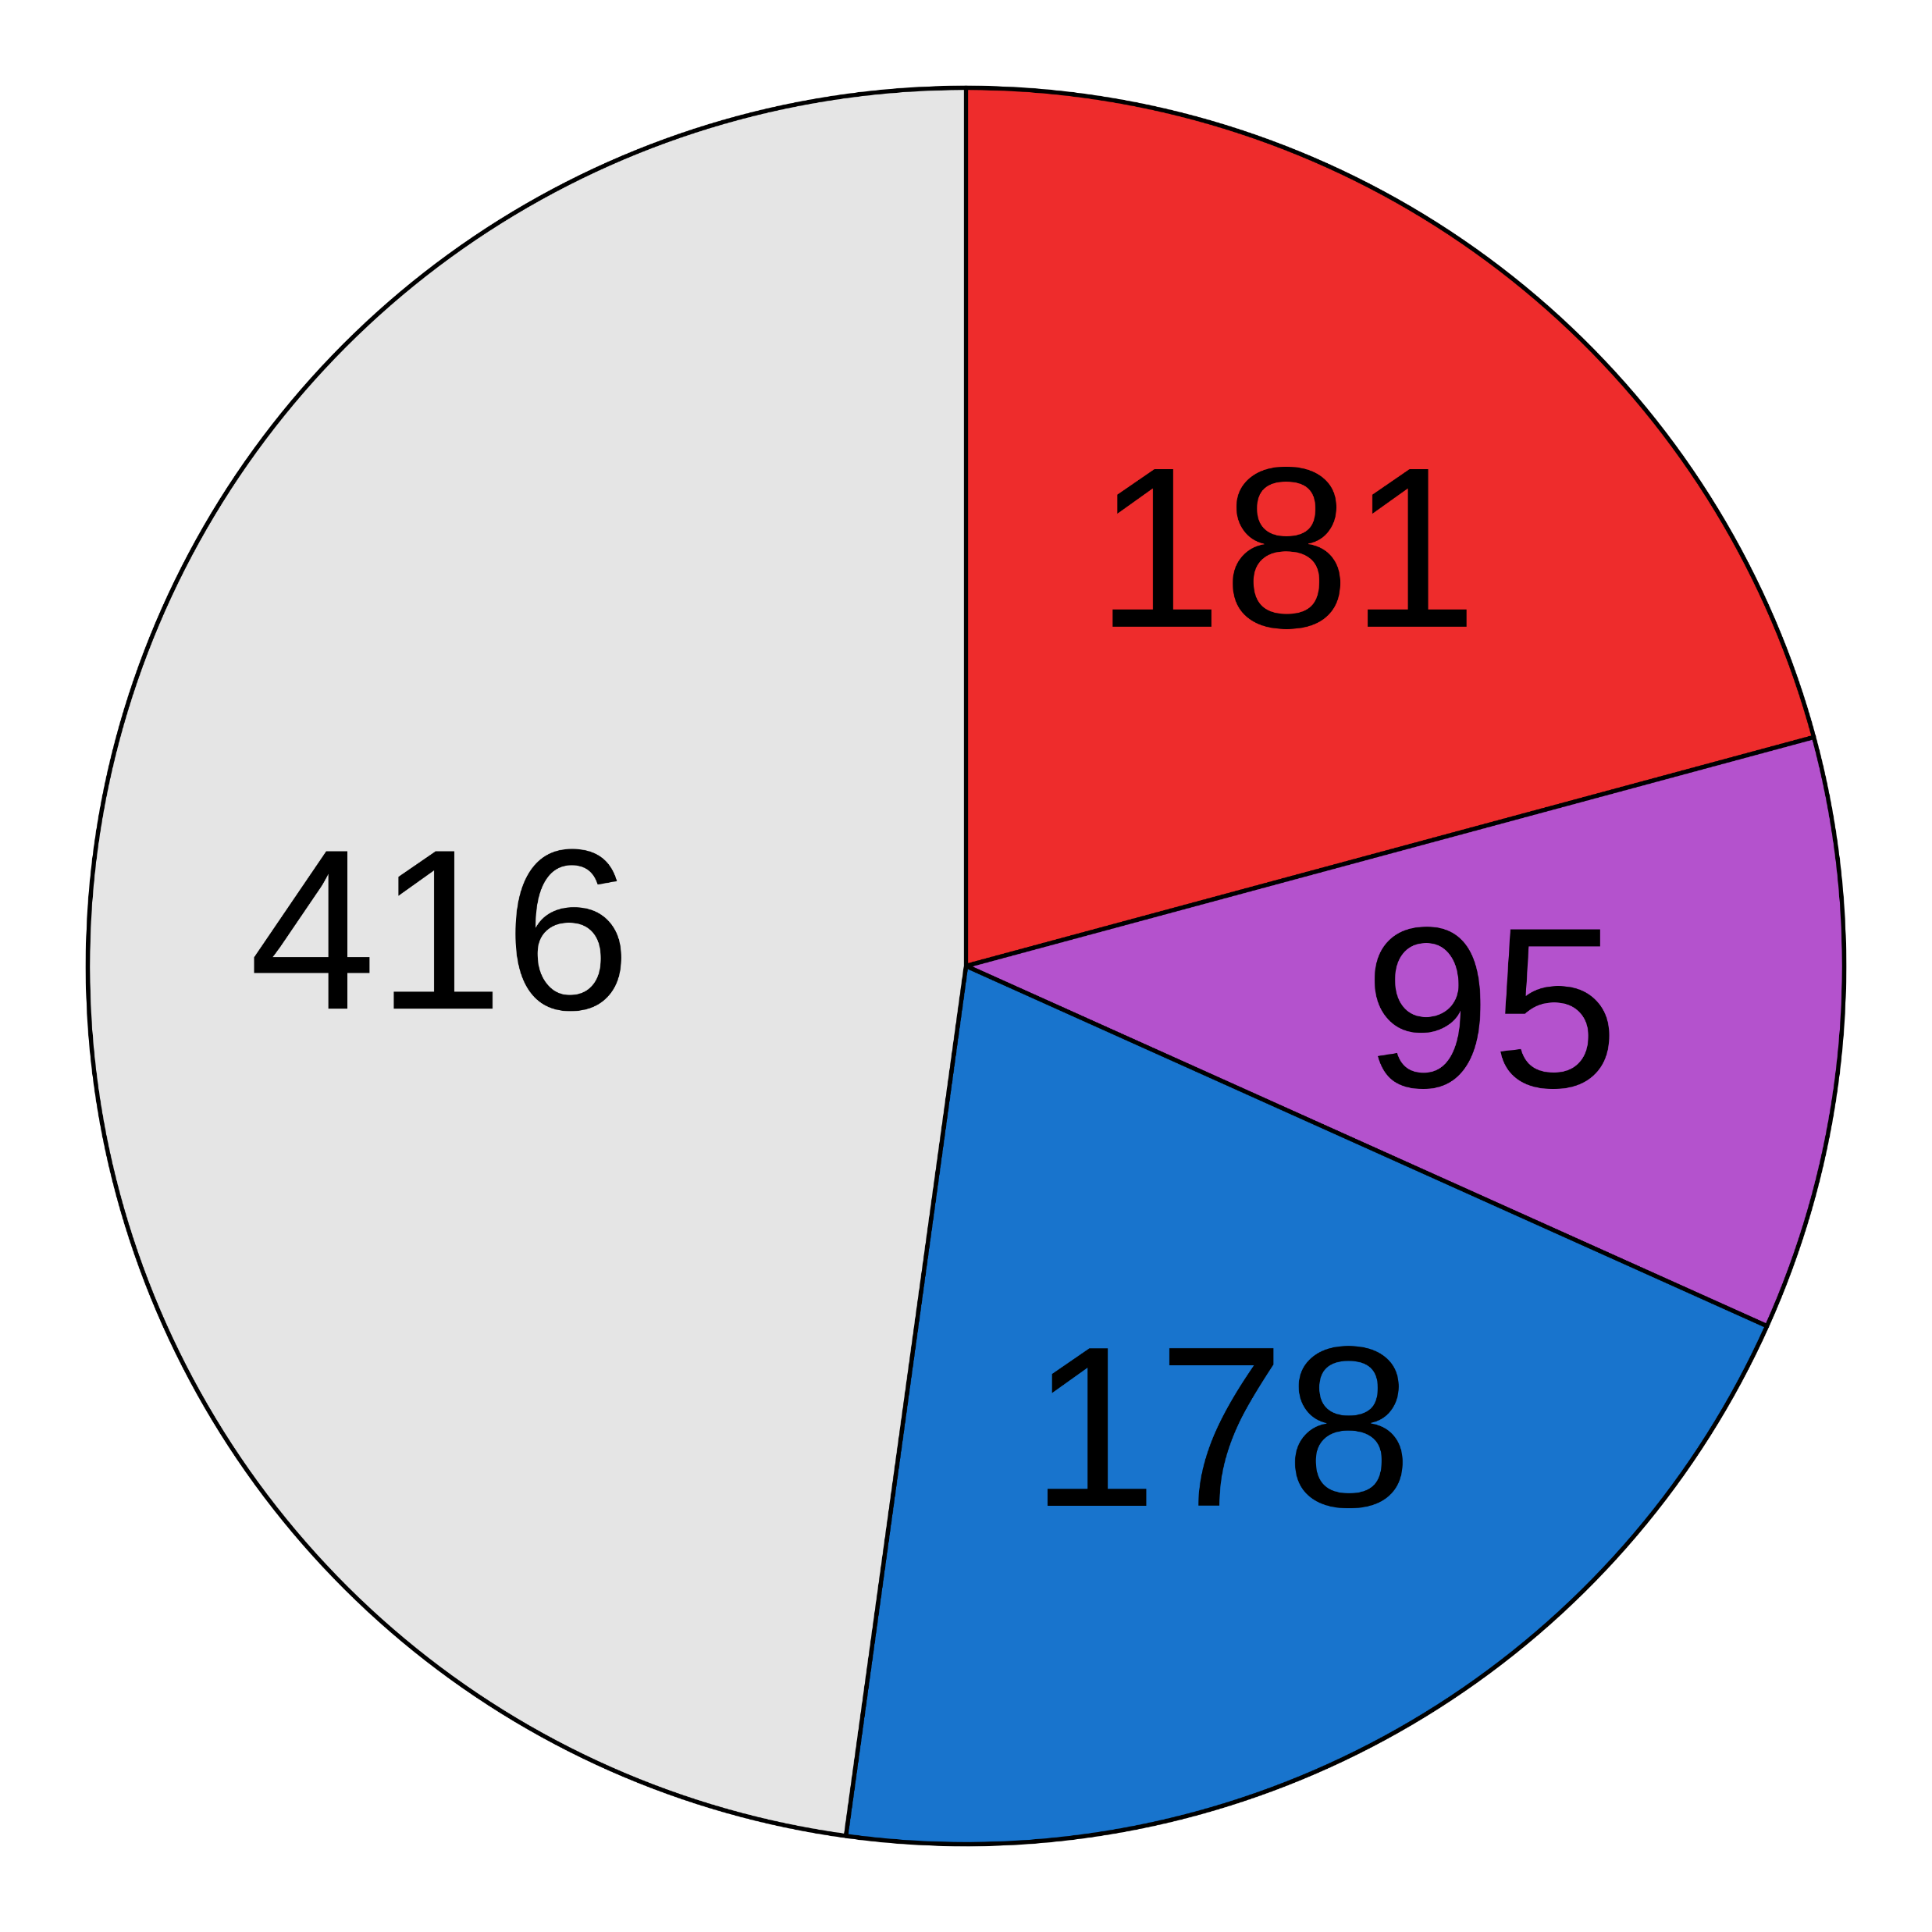
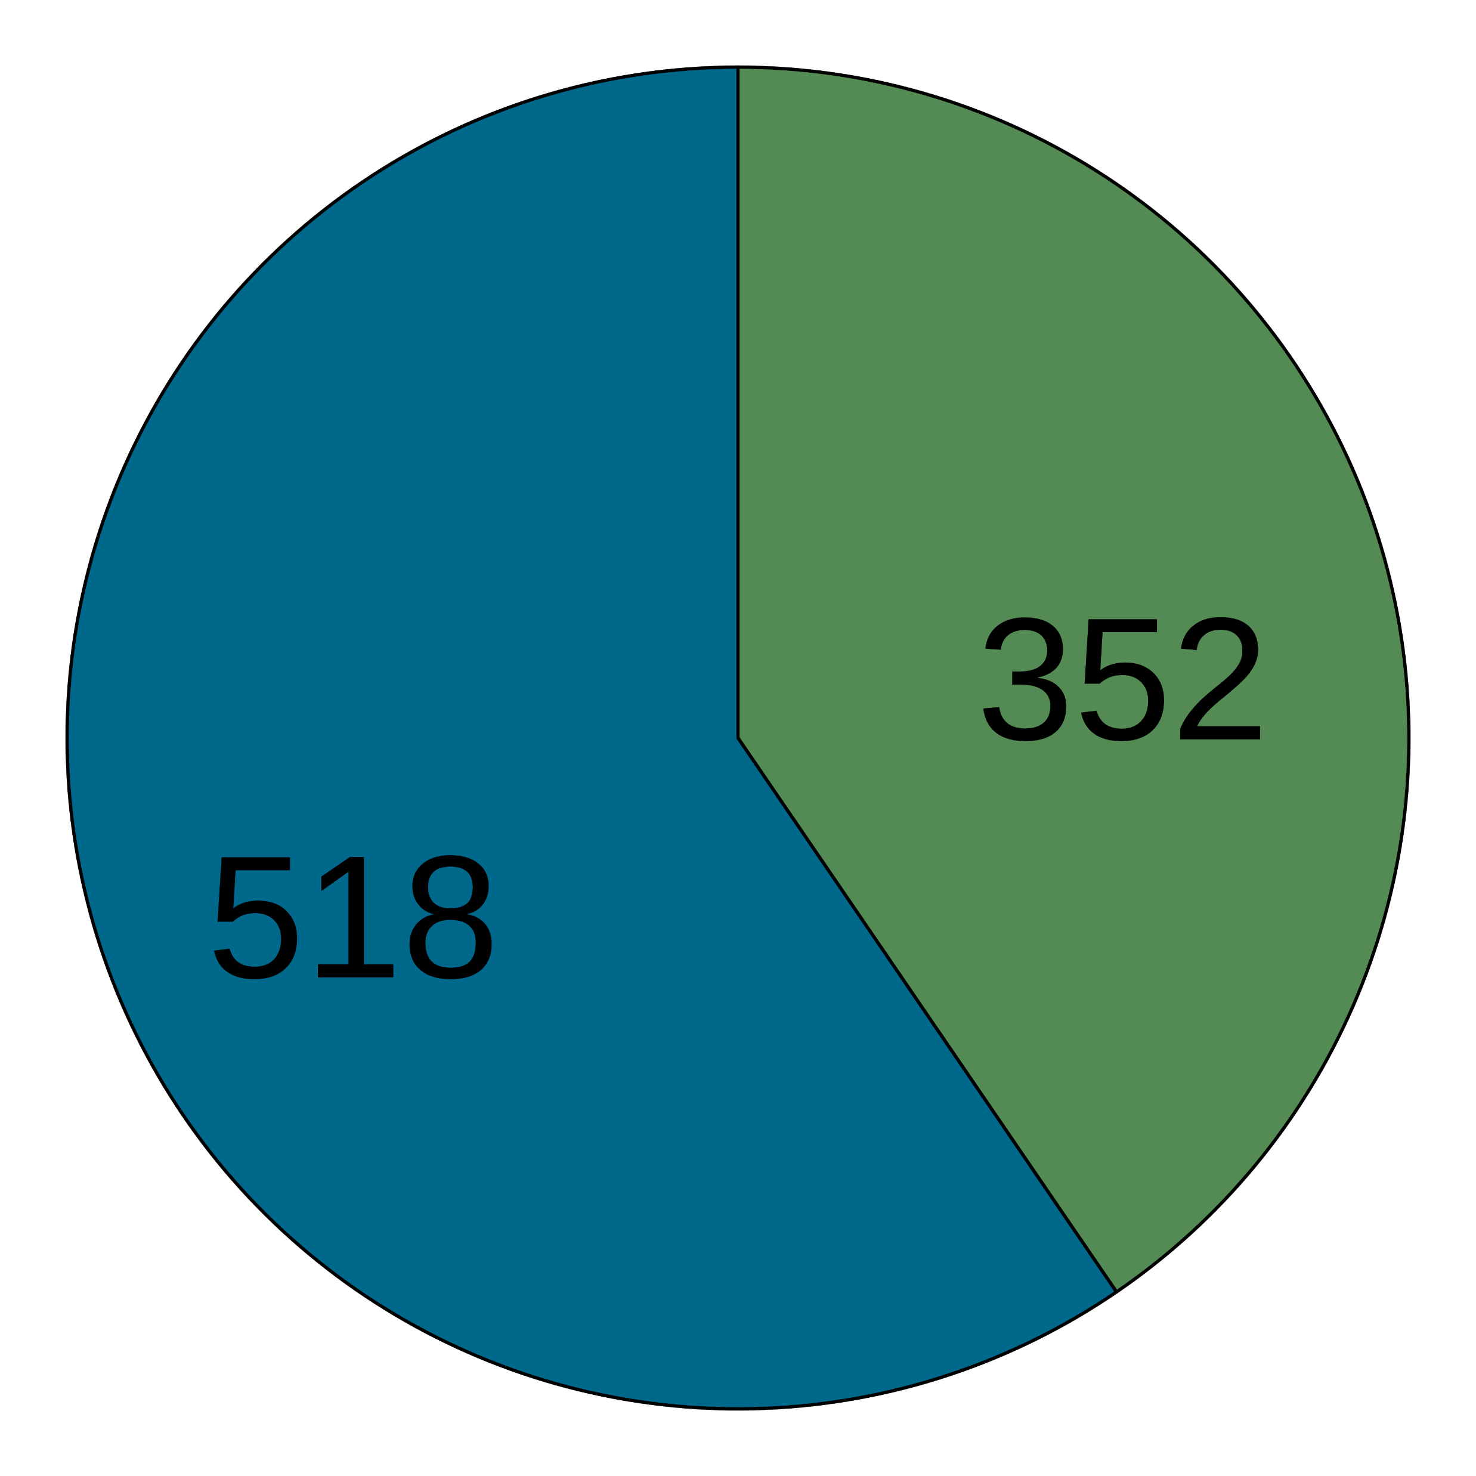
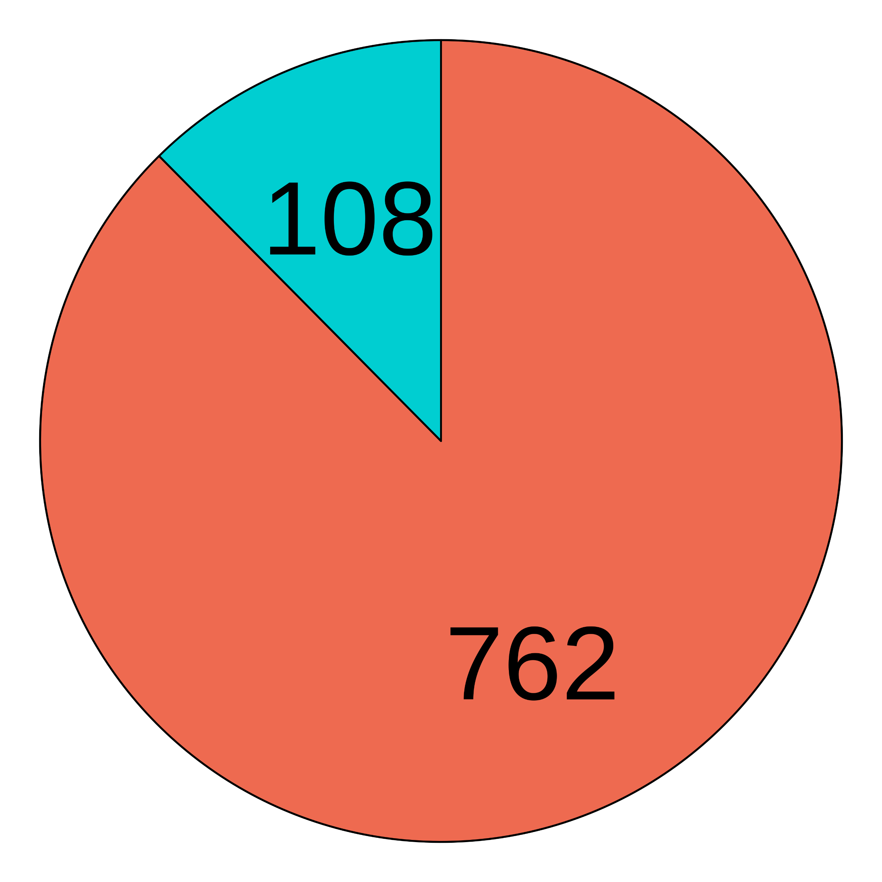
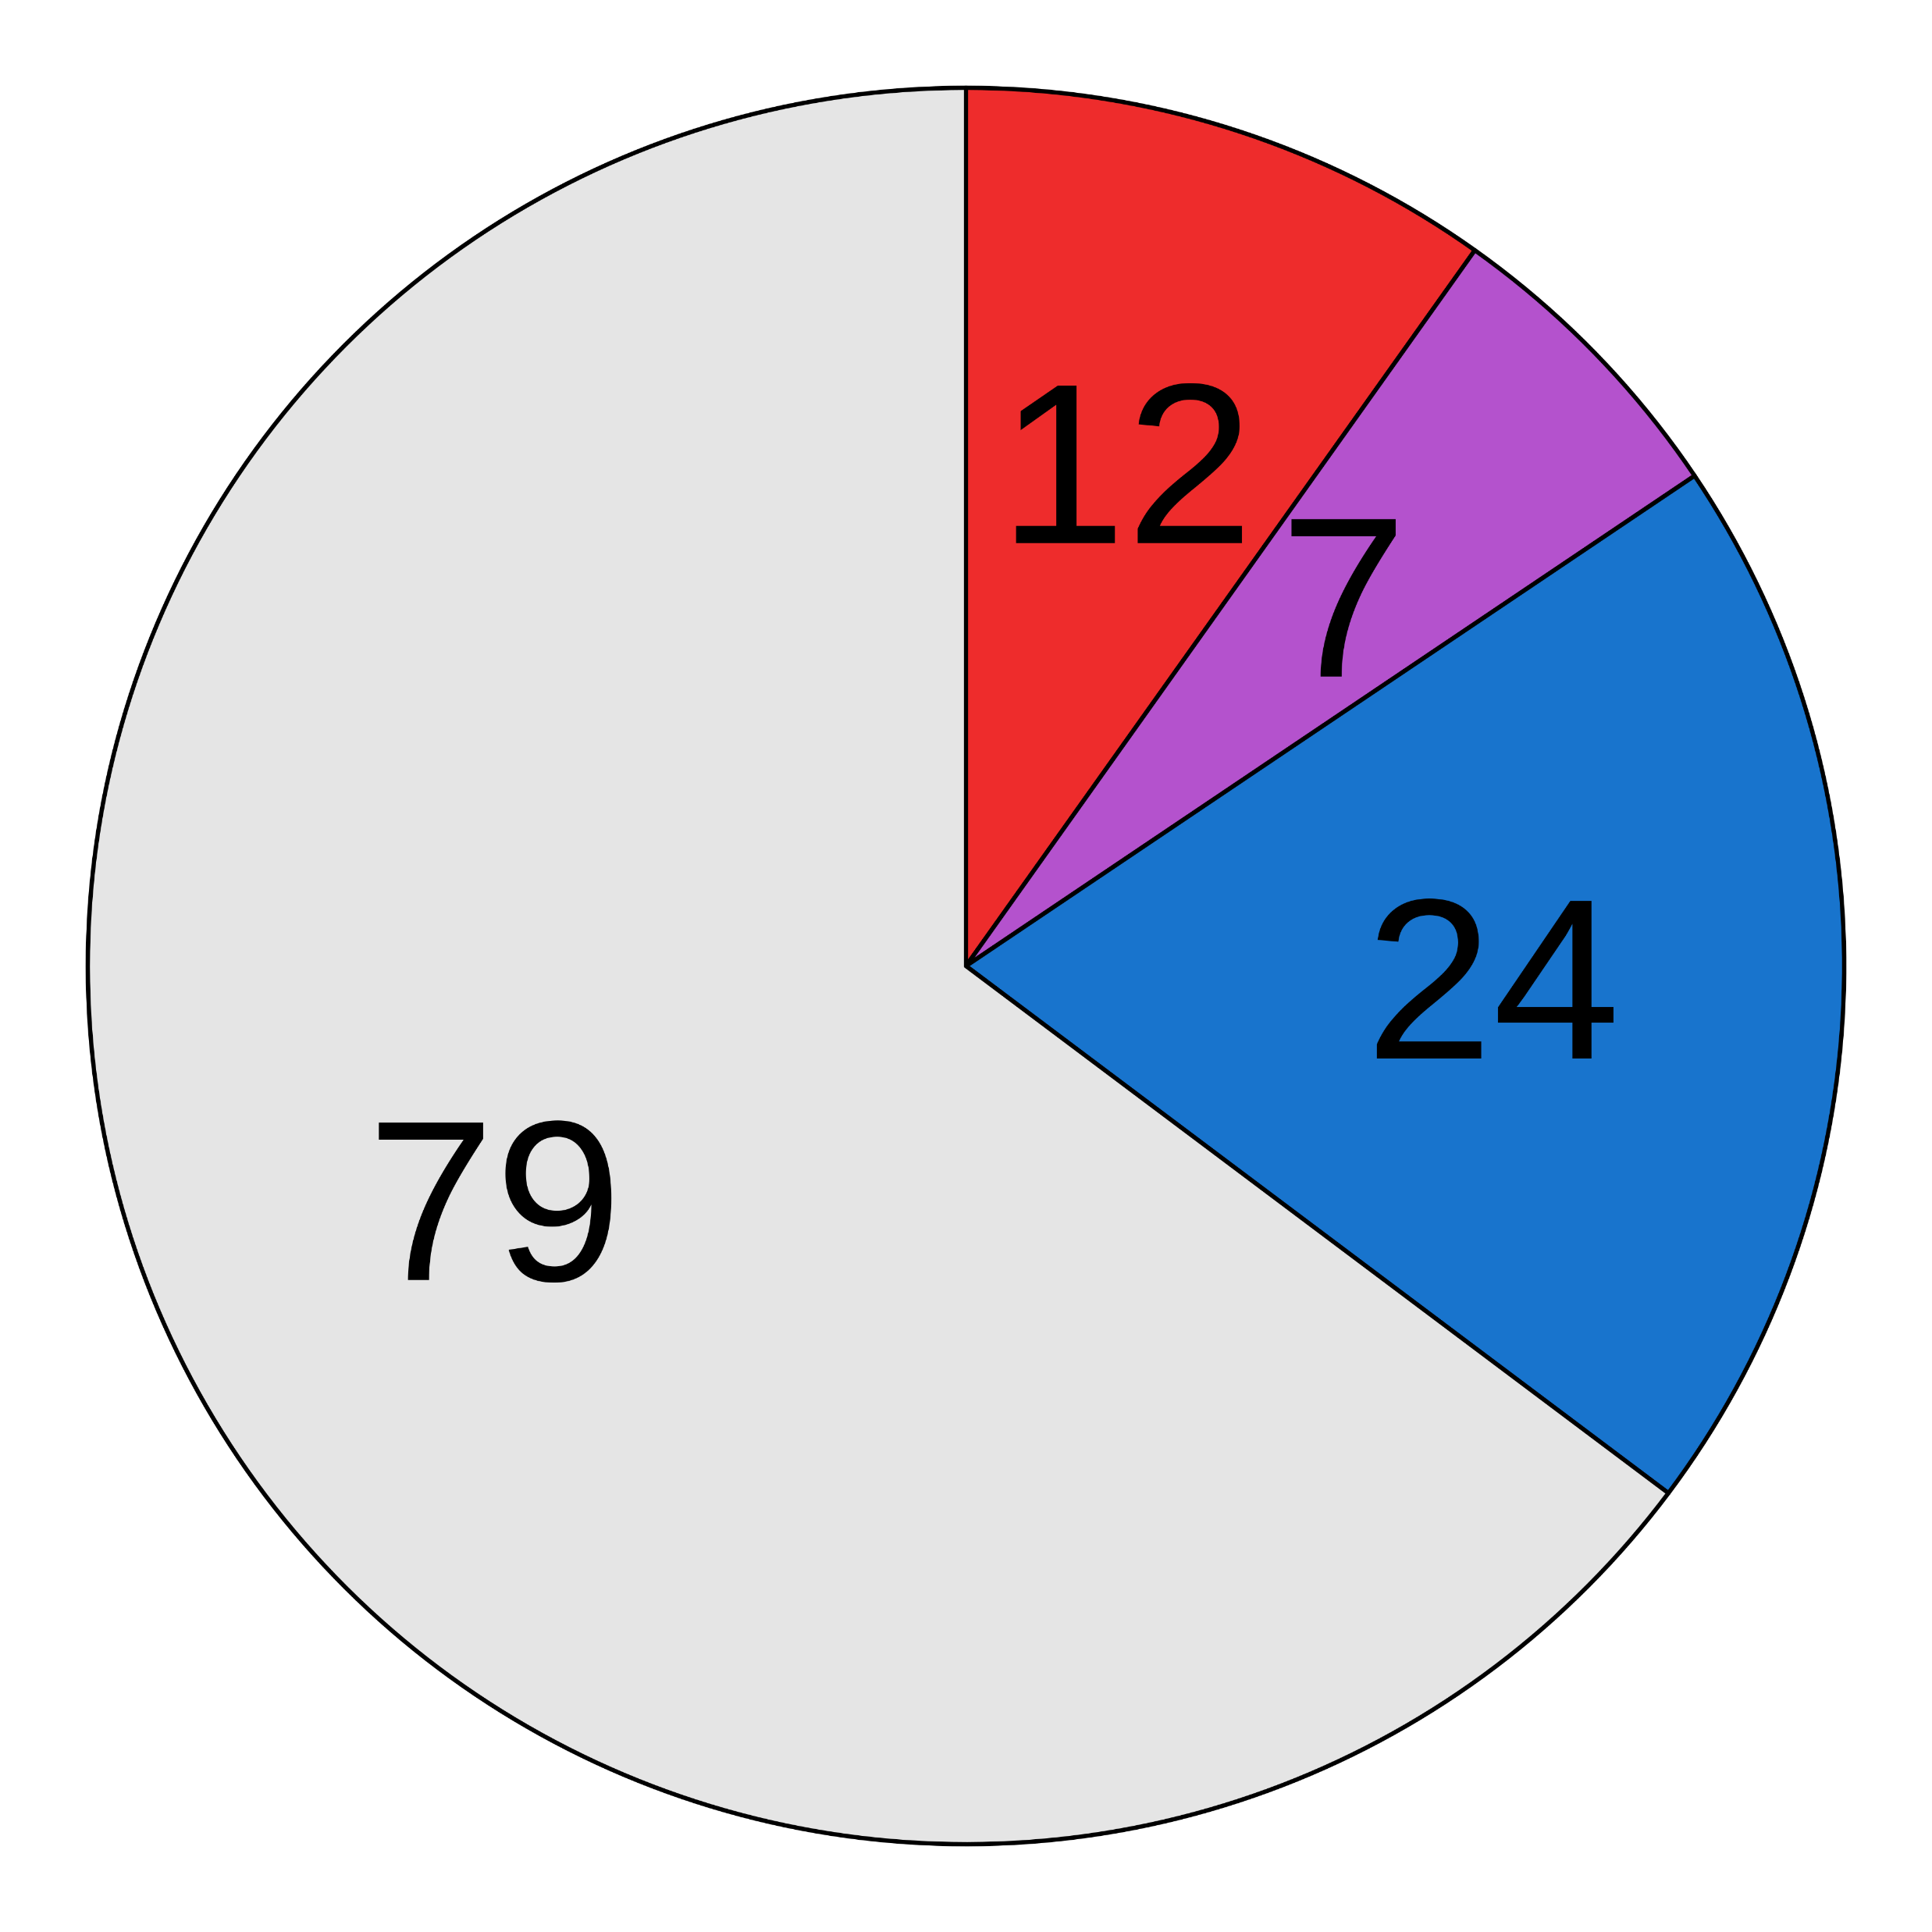
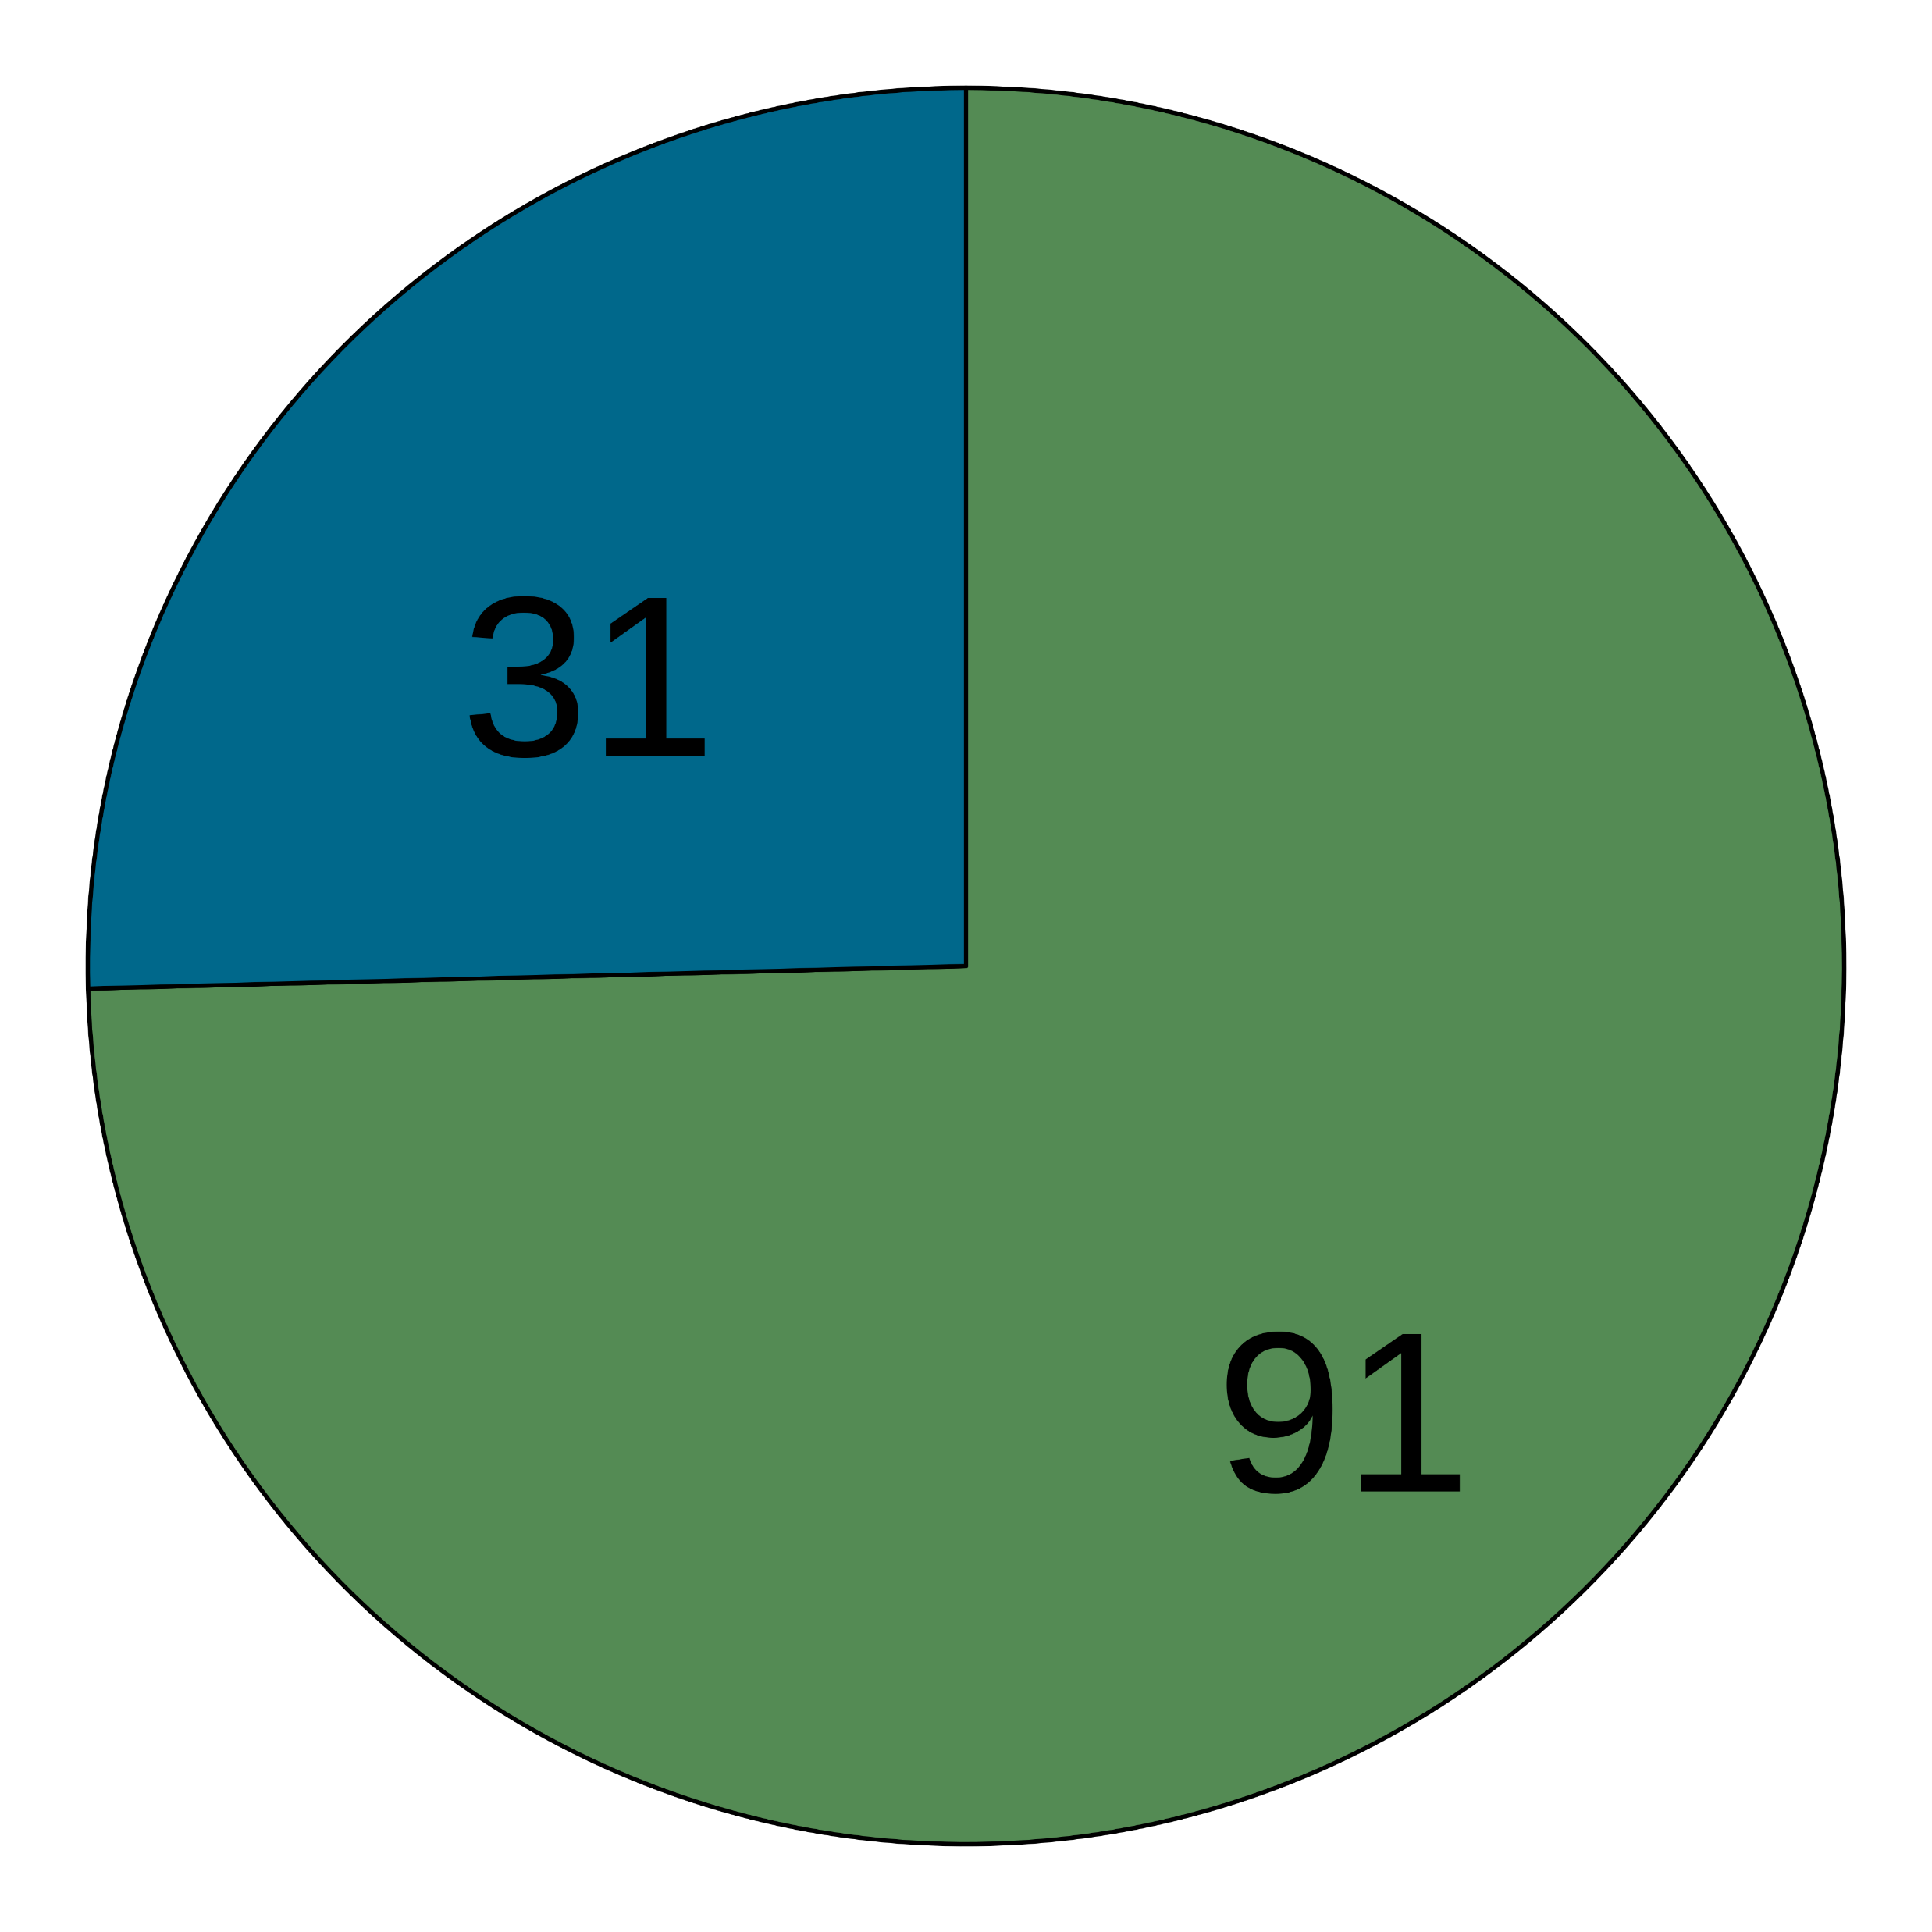
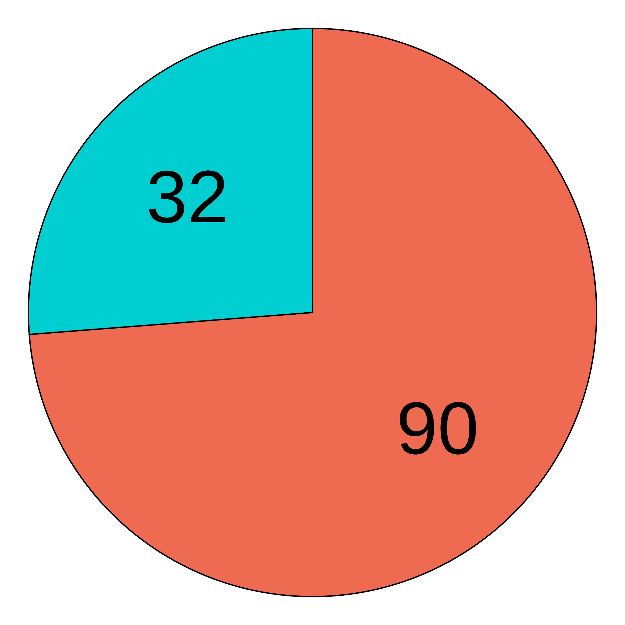
a
Read quality control
Healthy blood metagenomes
n = 9706
Remove GRCh38-mapped reads
1. Base quality trimming
2. Read quality filter
3. Low complexity read filter
Reduce sequence analysis artefacts
n = 8828
8841 species
Remove samples with low microbial signal
n = 9706
8841 species
Taxonomic classification
Abundance filter to reduce false-positive assignments
Decontamination
870 species
Prevalence filter
708 species
Correlation filter
533 species
Batch filter
188 species
Read count filter
122 species
Downstream analyses
Before decontamination
After decontamination
b
Contaminant?
c
Human-associated?
d
Detected in blood culture?
Likely
Yes
Yes
Mixed evidence
No
No
Potential pathogen/commensal
Not common contaminant
d
Notes:
Fig. 1: Decontamination results. (a) Summary of pre-processing steps and filters applied to taxonomic profiles (n = 9706 individuals) and the number of taxa retained after each filter. Pie charts showing the proportion of microbial species that are (b) human-associated, (c) common sequencing contaminants, and (d) detected in blood culture records, before and after applying the decontamination filters.

Slide 3
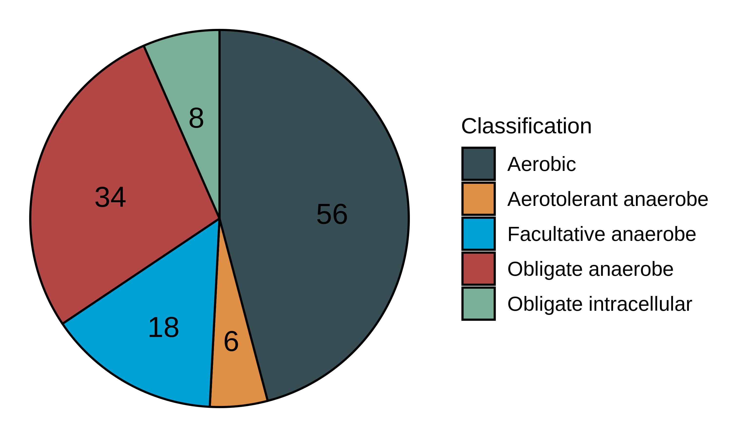
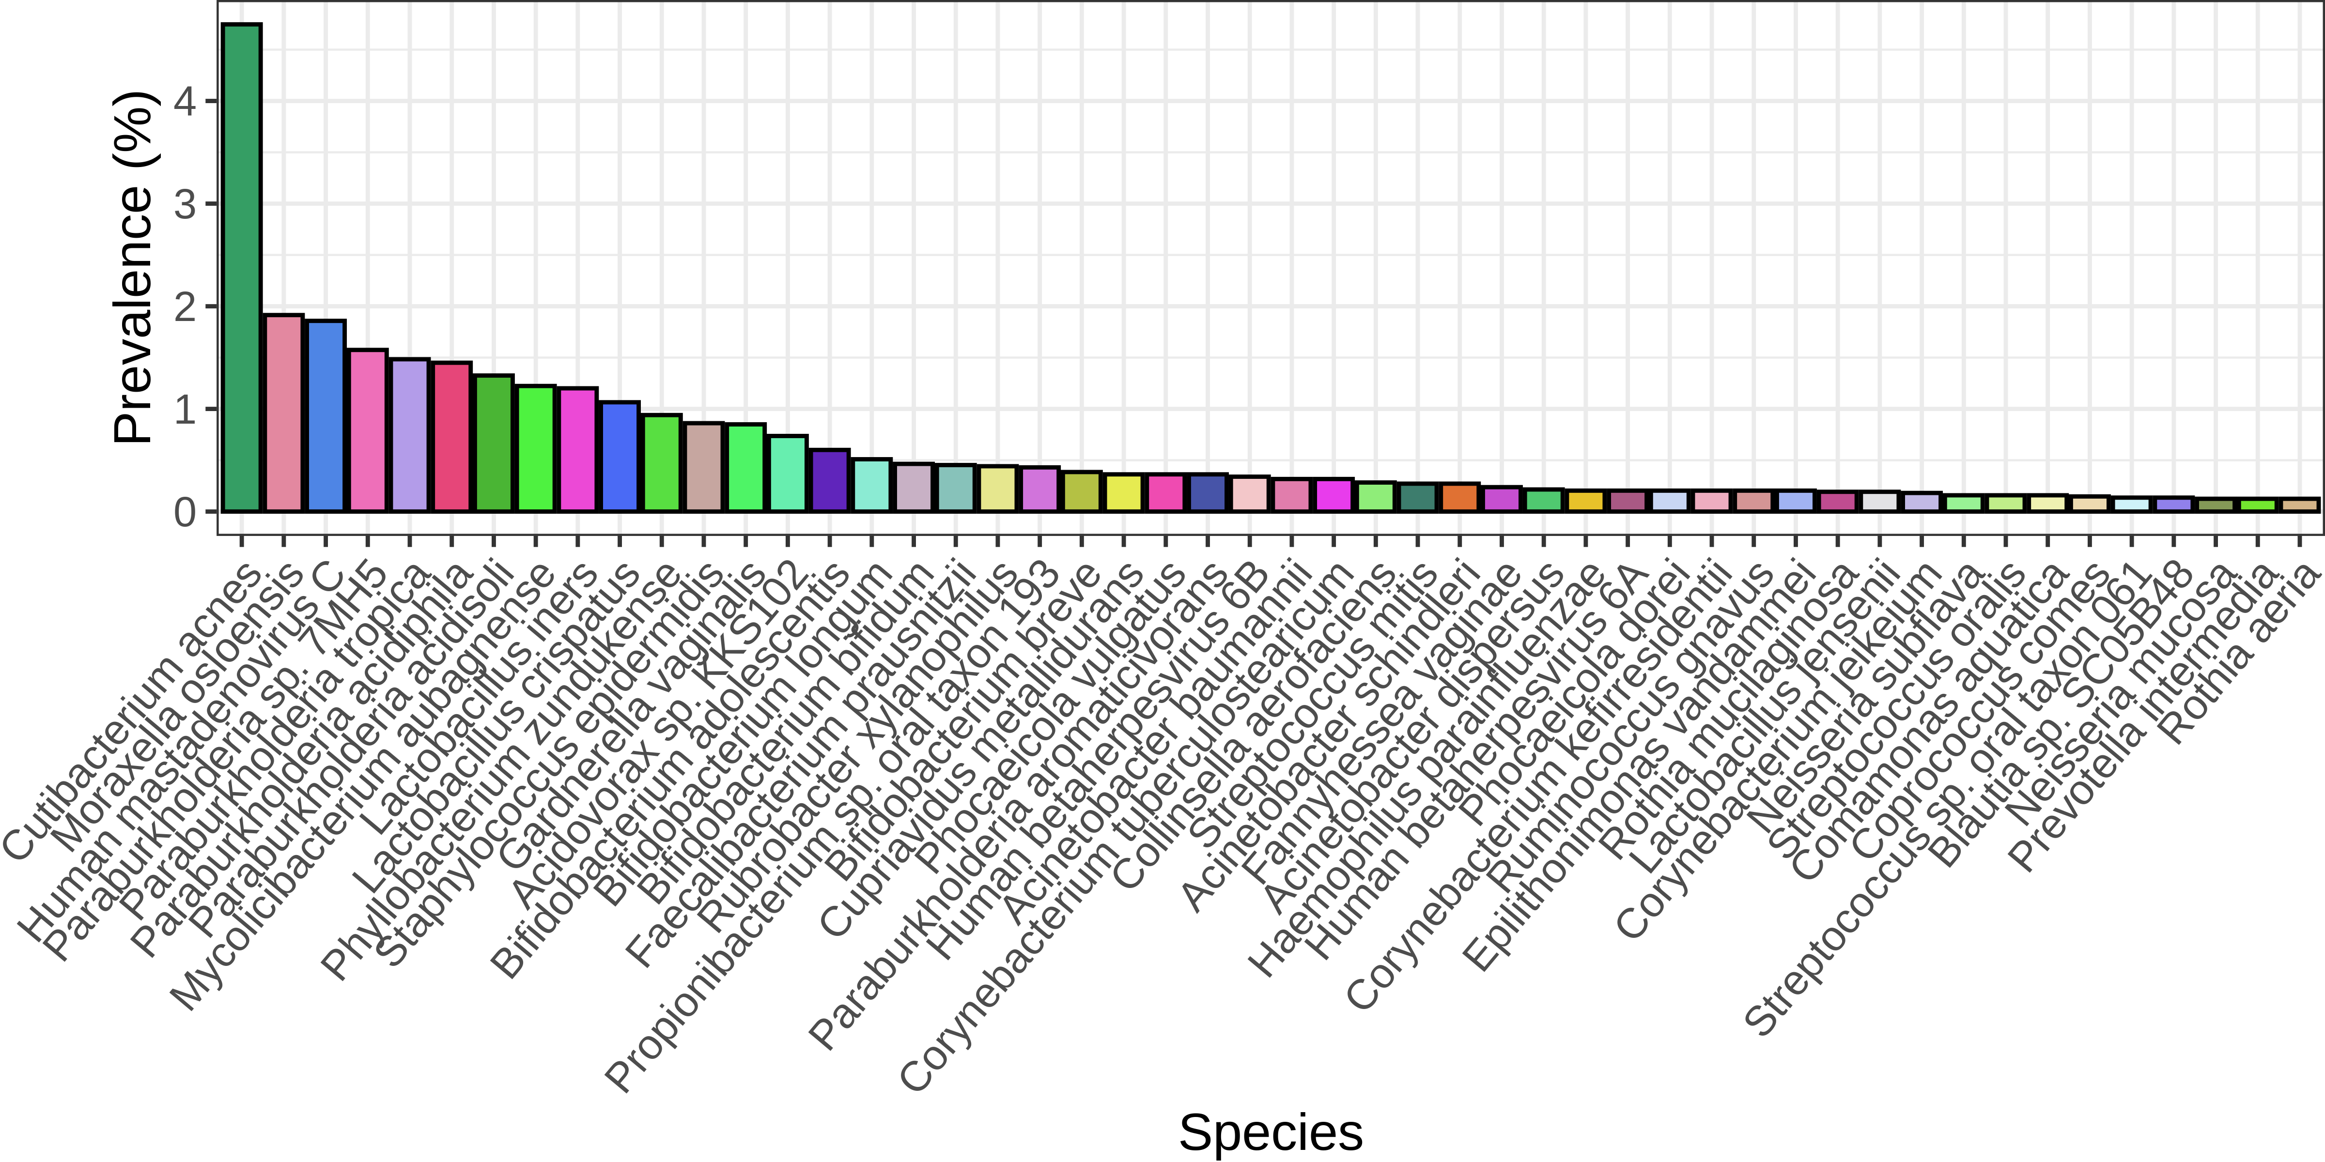
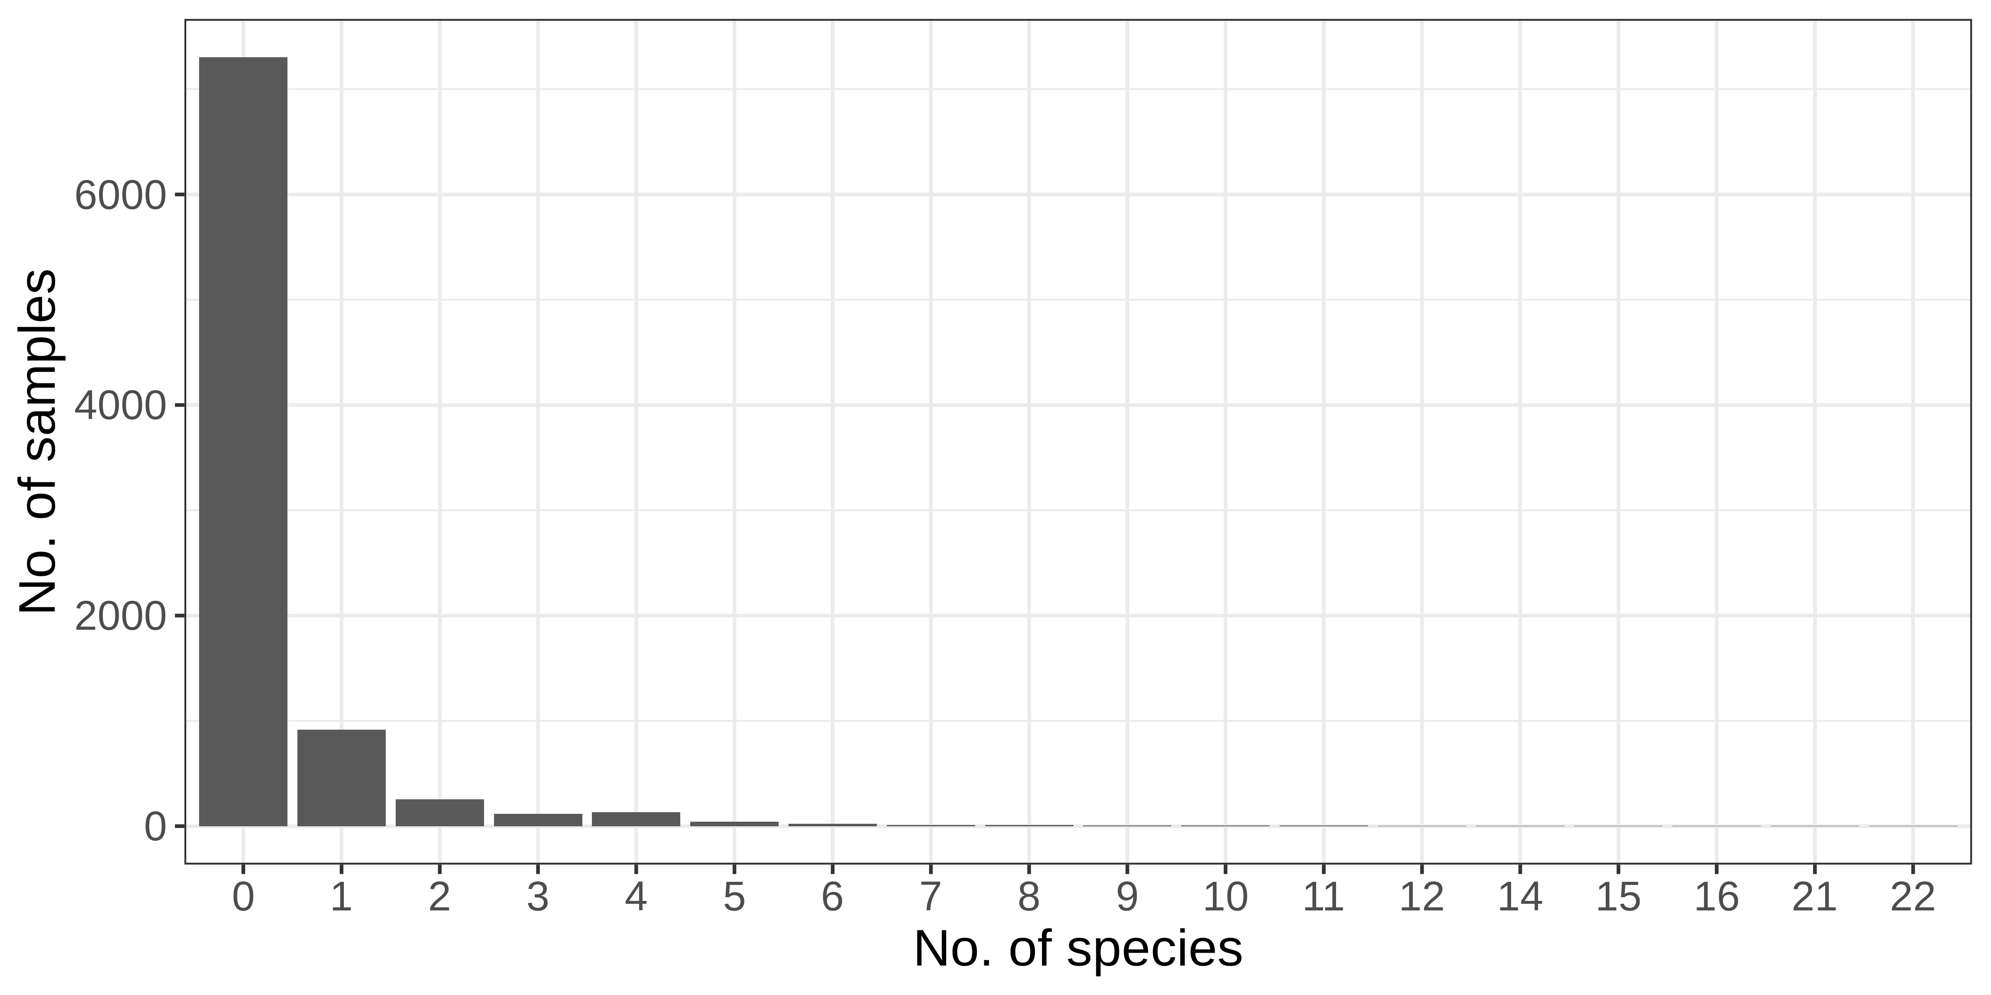
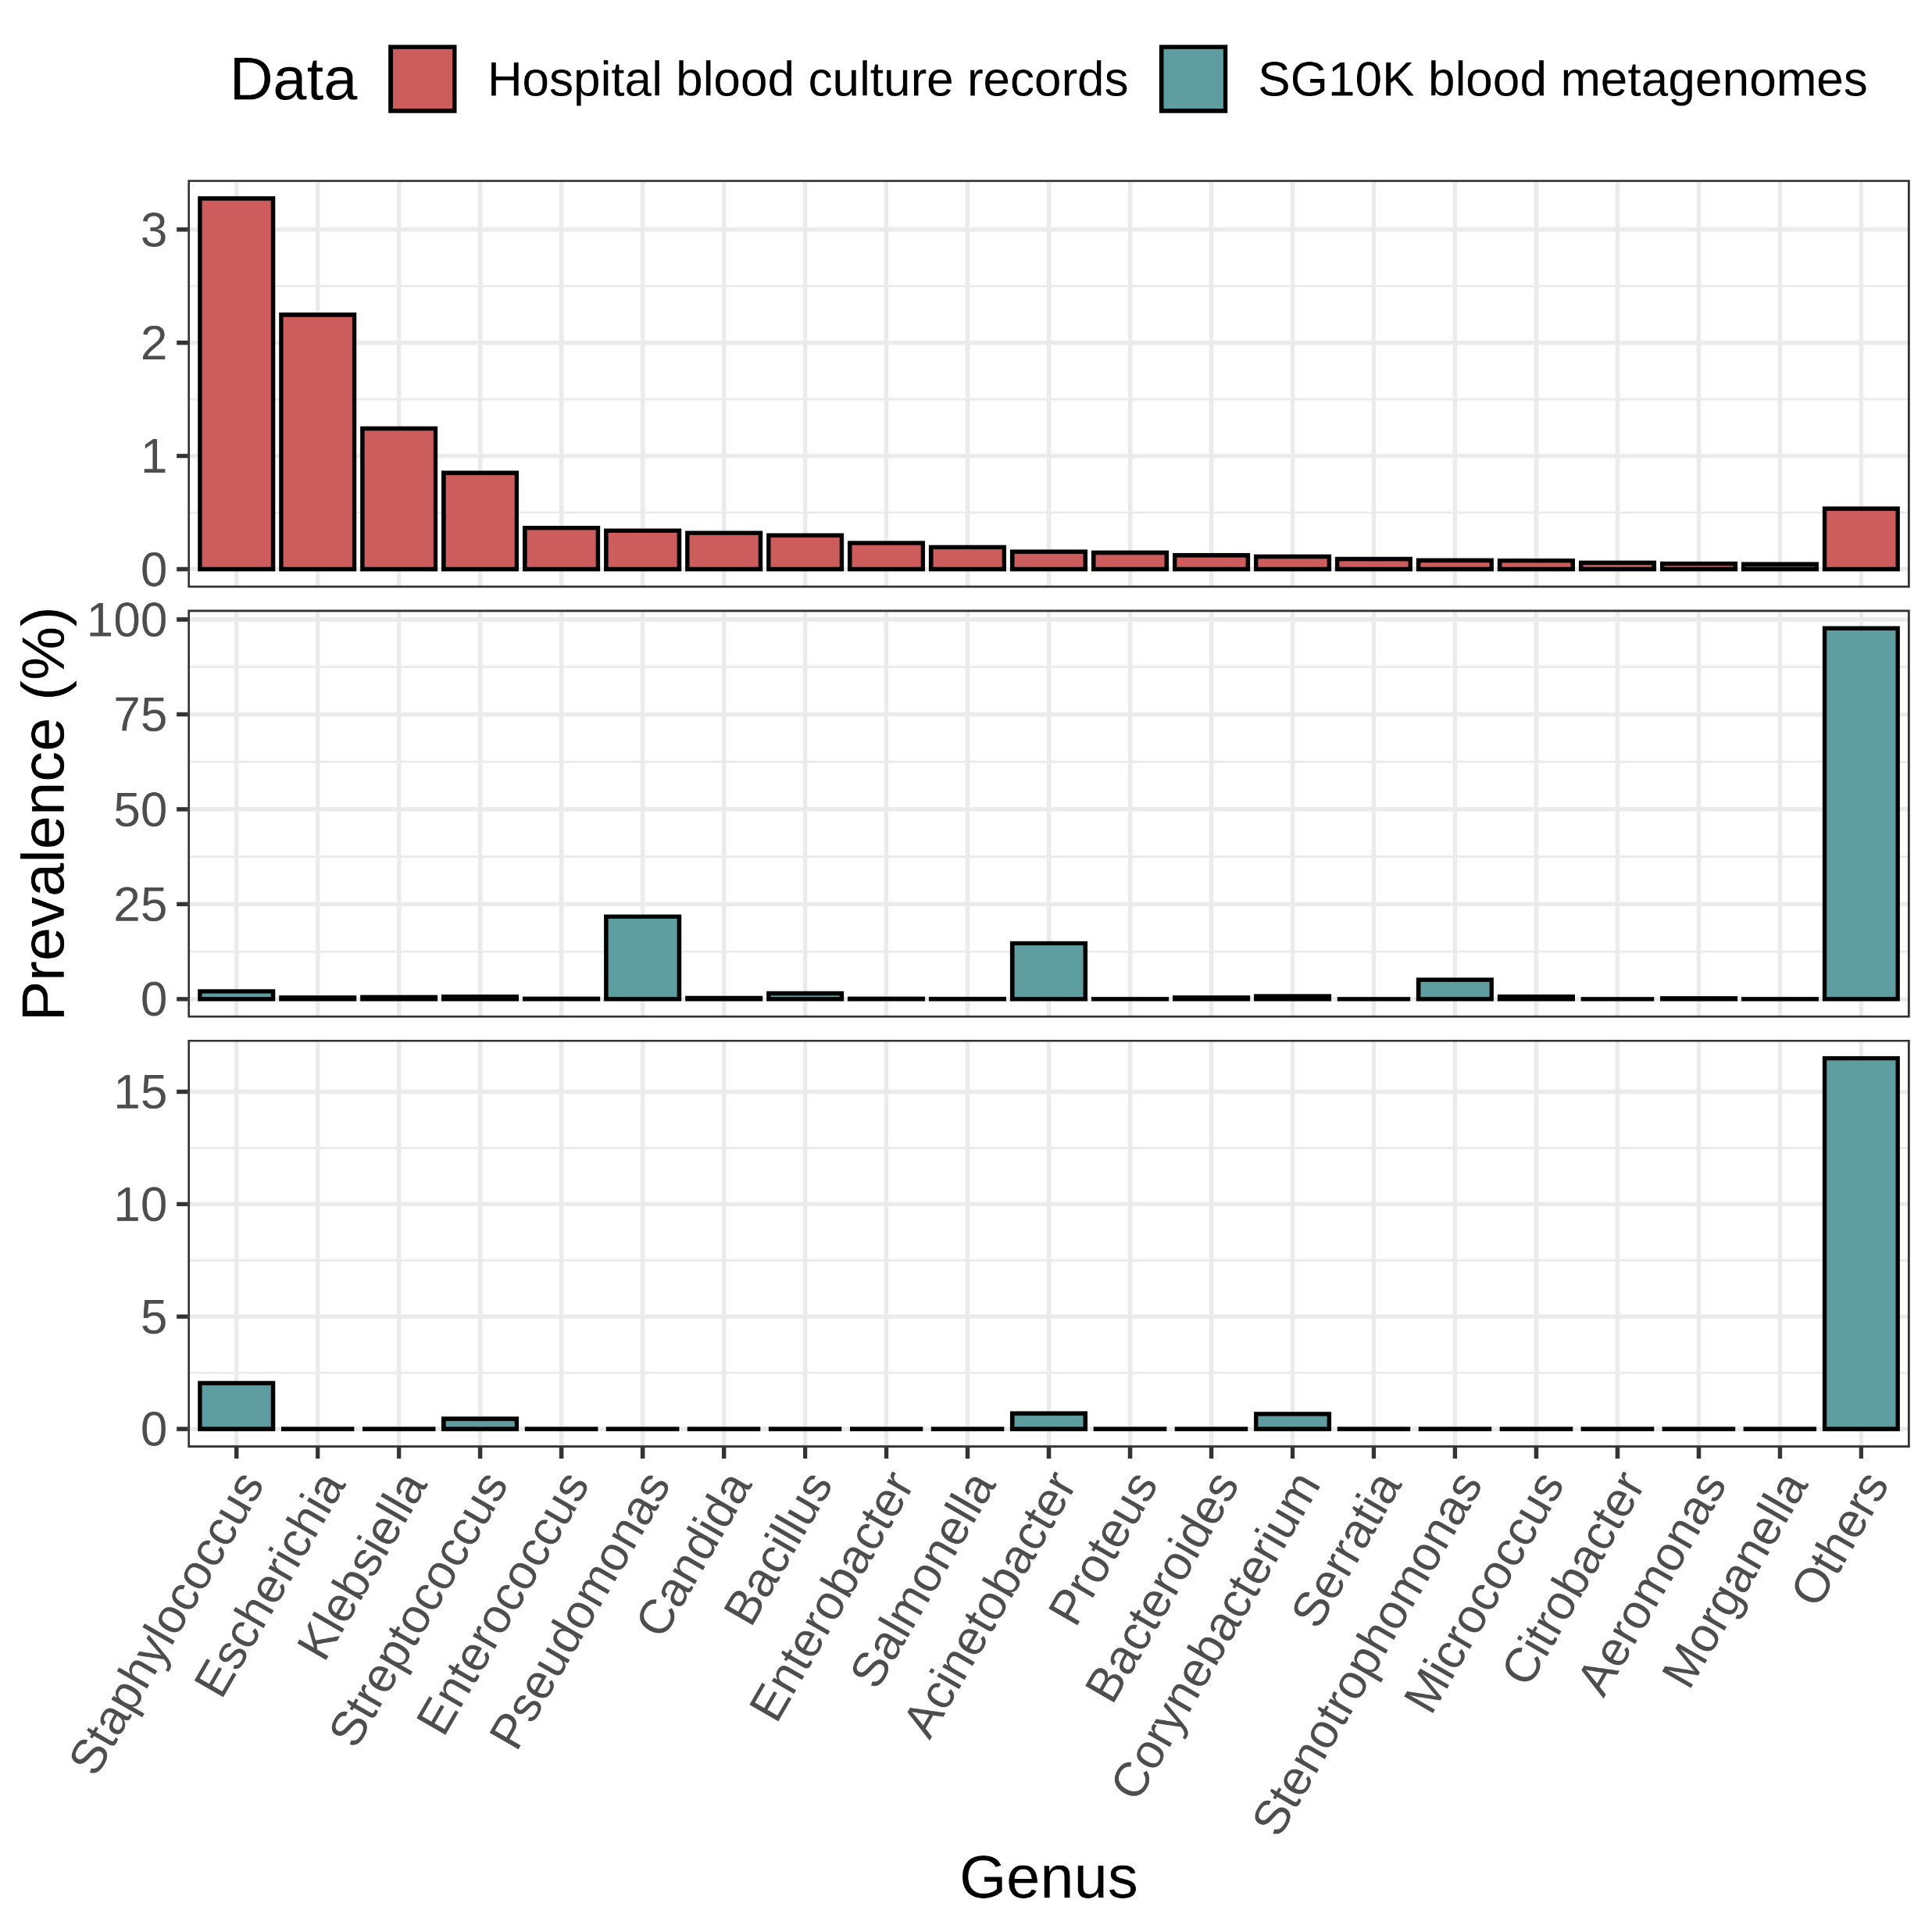
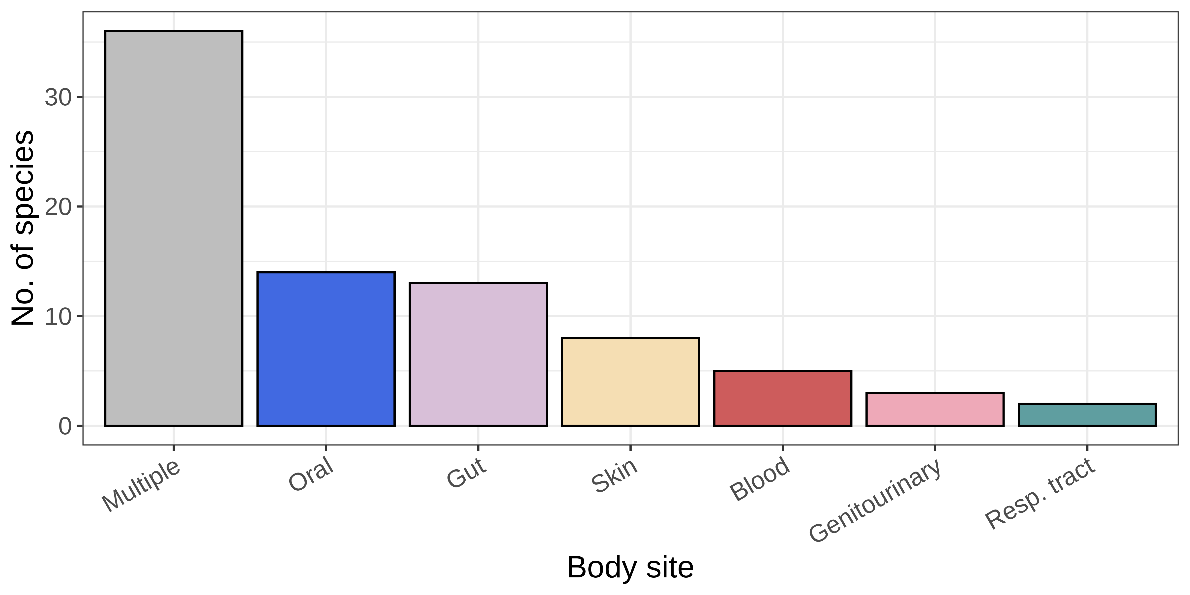
a
n = 8,828
d
b
n = 8,828
e
n = 281,704
Before decontamination (n = 8,828)
c
After decontamination (n = 8,828)
Notes:
Fig. 2: Microbial signatures in healthy human blood. (a) Bar chart of the top 50 putatively non-contaminant microbial species ranked by their prevalence in all 8828 blood metagenomes. (b) The number of the microbial species per sample. (c) Human body sites that the 122 non-contaminant species are associated with, as determined using the Disbiome database (35). Species are classified as ‘multiple’ if they are associated with more than one body site and classified otherwise if they are only associated with a single body site. (d) Microbiological classification of the 122 non-contaminant species identified. (e) Prevalence of genera in blood culture records and in the blood metagenomes before or after decontamination.

Slide 4
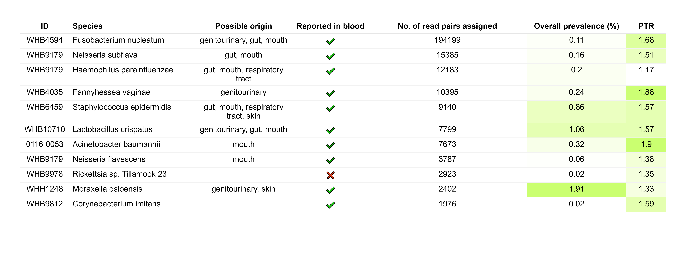
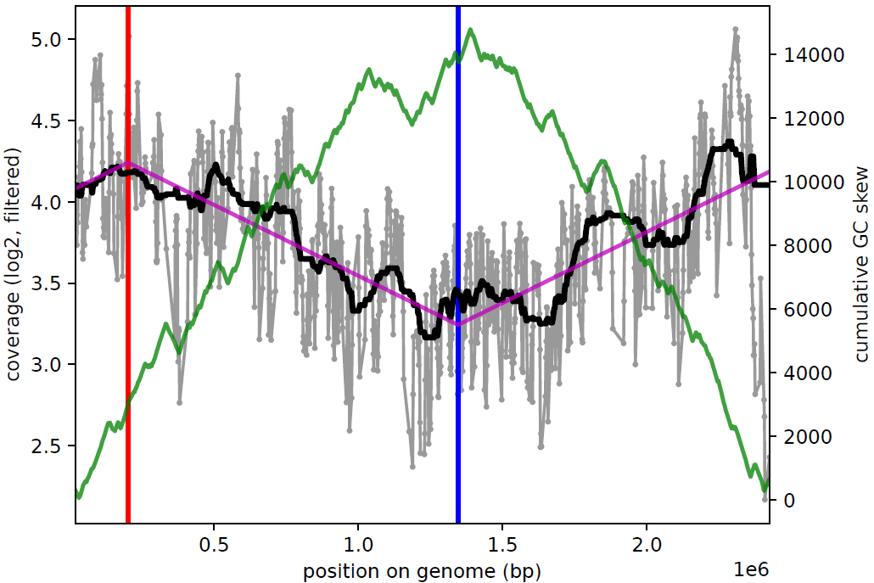
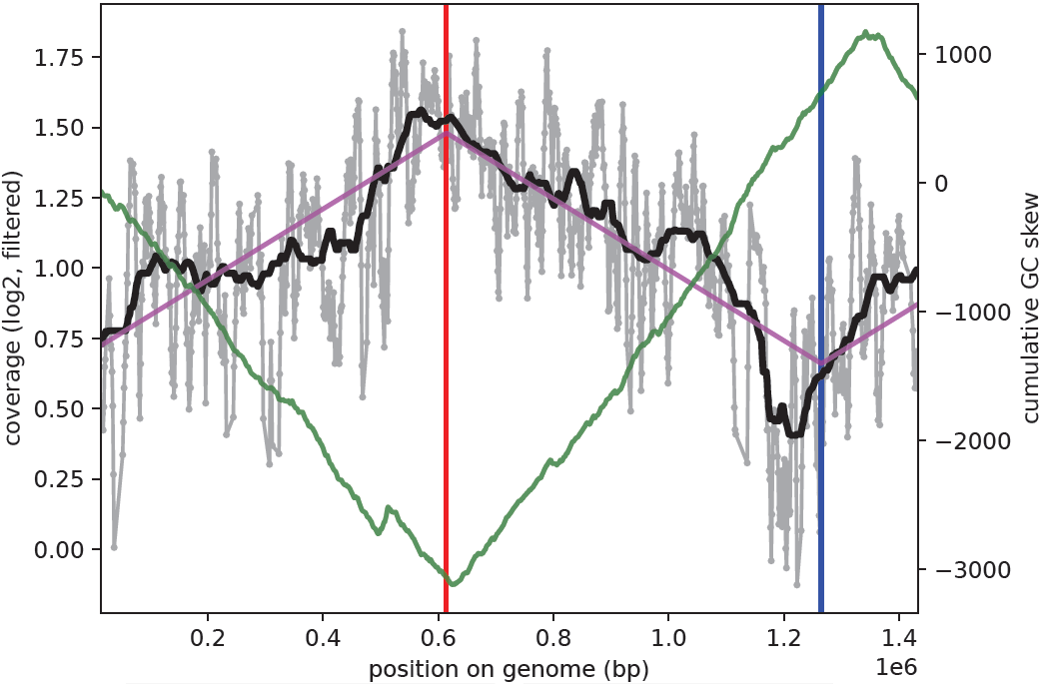
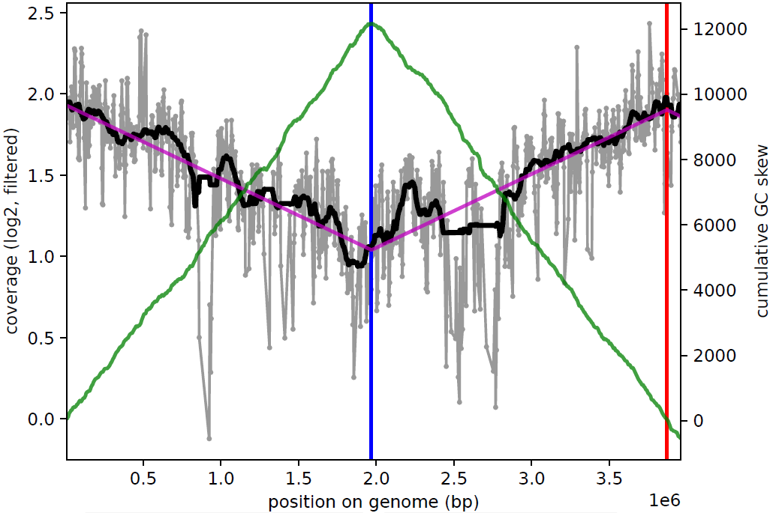
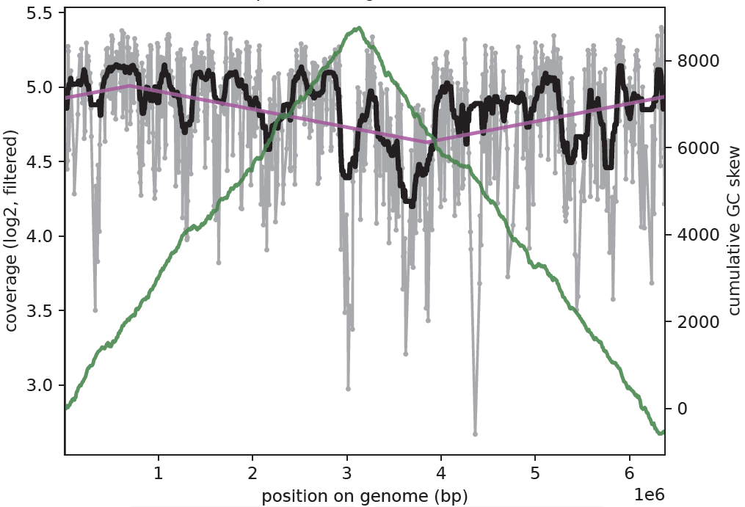
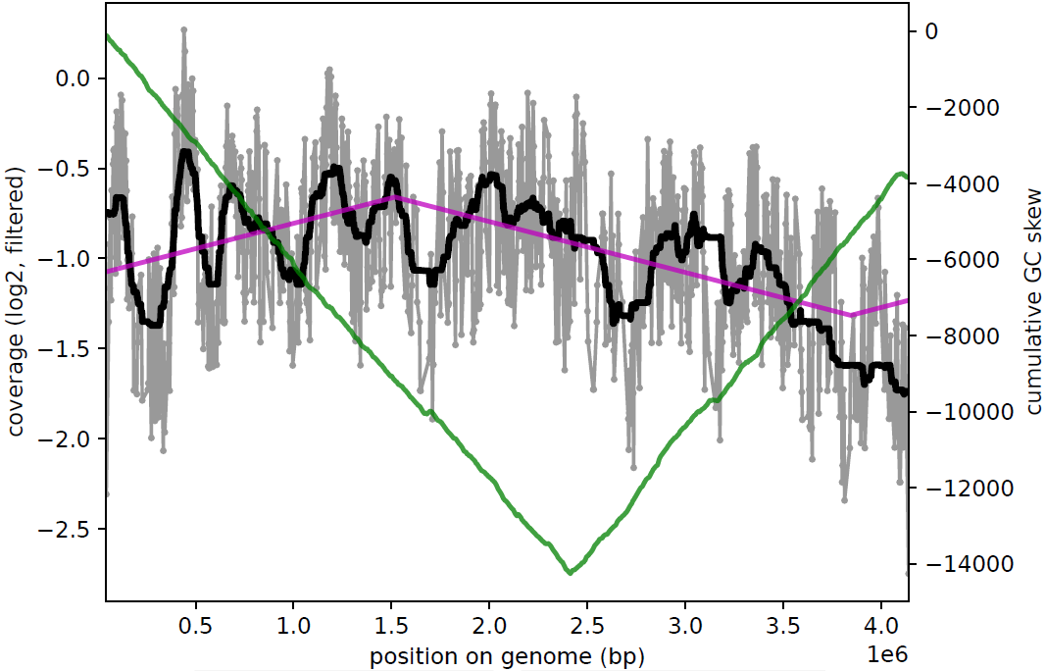
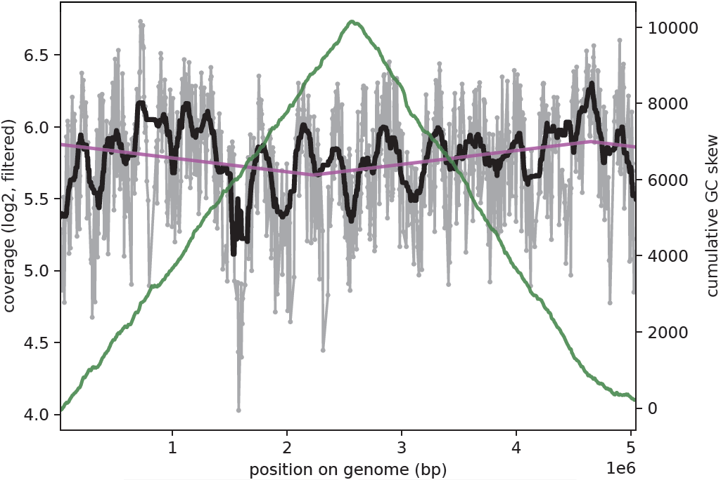
a
b
F. nucleatum
F. vaginae
A. baumannii
Non-contaminants
Log2(coverage)
Cumulative GC skew
c
A. faecalis
P. mendocina
A. xylosoxidans
c
Contaminants
Position on genome (10⁶ bp)
Legend
Coverage
Ori
Median smoothing
GC skew
Ter
Least squares fit
Notes:
Fig. 3: Evidence for replicating bacteria in healthy blood samples. (a) Summary statistics of samples where bacterial species were deemed to be replicating using iRep (22) (ie., peak-to-trough ratio (PTR) > 1). The number of reads assigned to the species by Kraken2 (24), the possible body sites the species are associated with, whether they were previously reported in published studies of bacteraemia, the overall prevalence of the species across all 8828 individuals in our study and the calculated PTR values, are indicated. Coverage plots of (b) three representative confidently detected species and (c) three representative contaminant species.

Slide 5
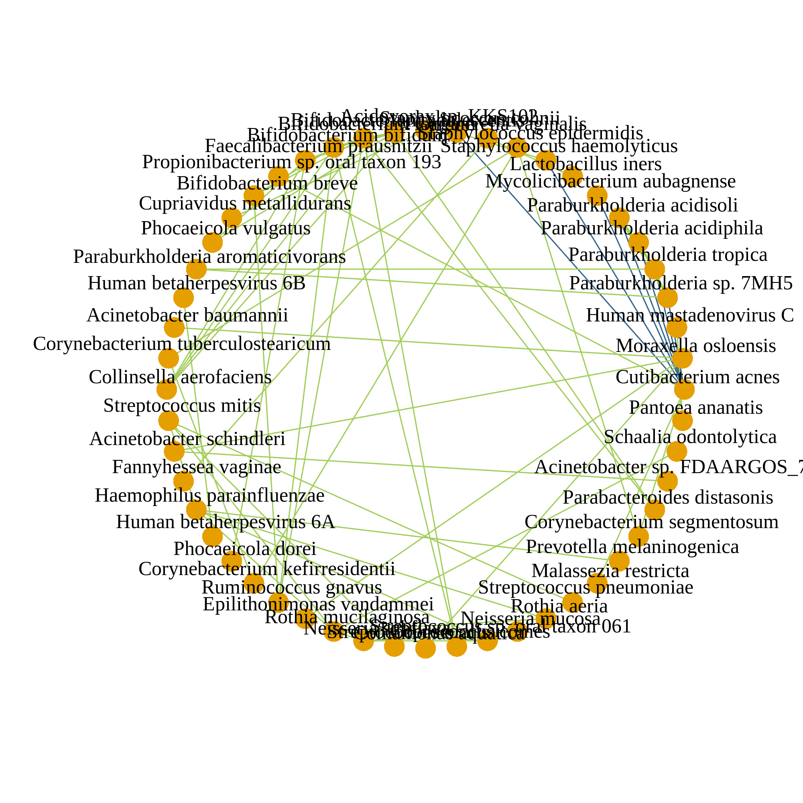
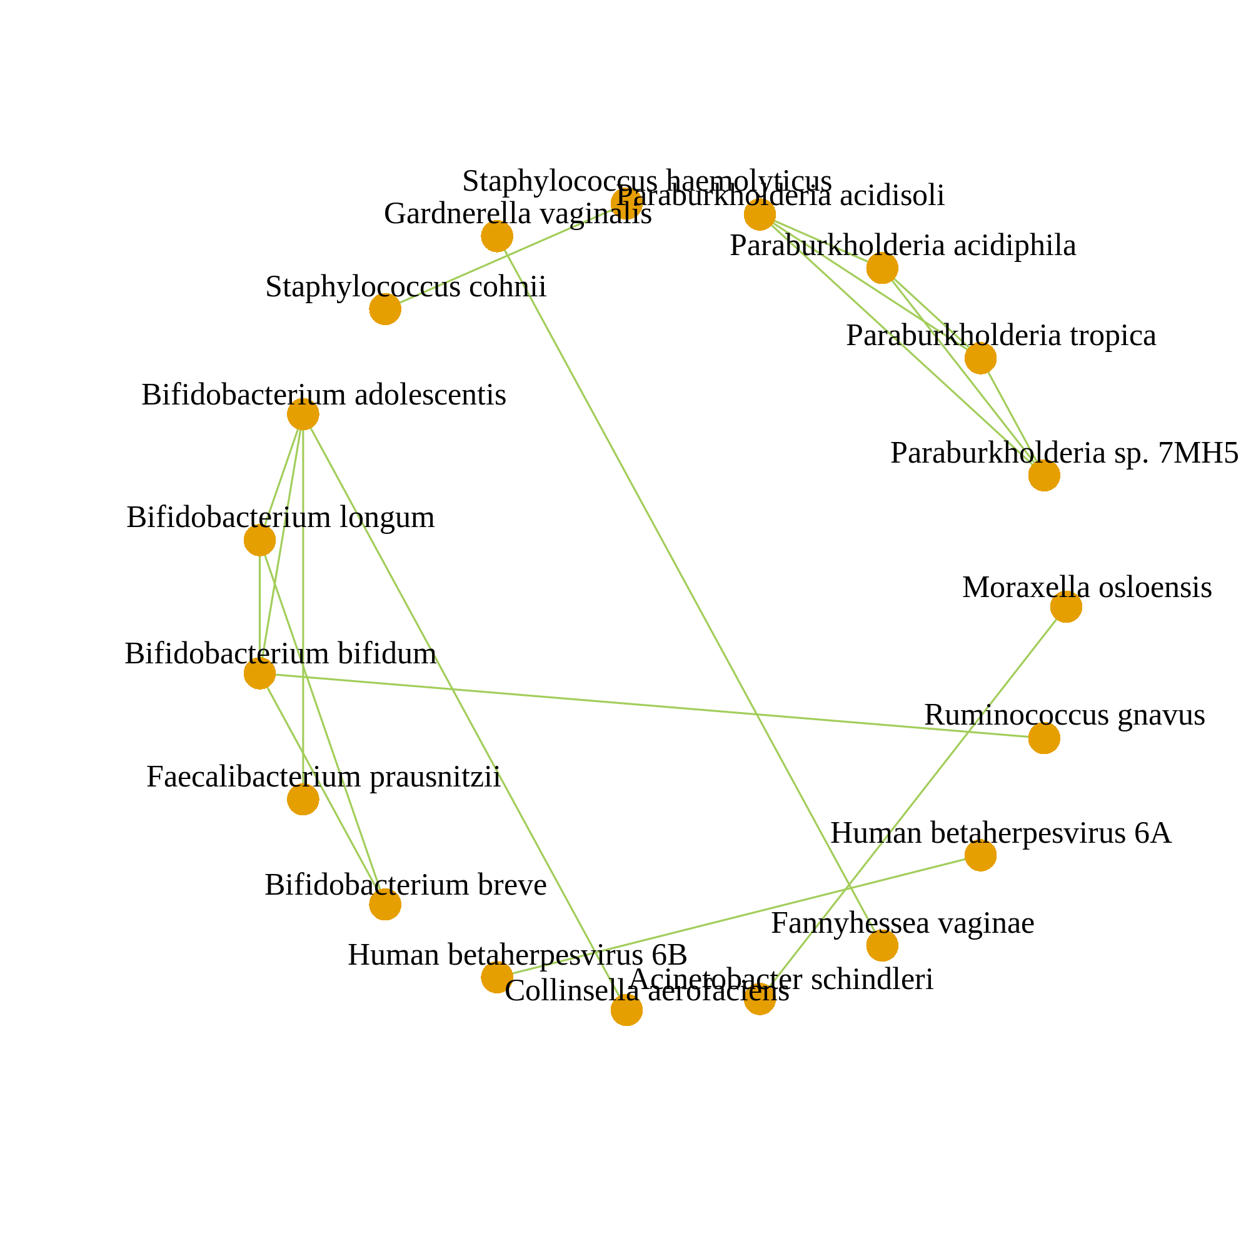
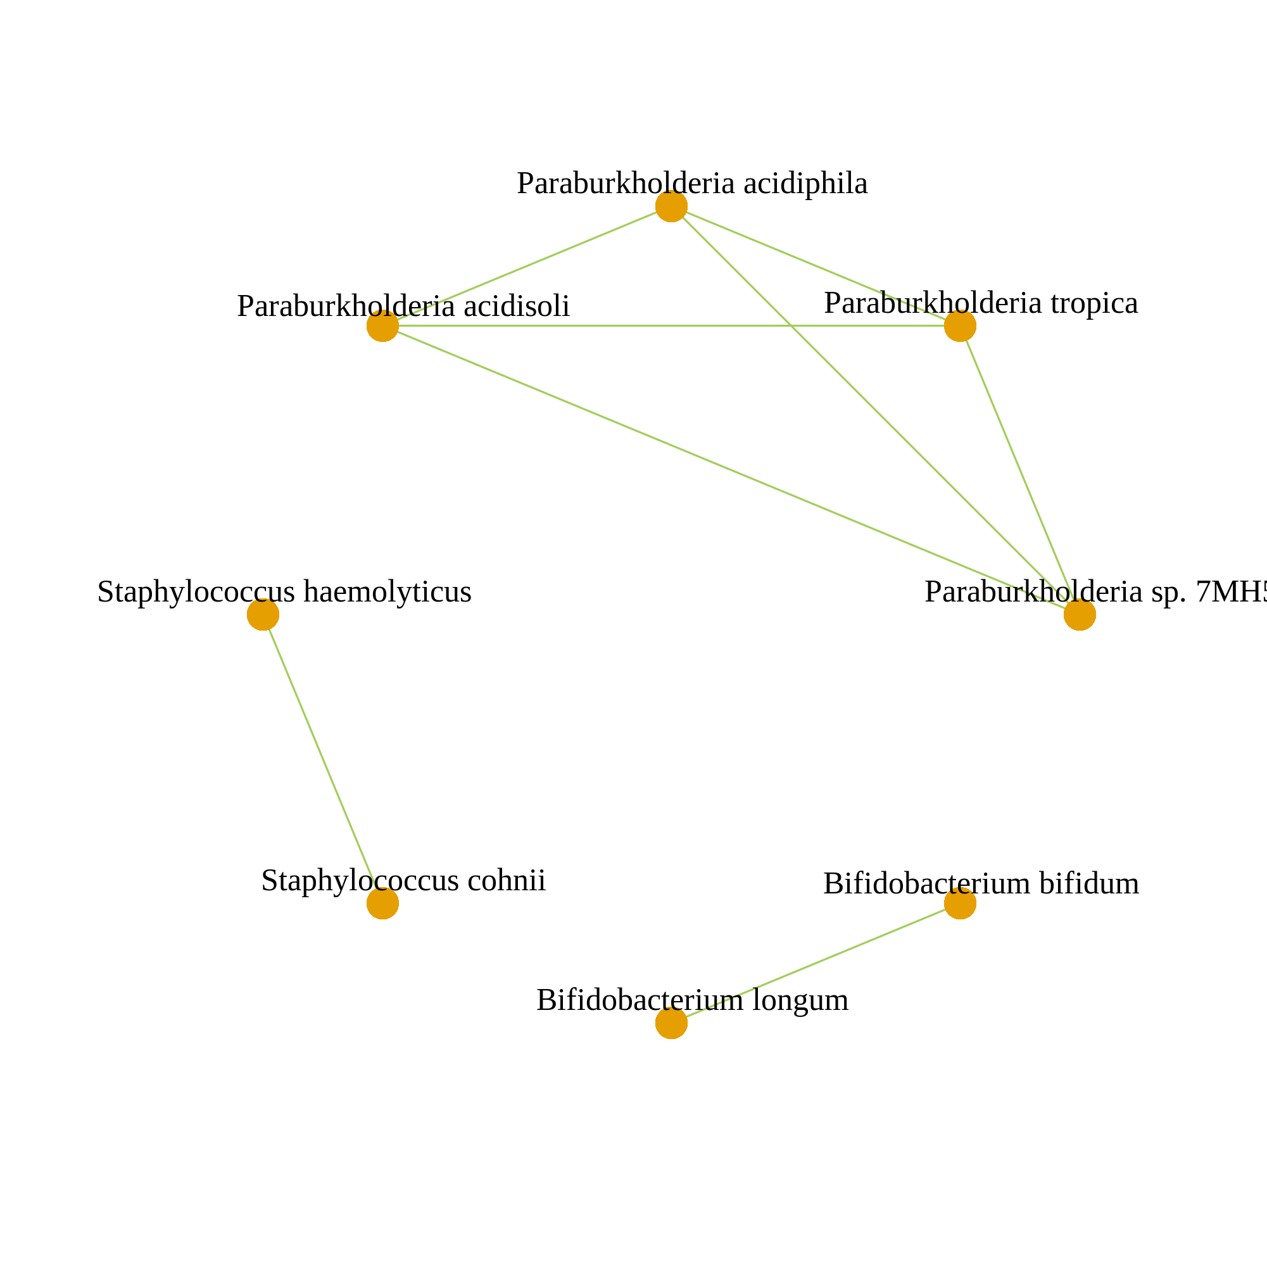
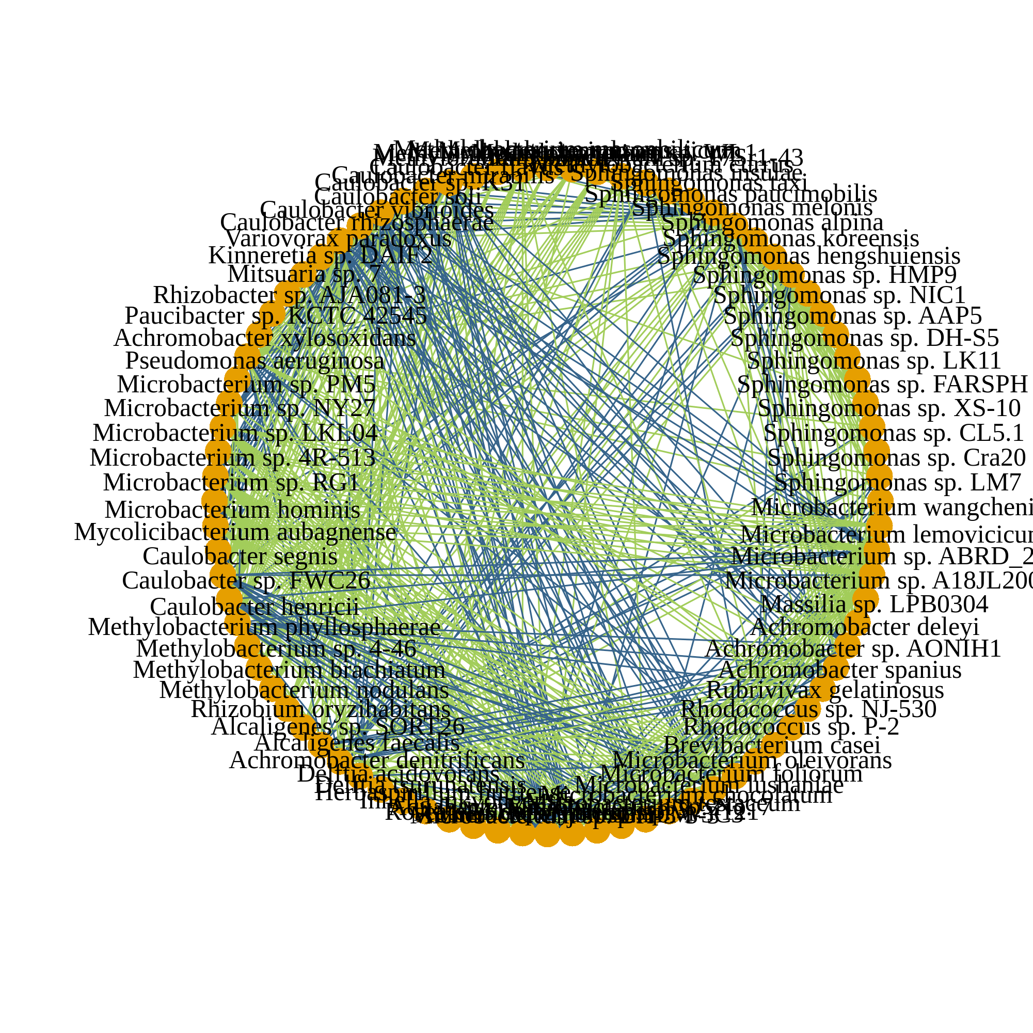
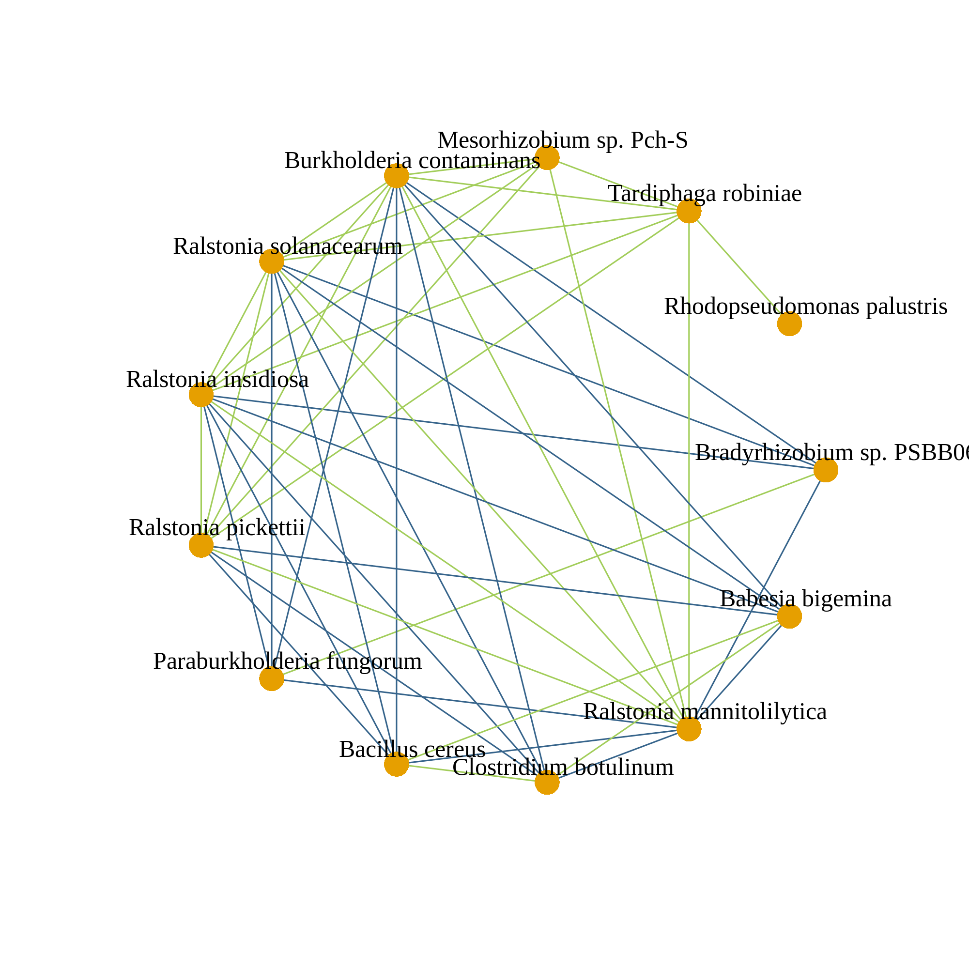
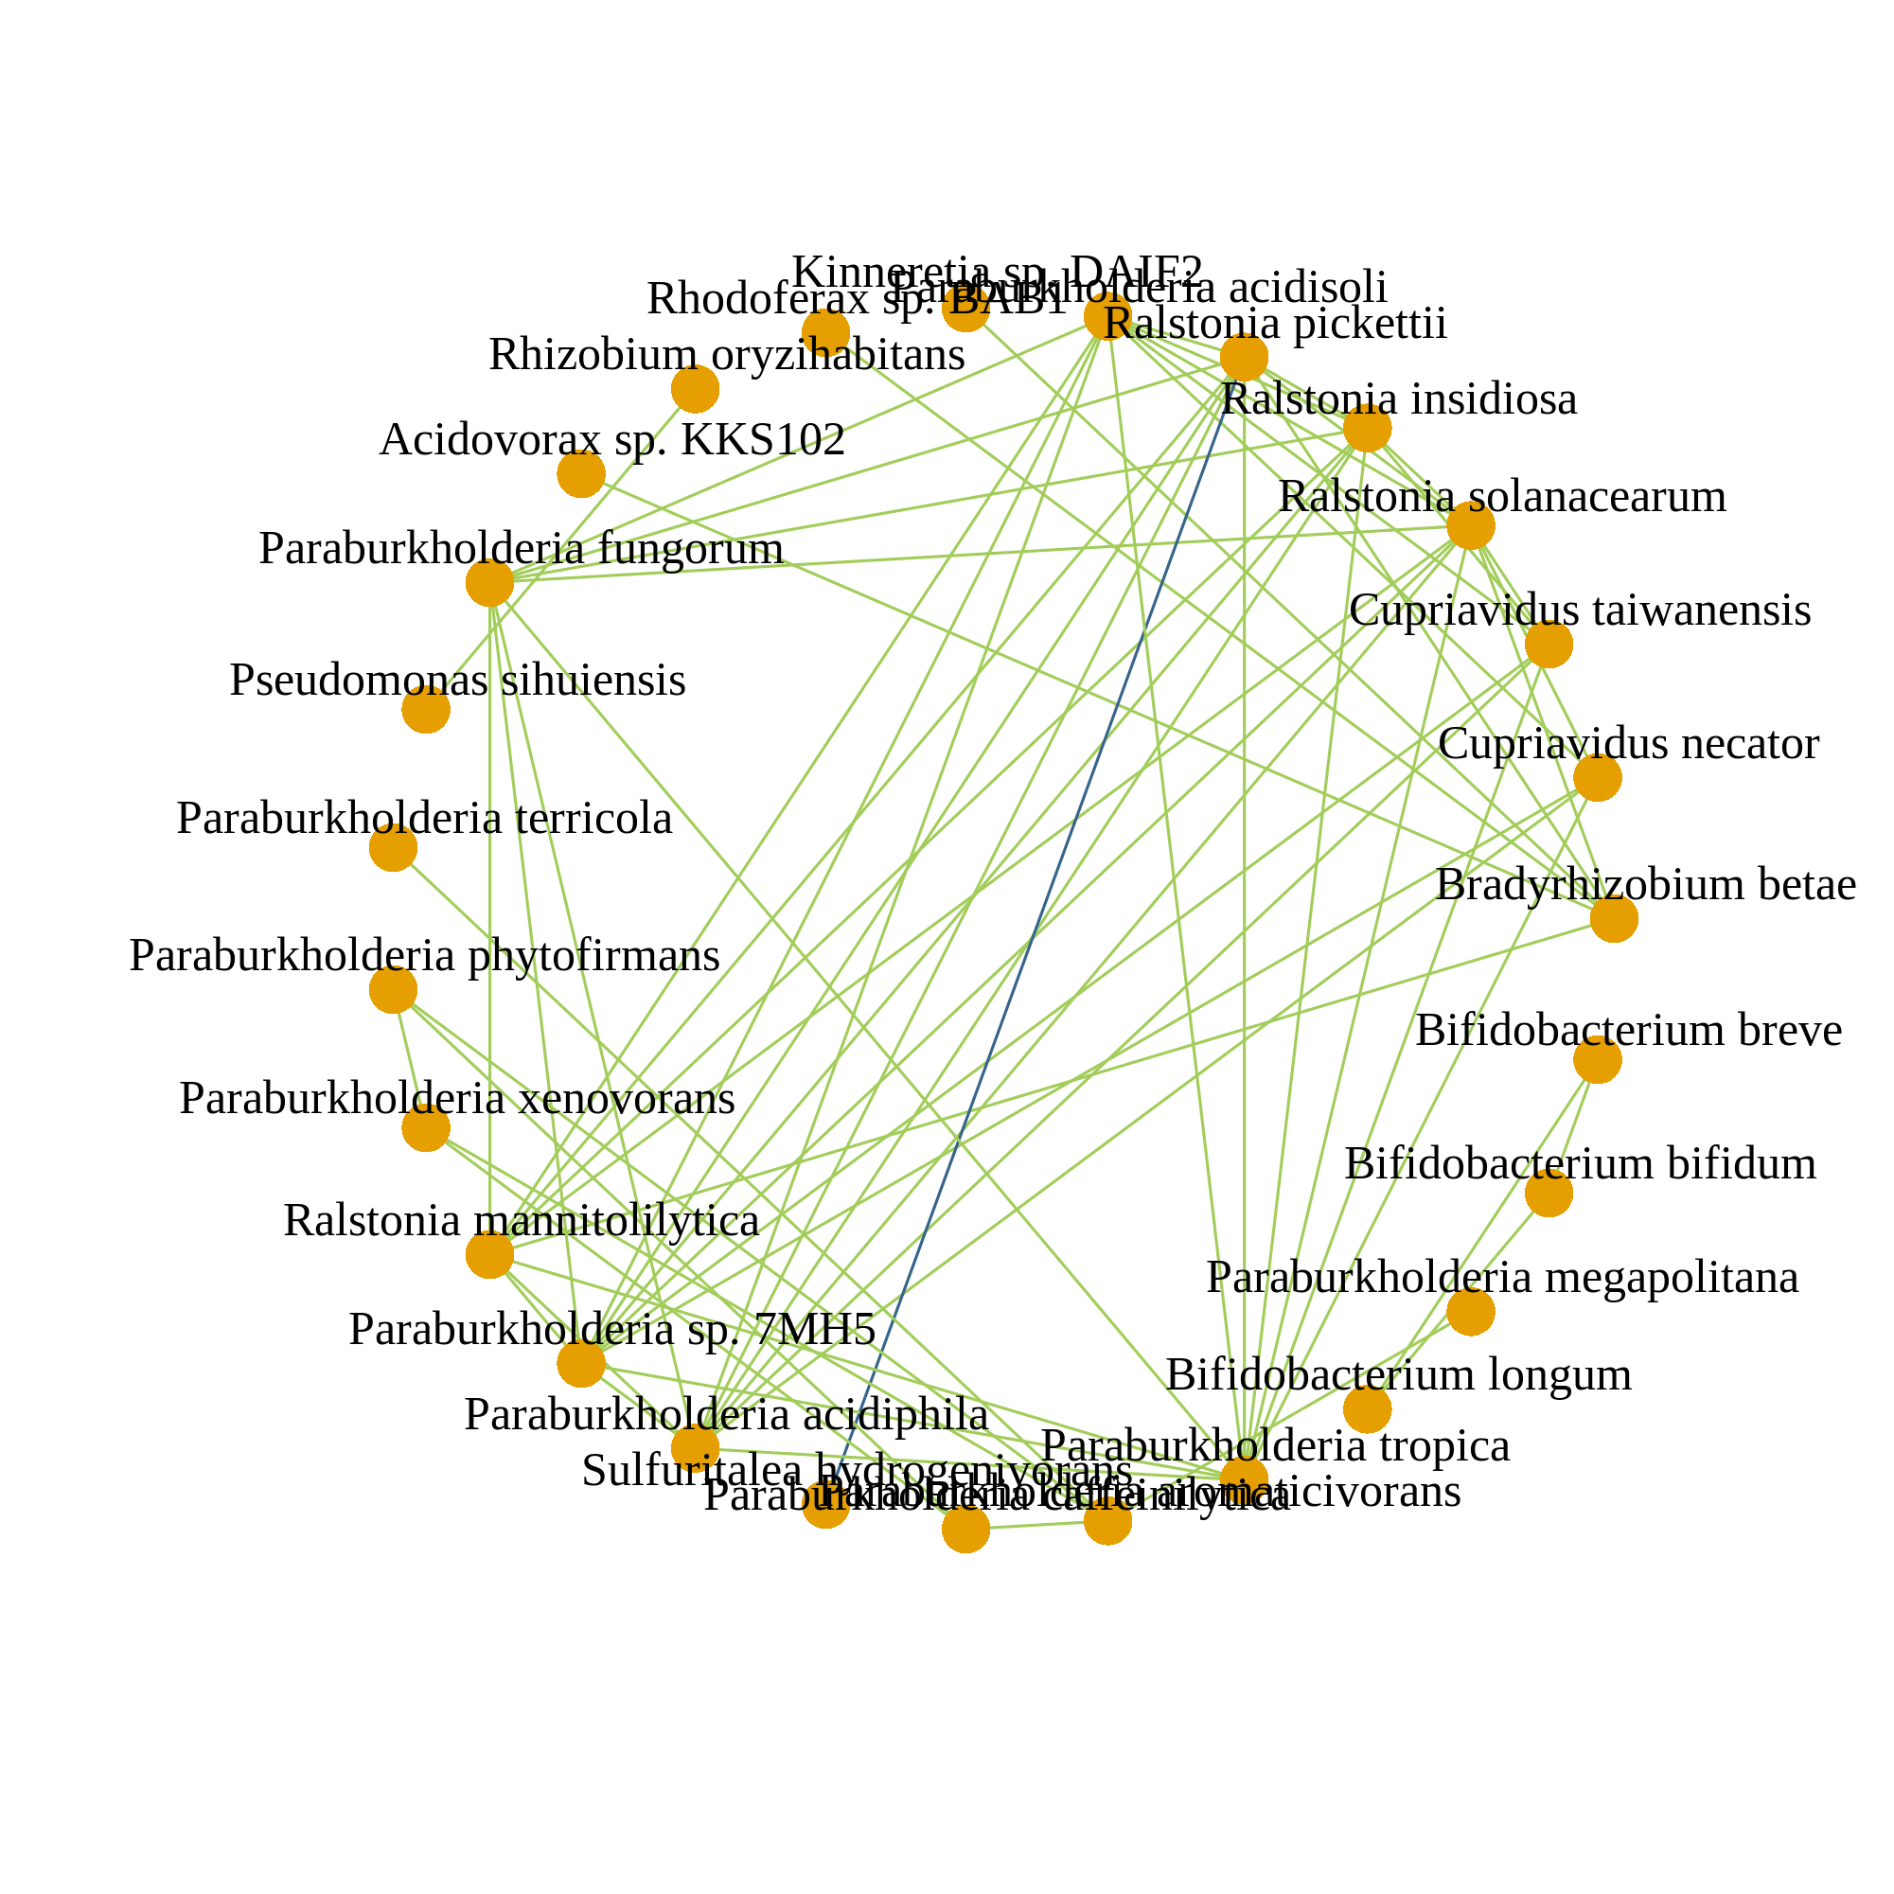
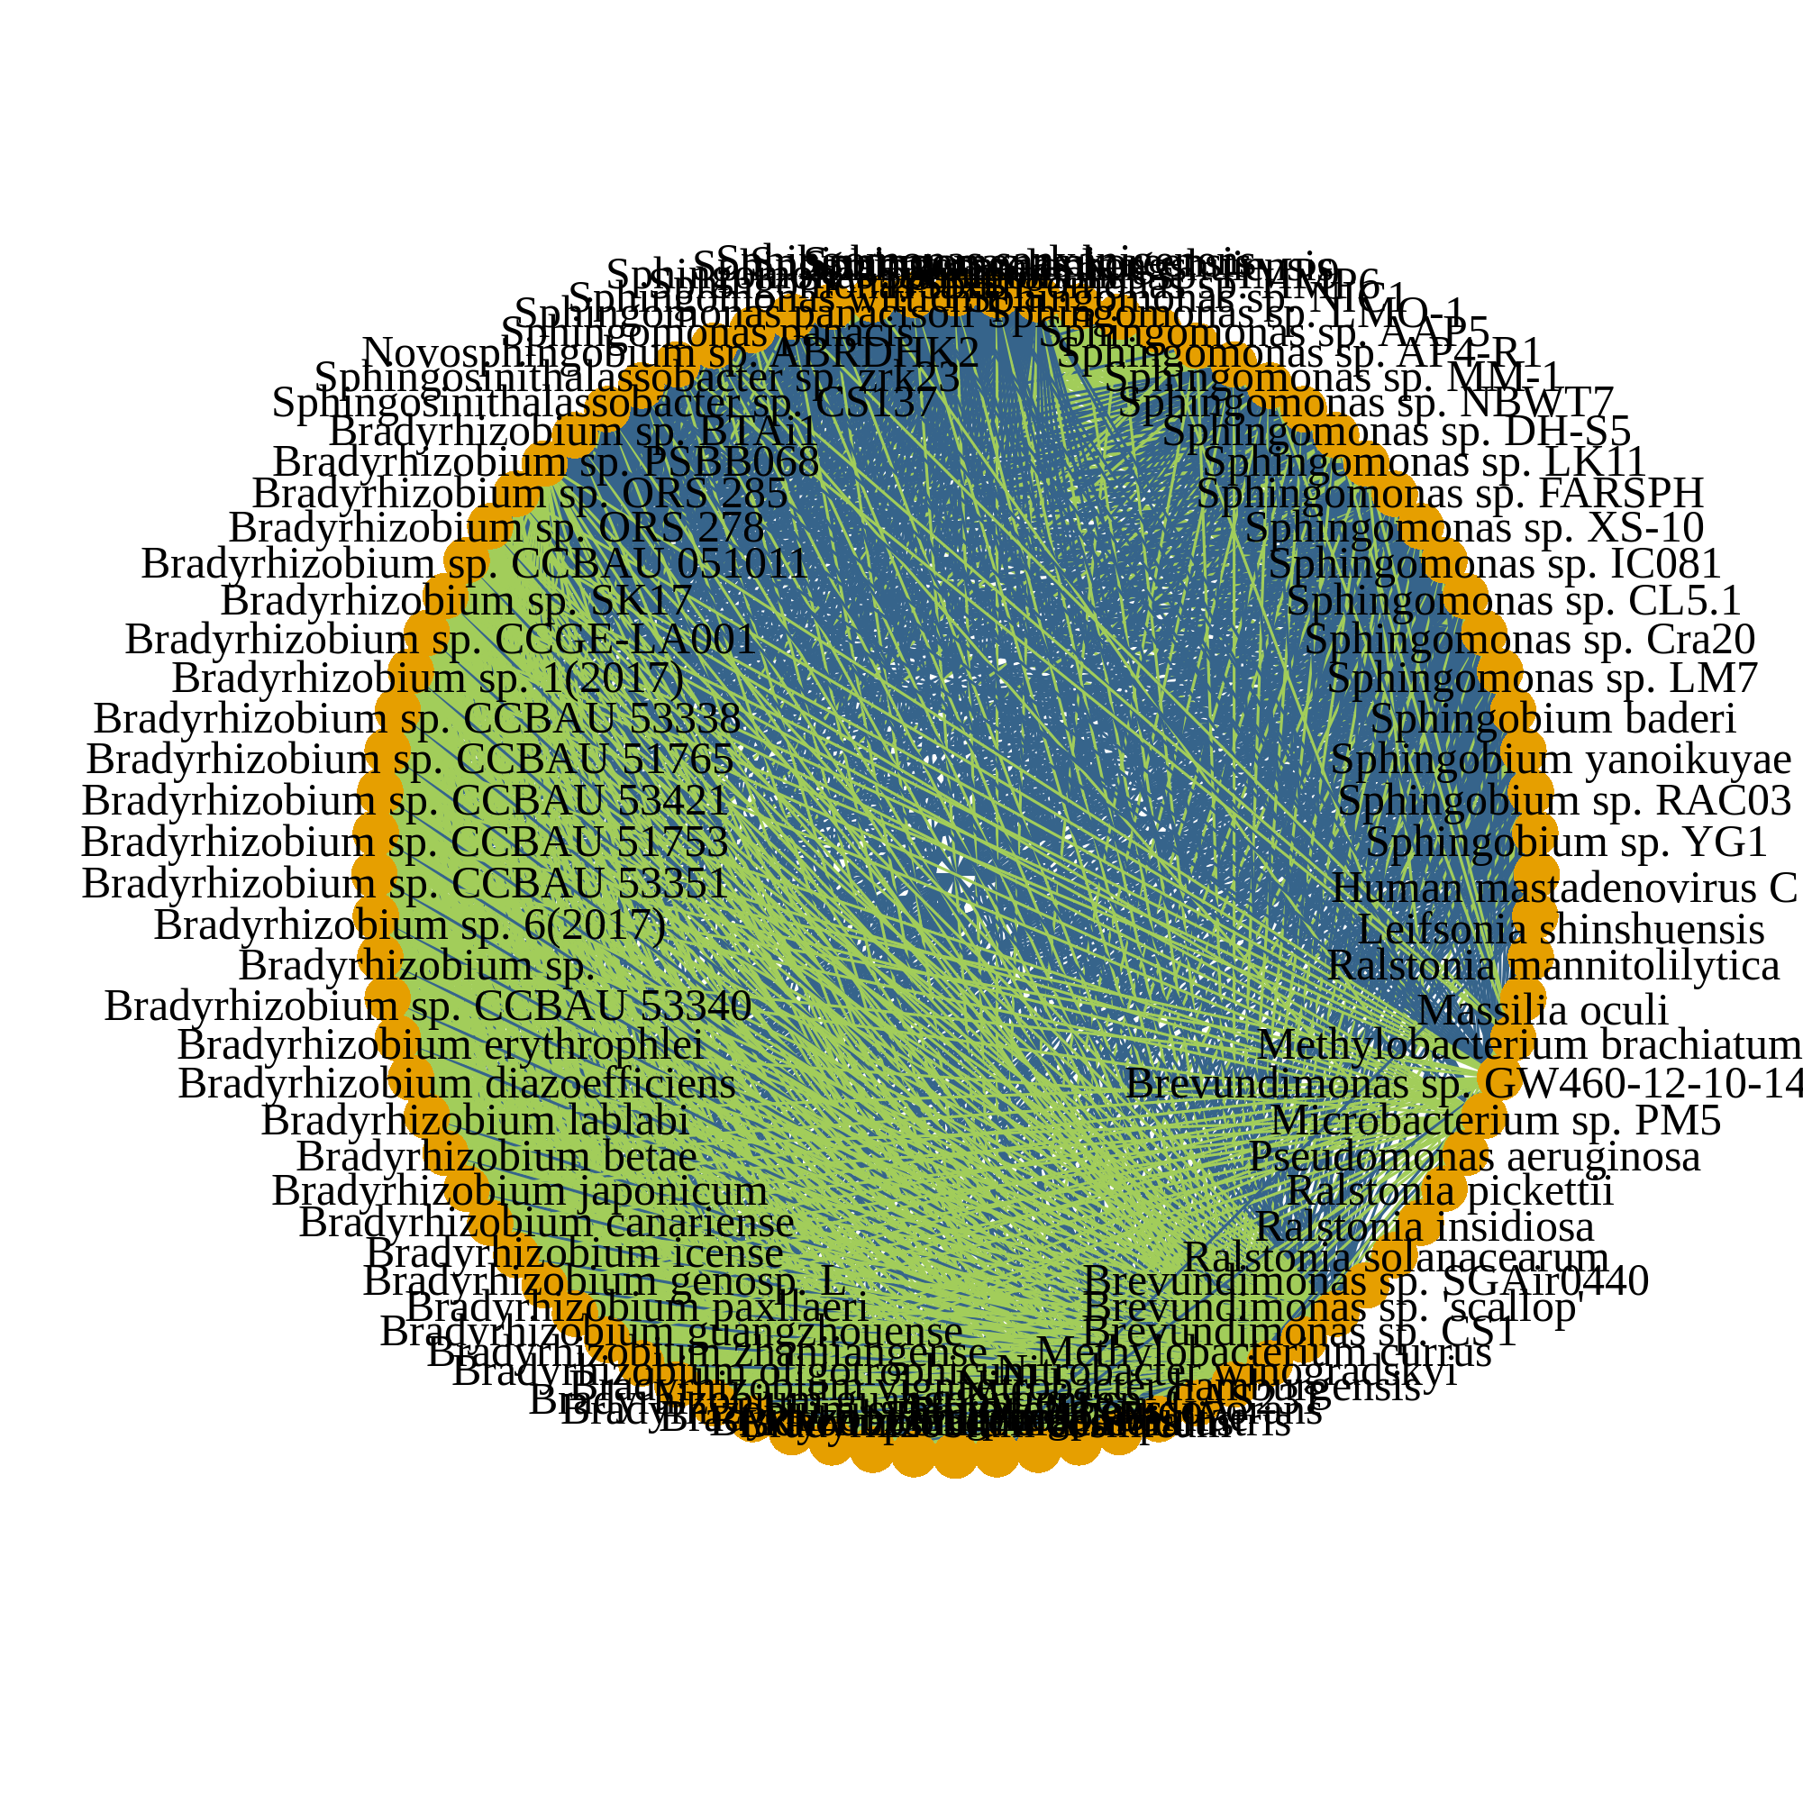
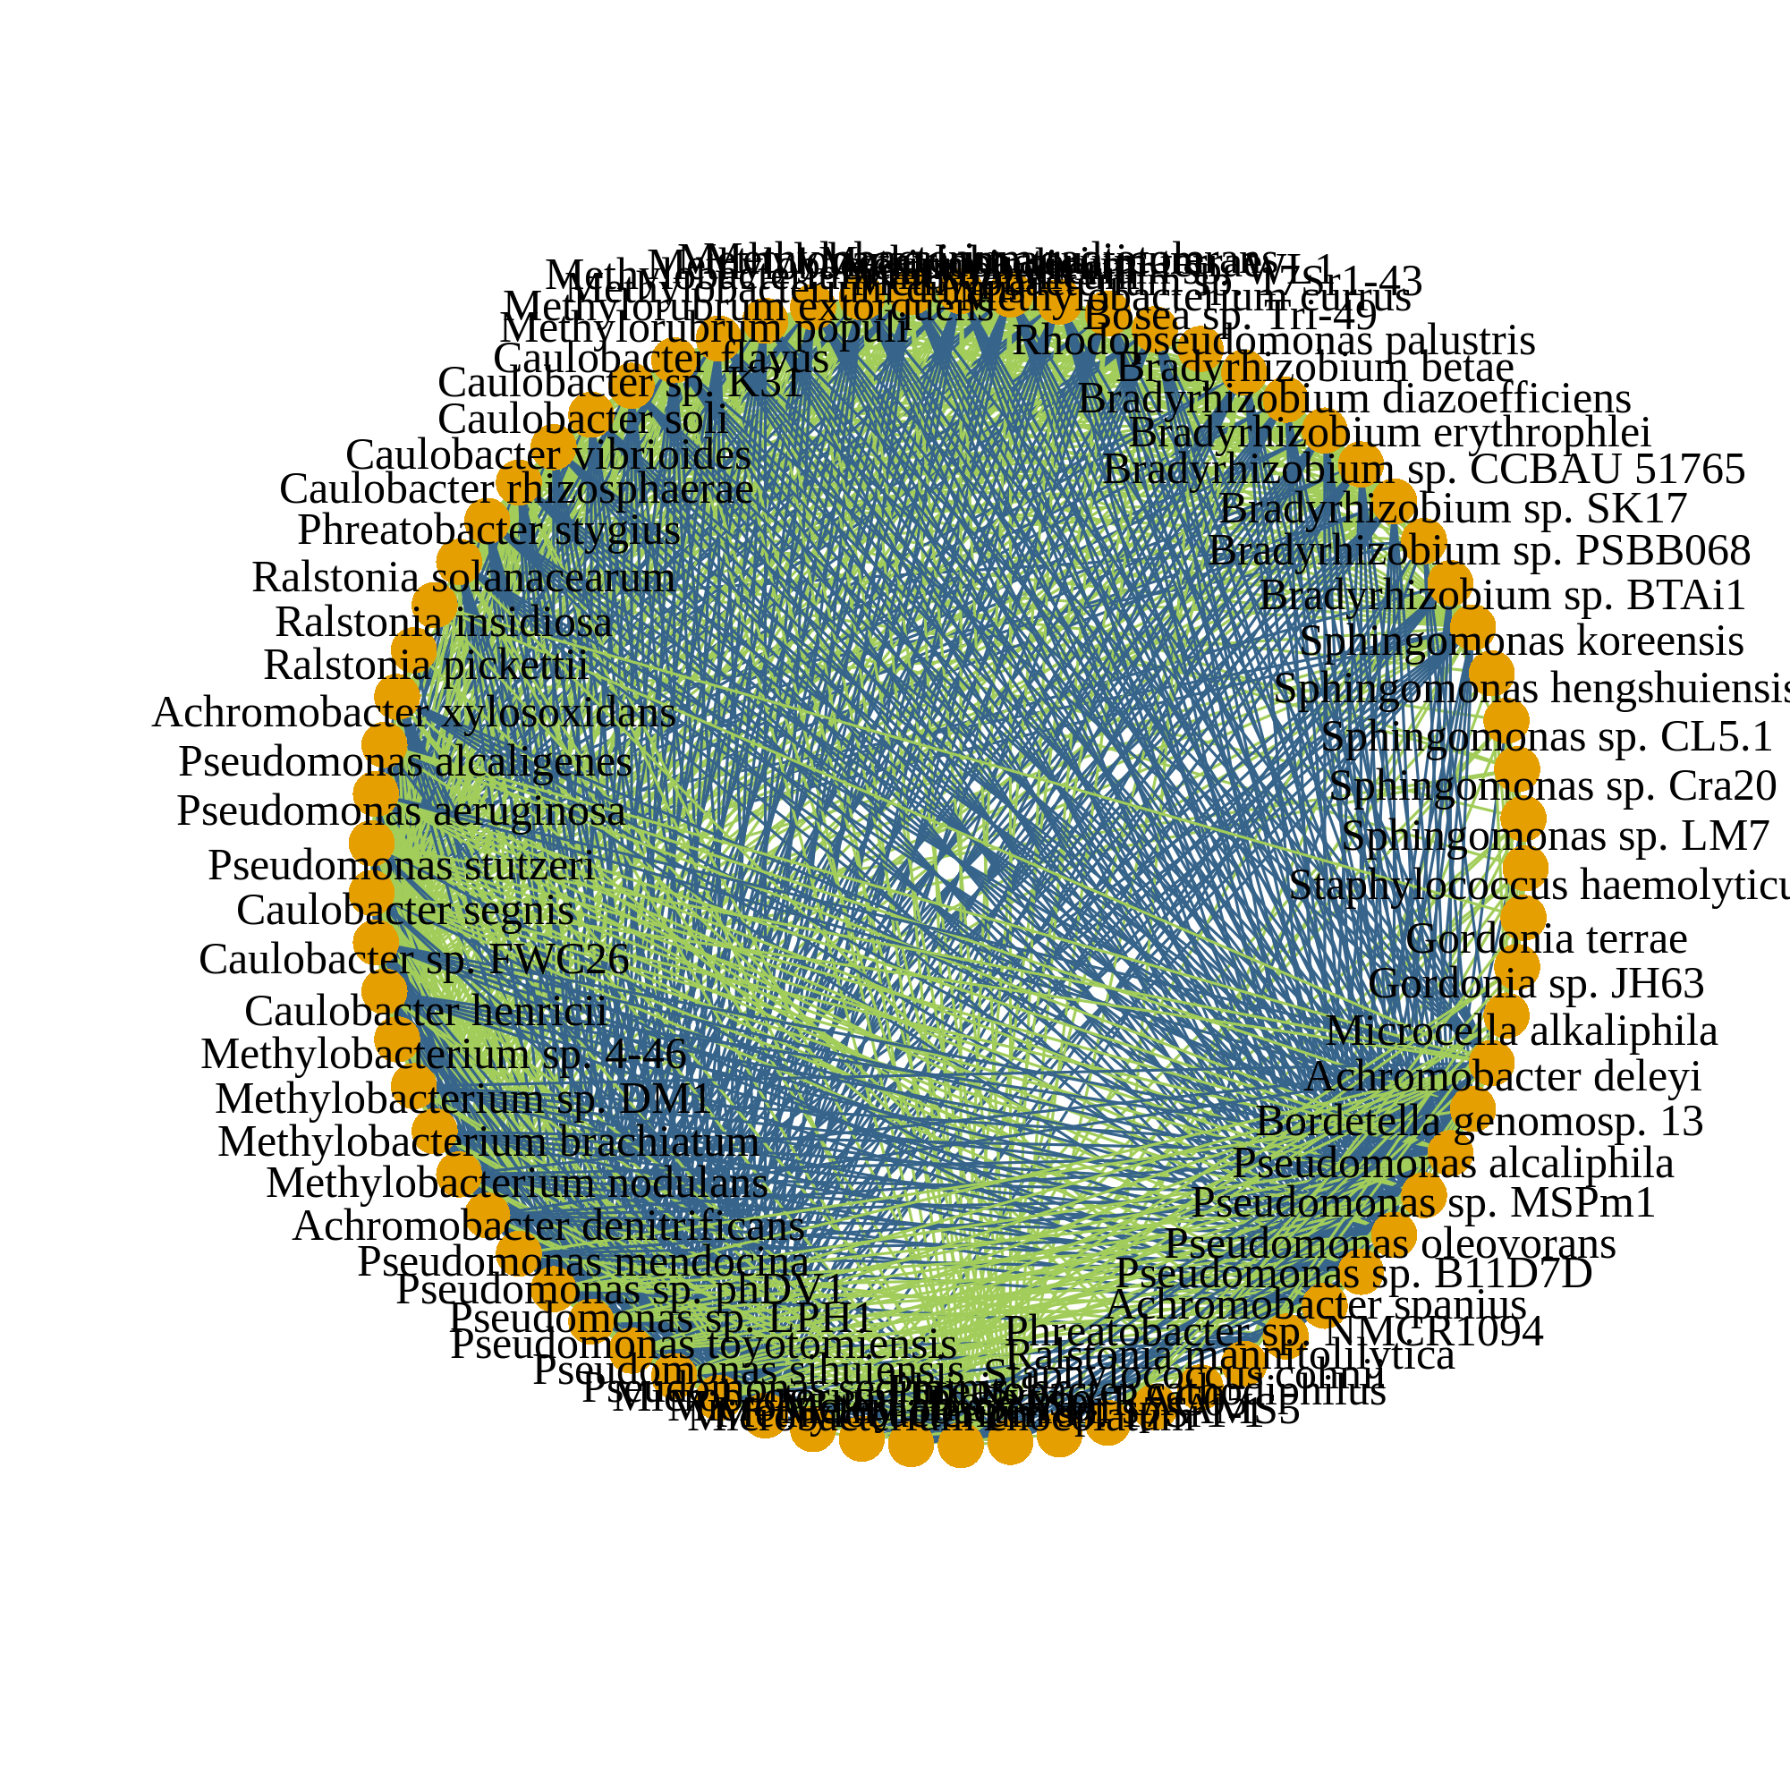
a
After decontamination (124 species)
Corr. > 0.05
Corr. > 0.1
Corr. > 0.2
n = 1526
b
Corr. > 0.2
Before decontamination (870 species)
HELIOS (n = 2284)
TTSH (n = 653)
SEED (n = 835)
MEC (n = 2713)
PRISM (n = 1248)
Legend
No common associations
Microbial species
Co-occurrence
Co-exclusion
Notes:
Fig. 4: Microbial co-occurrence networks. (a) SparCC (42) co-occurrence networks computed from all samples with at least one microbial taxon following decontamination at different SparCC correlation thresholds (0.05, 0.1, 0.2). Only associations with a magnitude of SparCC correlation greater than the respective thresholds are retained. (b) SparCC networks for individual cohorts at a correlation threshold of 0.2. No co-occurrence associations were retained after taking the intersection of edges between all cohort networks. For (a) and (b), each node represents a single microbial species, and each edge a single association between a pair of microbial species. Edge thickness is scaled by the magnitude of correlation. The number of samples used to compute each network and the correlation thresholds used are annotated. Positive and negative SparCC correlations are indicated in green and blue respectively.

Slide 6
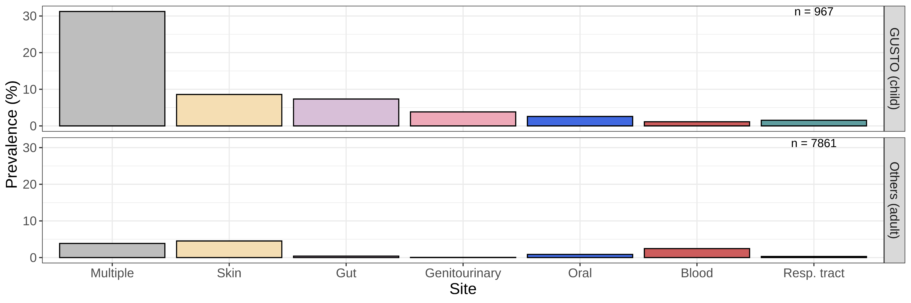


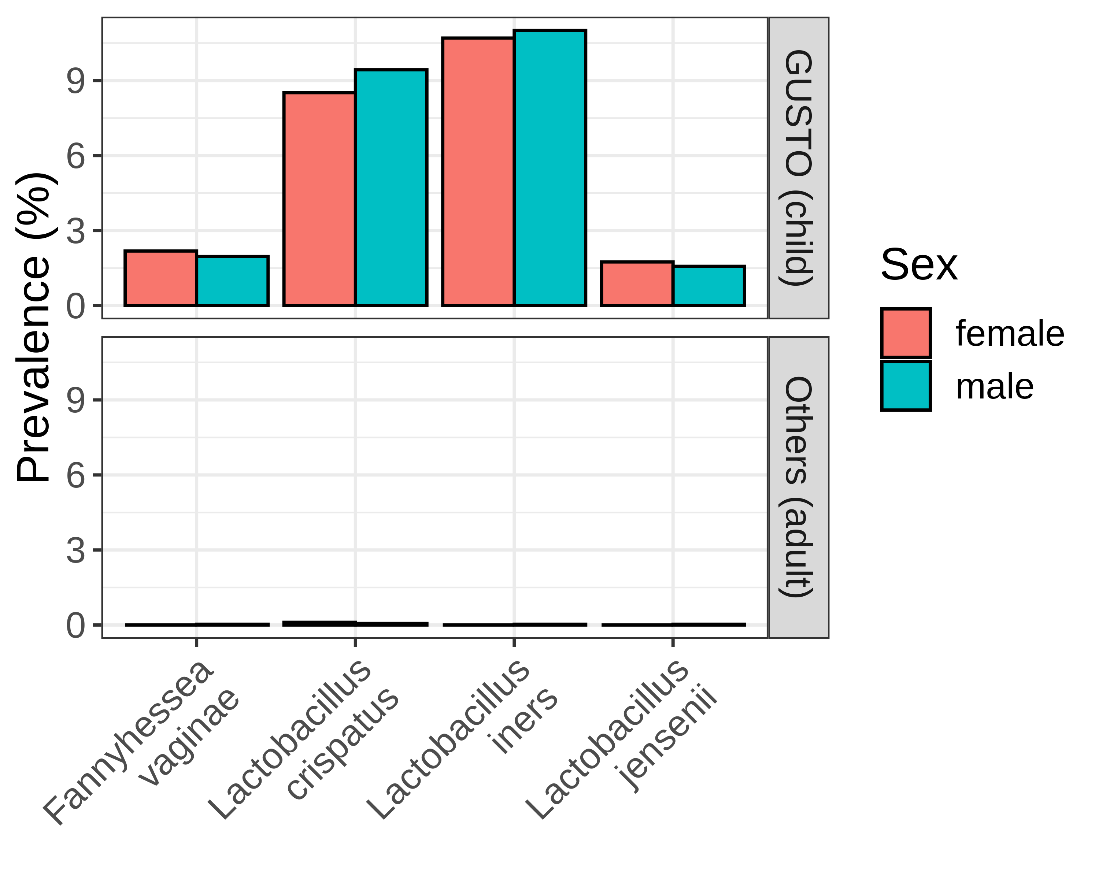
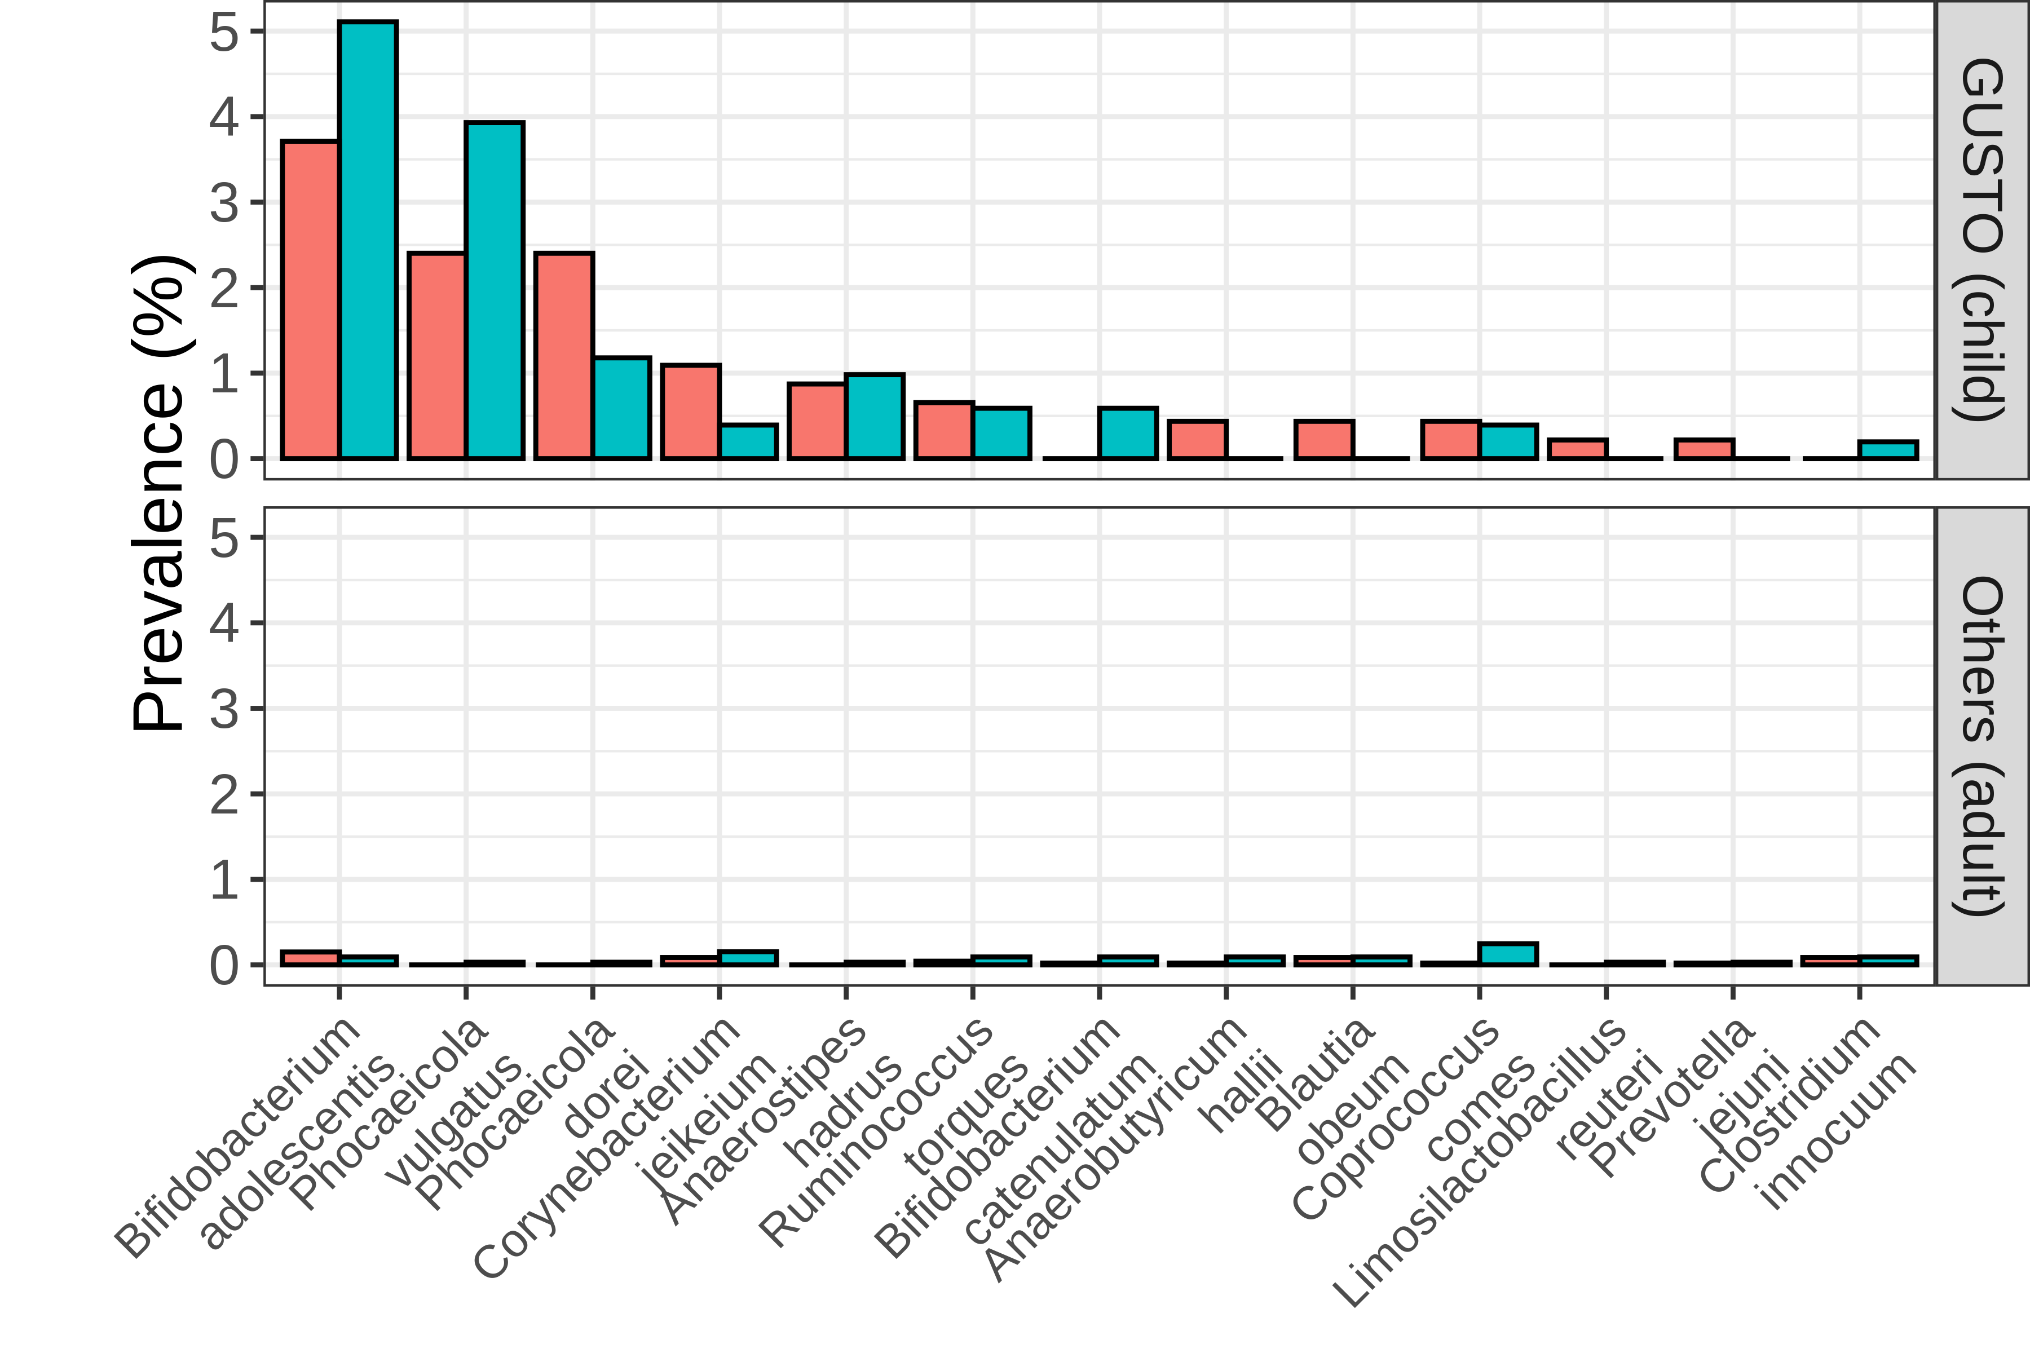
a
b
c
Genital microbes
Gut microbes
Notes:
Fig. 5: Higher prevalence of microbes in the blood of healthy children. (a) The disproportionately high prevalence of microbes in the child cohort GUSTO relative to the other adult cohorts. Prevalence of (c) genital-associated and (d) gut-associated microbes in the child and adult cohorts, stratified by sex. Body site classifications were determined using the Disbiome database (30).

Slide 7
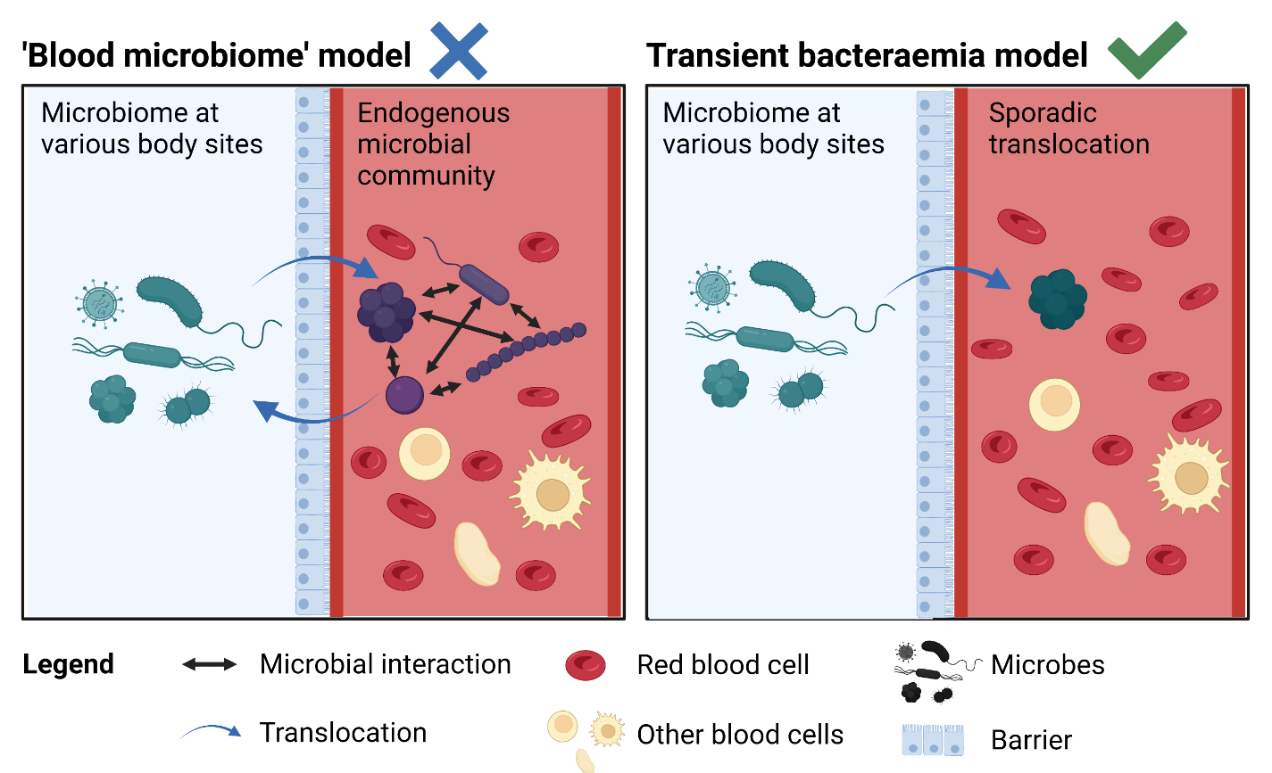
Notes:
Fig. 6: Models of microbes in blood. Created with BioRender.com under an academic subscription.

Slide 8
SUPPLEMENTARY FIGURES

Slide 9
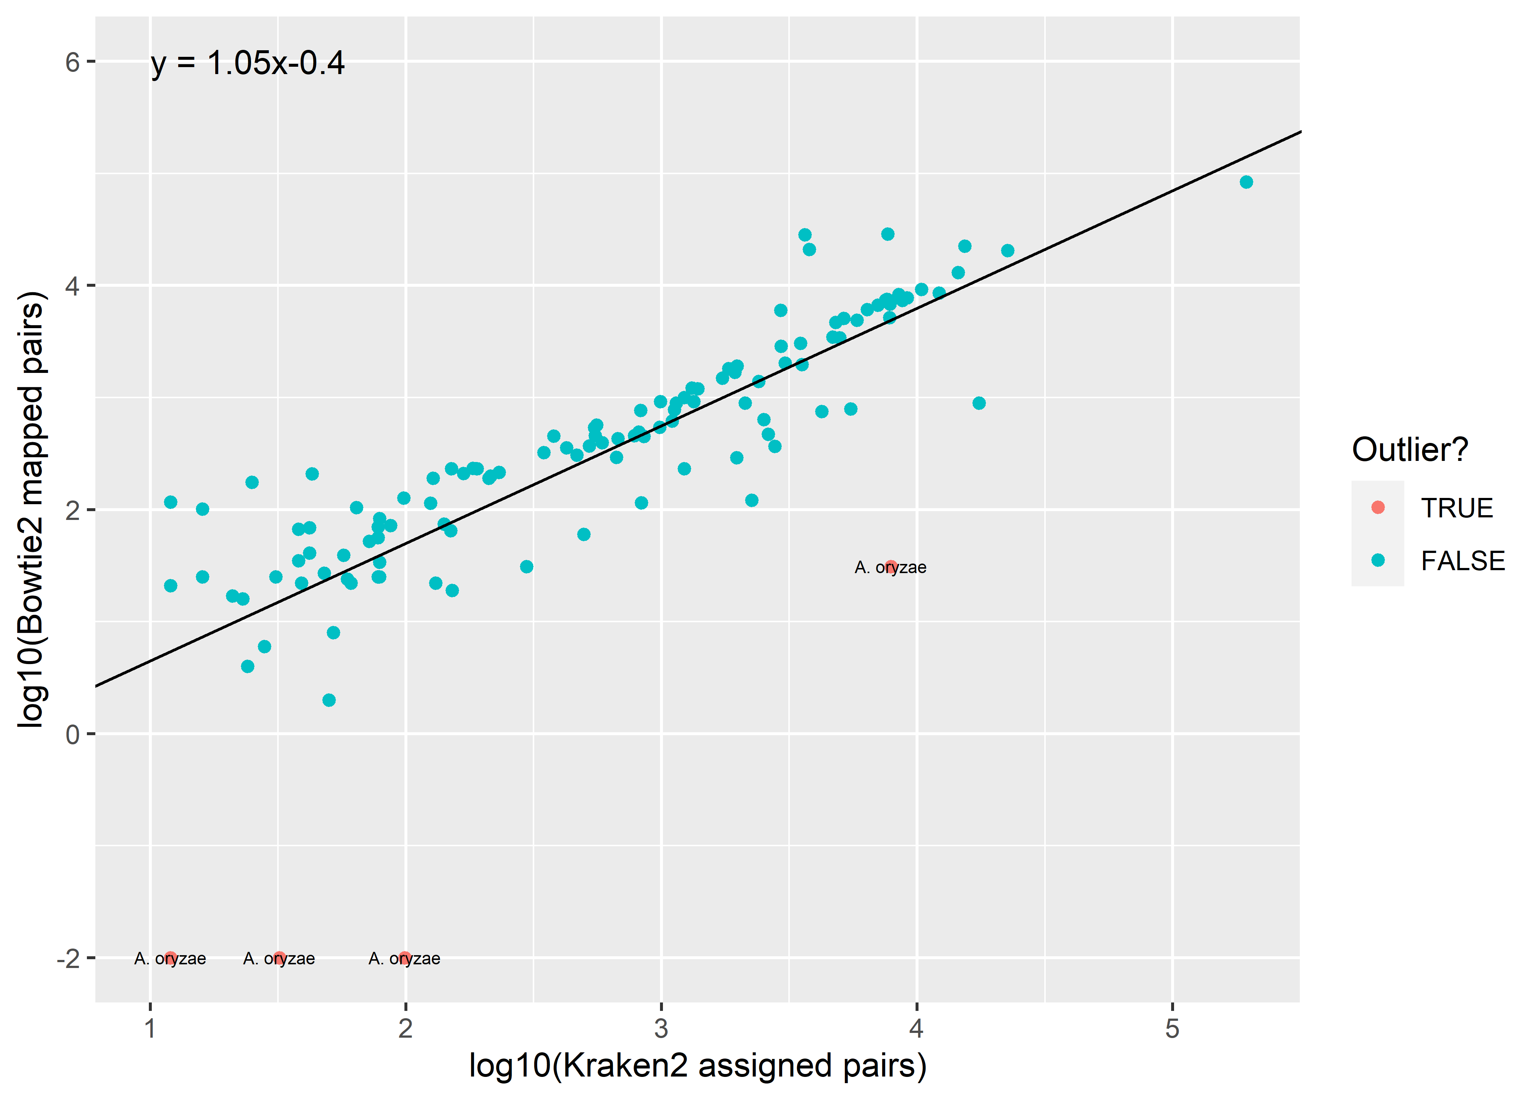
Notes:
Supplementary Fig. 1

Slide 10
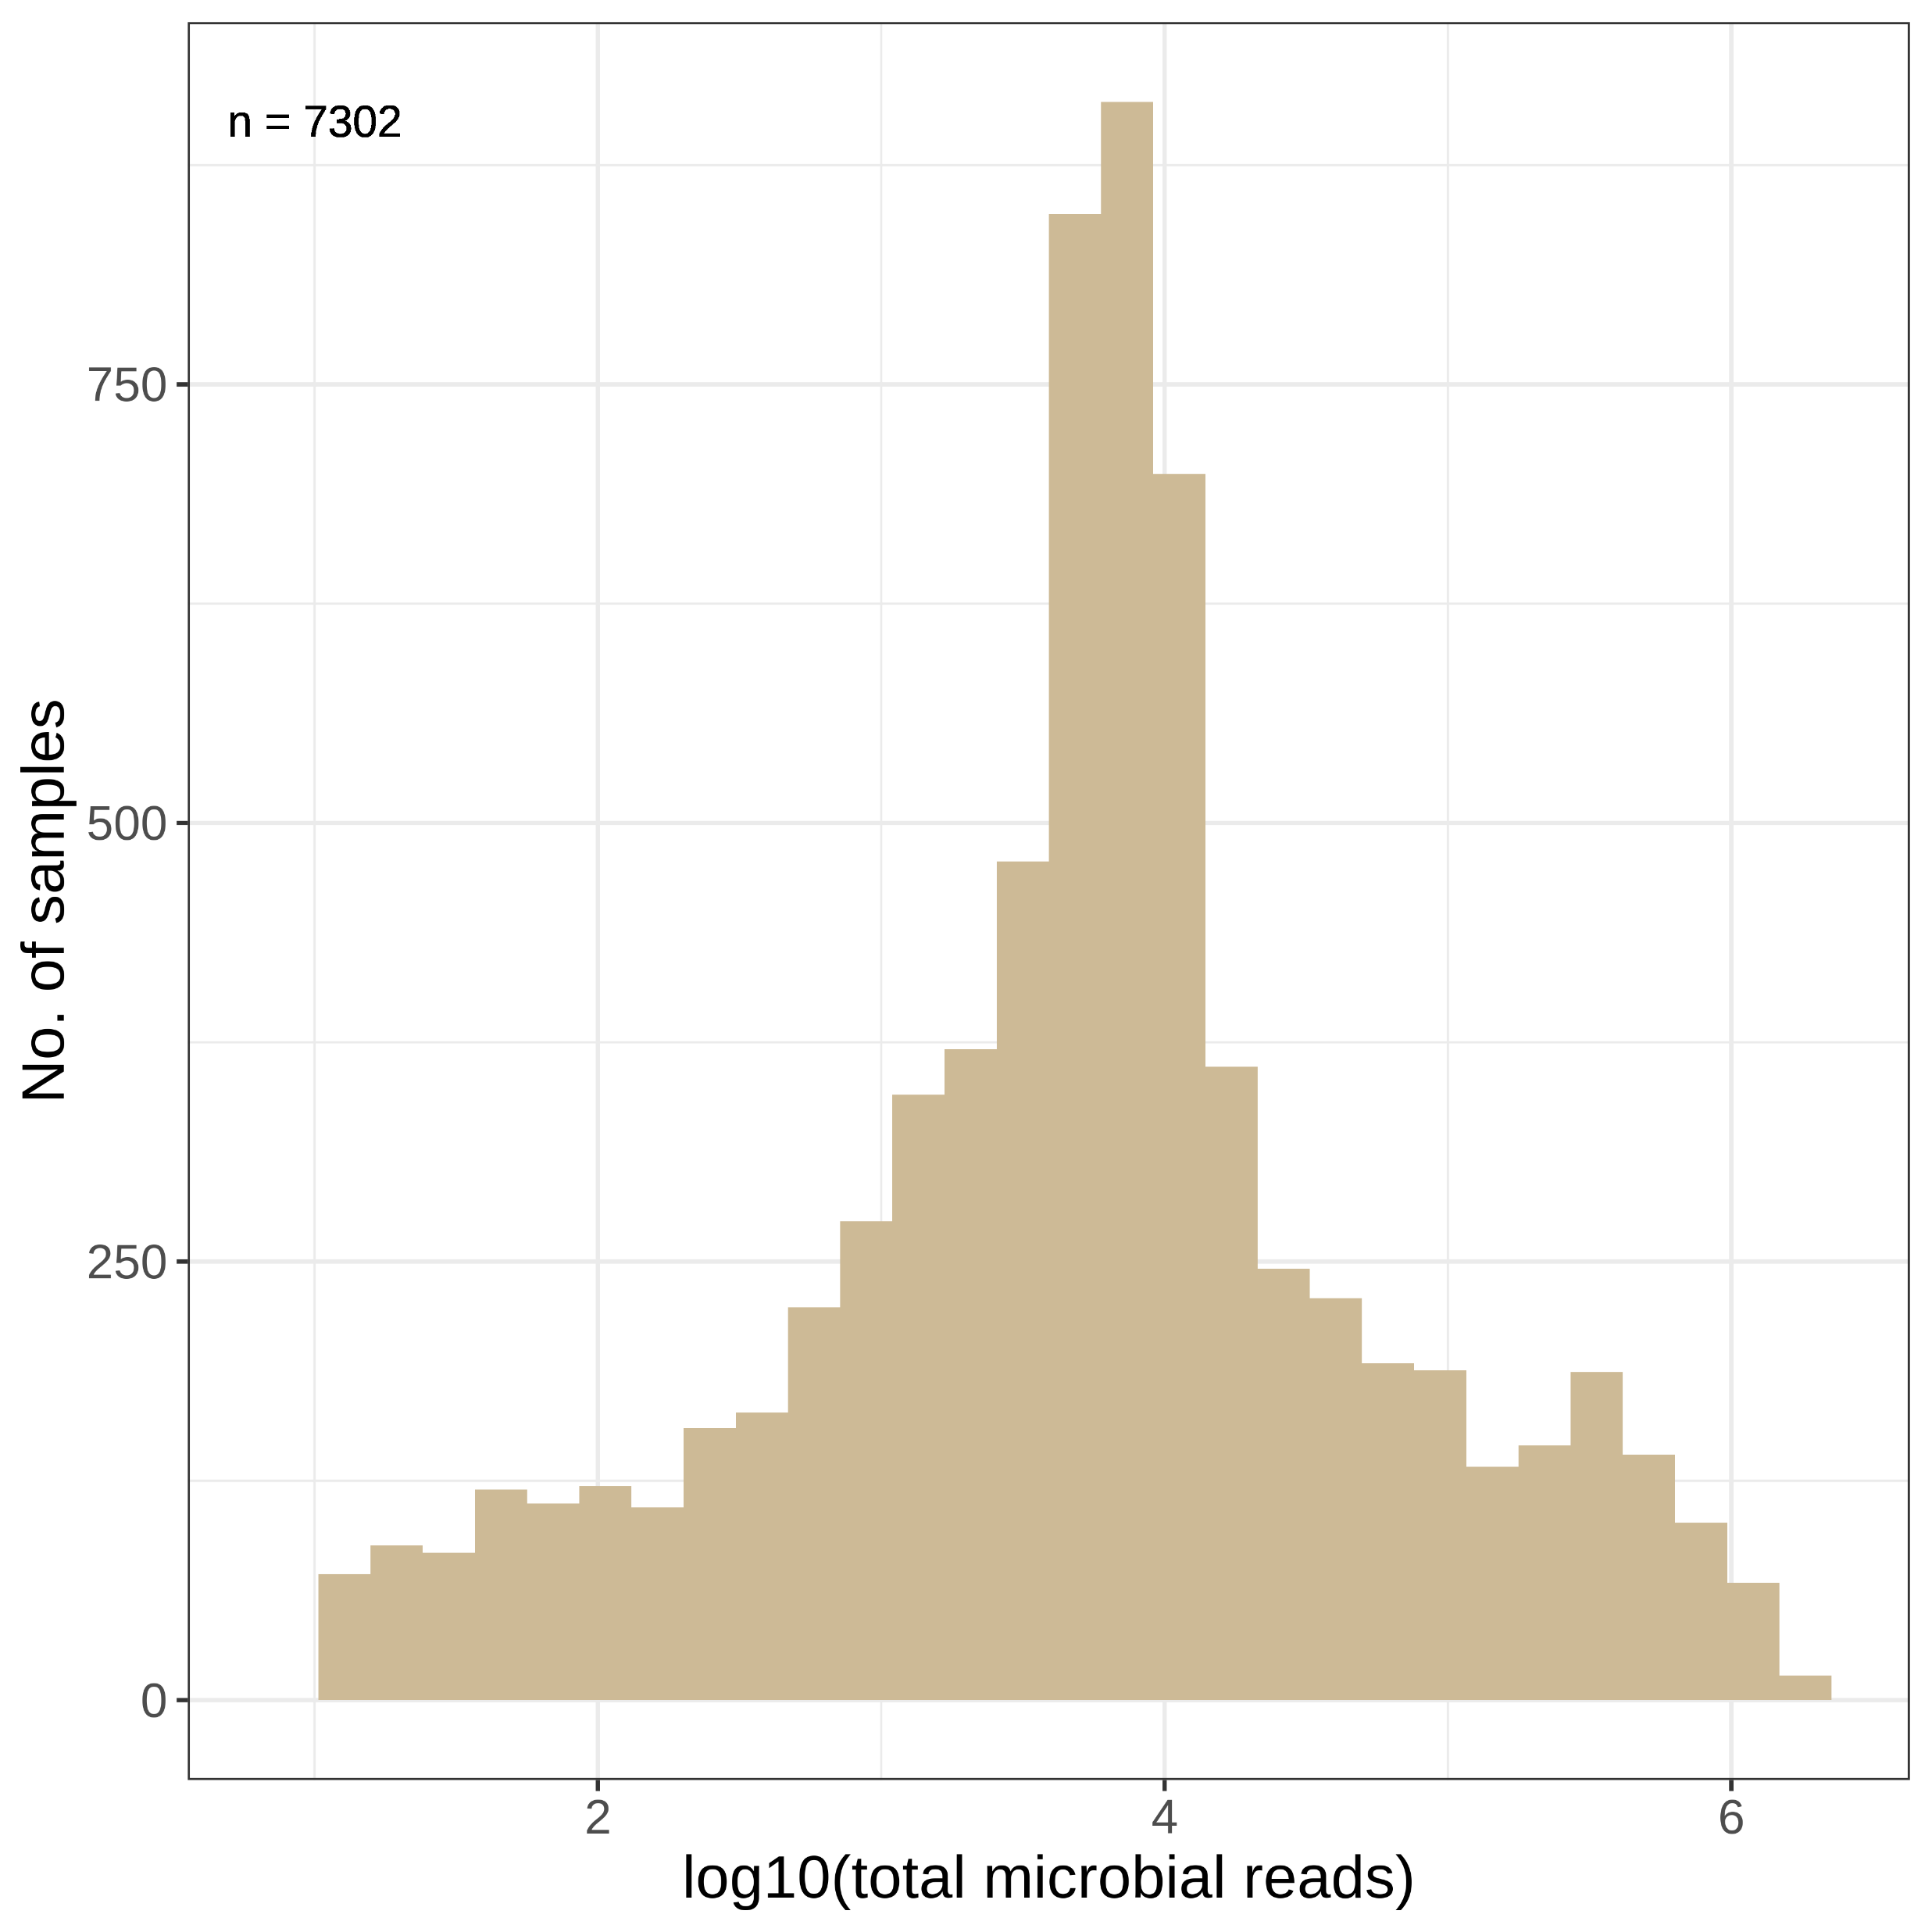
Notes:
Supplementary Fig. 2

Slide 11
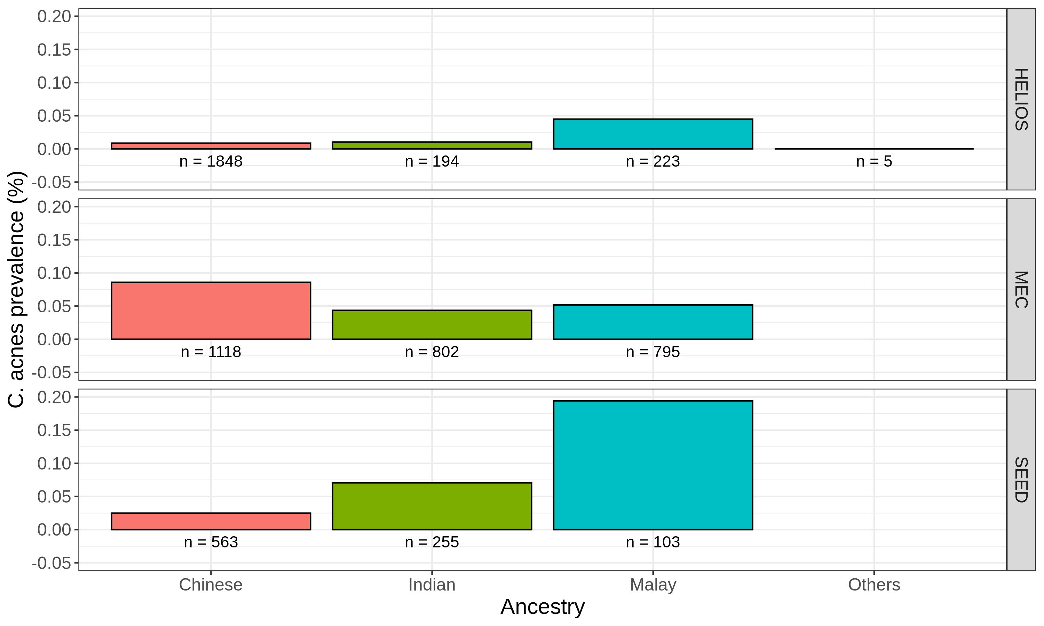
Notes:
Supplementary Fig. 3

Slide 12
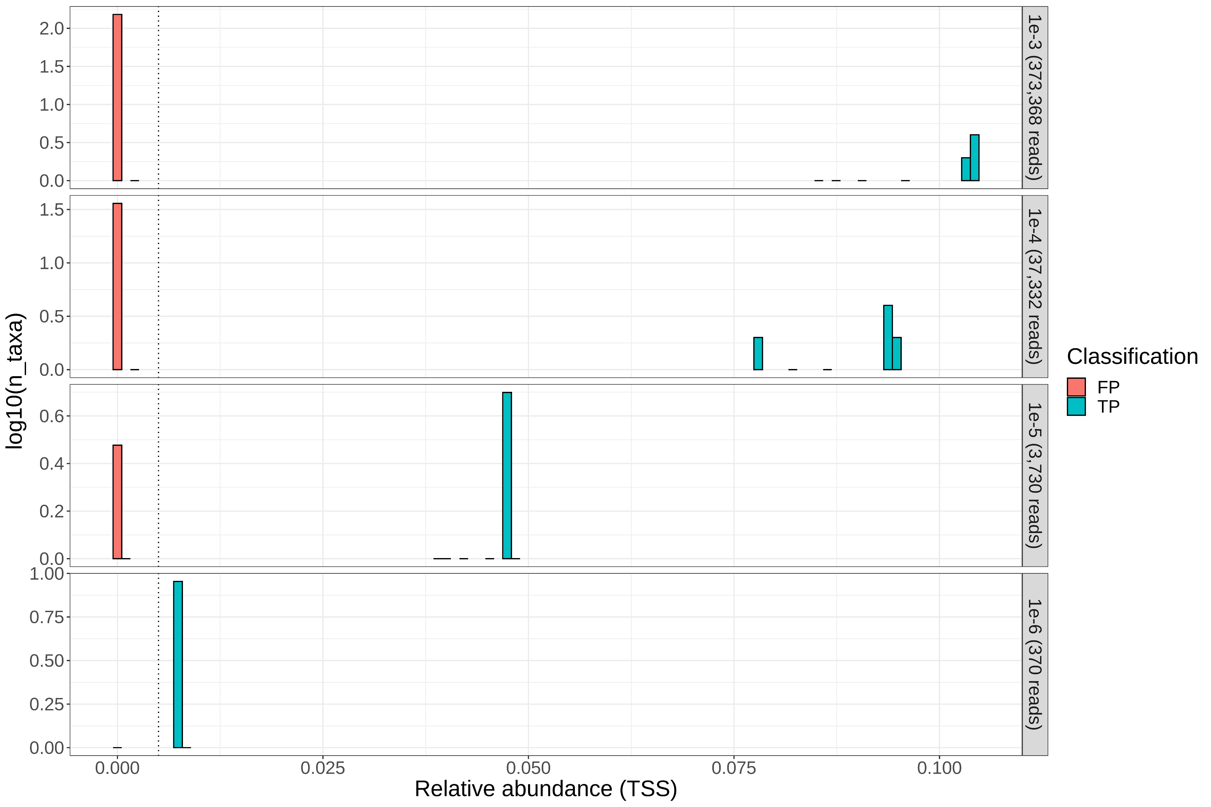
Relative abundance = 0.005
Microbial fraction (no. of reads)
log₁₀(no. of species)
~373 million total reads generated from:
Human (GRCh38)
7 bacteria
2 viruses
1 fungus
Relative abundance
Notes:
Supplementary Fig. 4

Slide 13
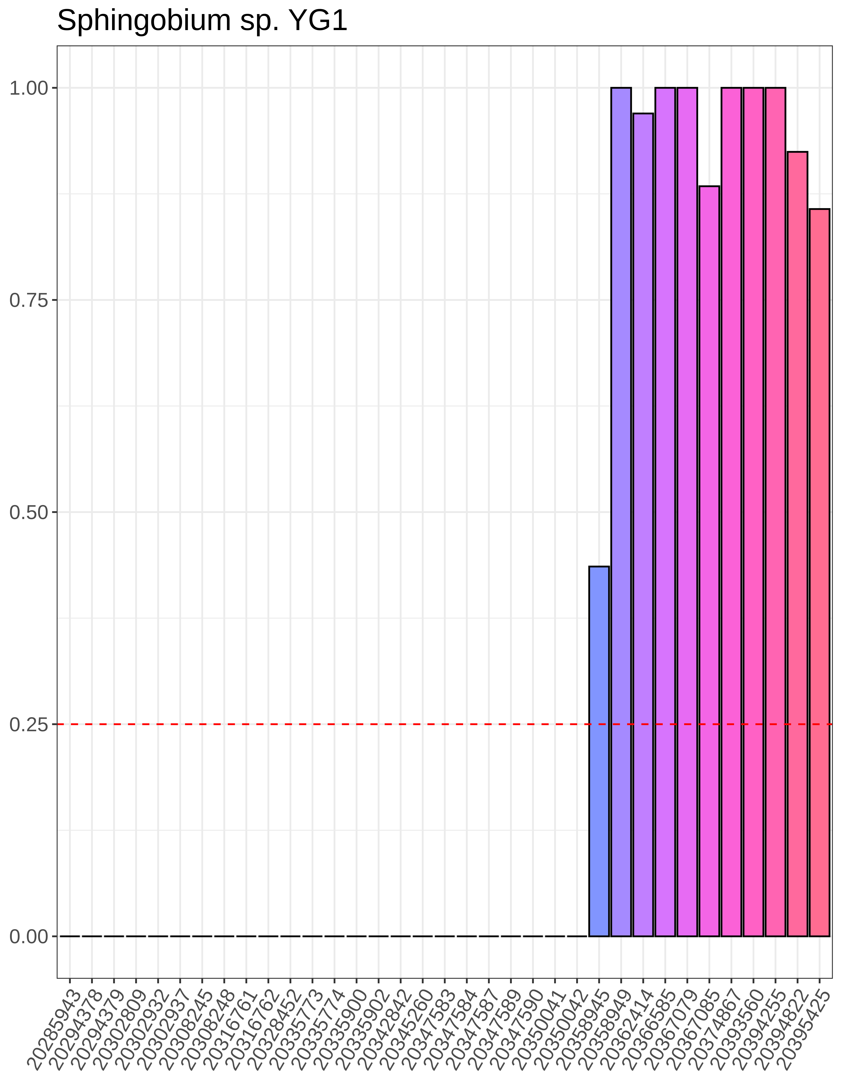
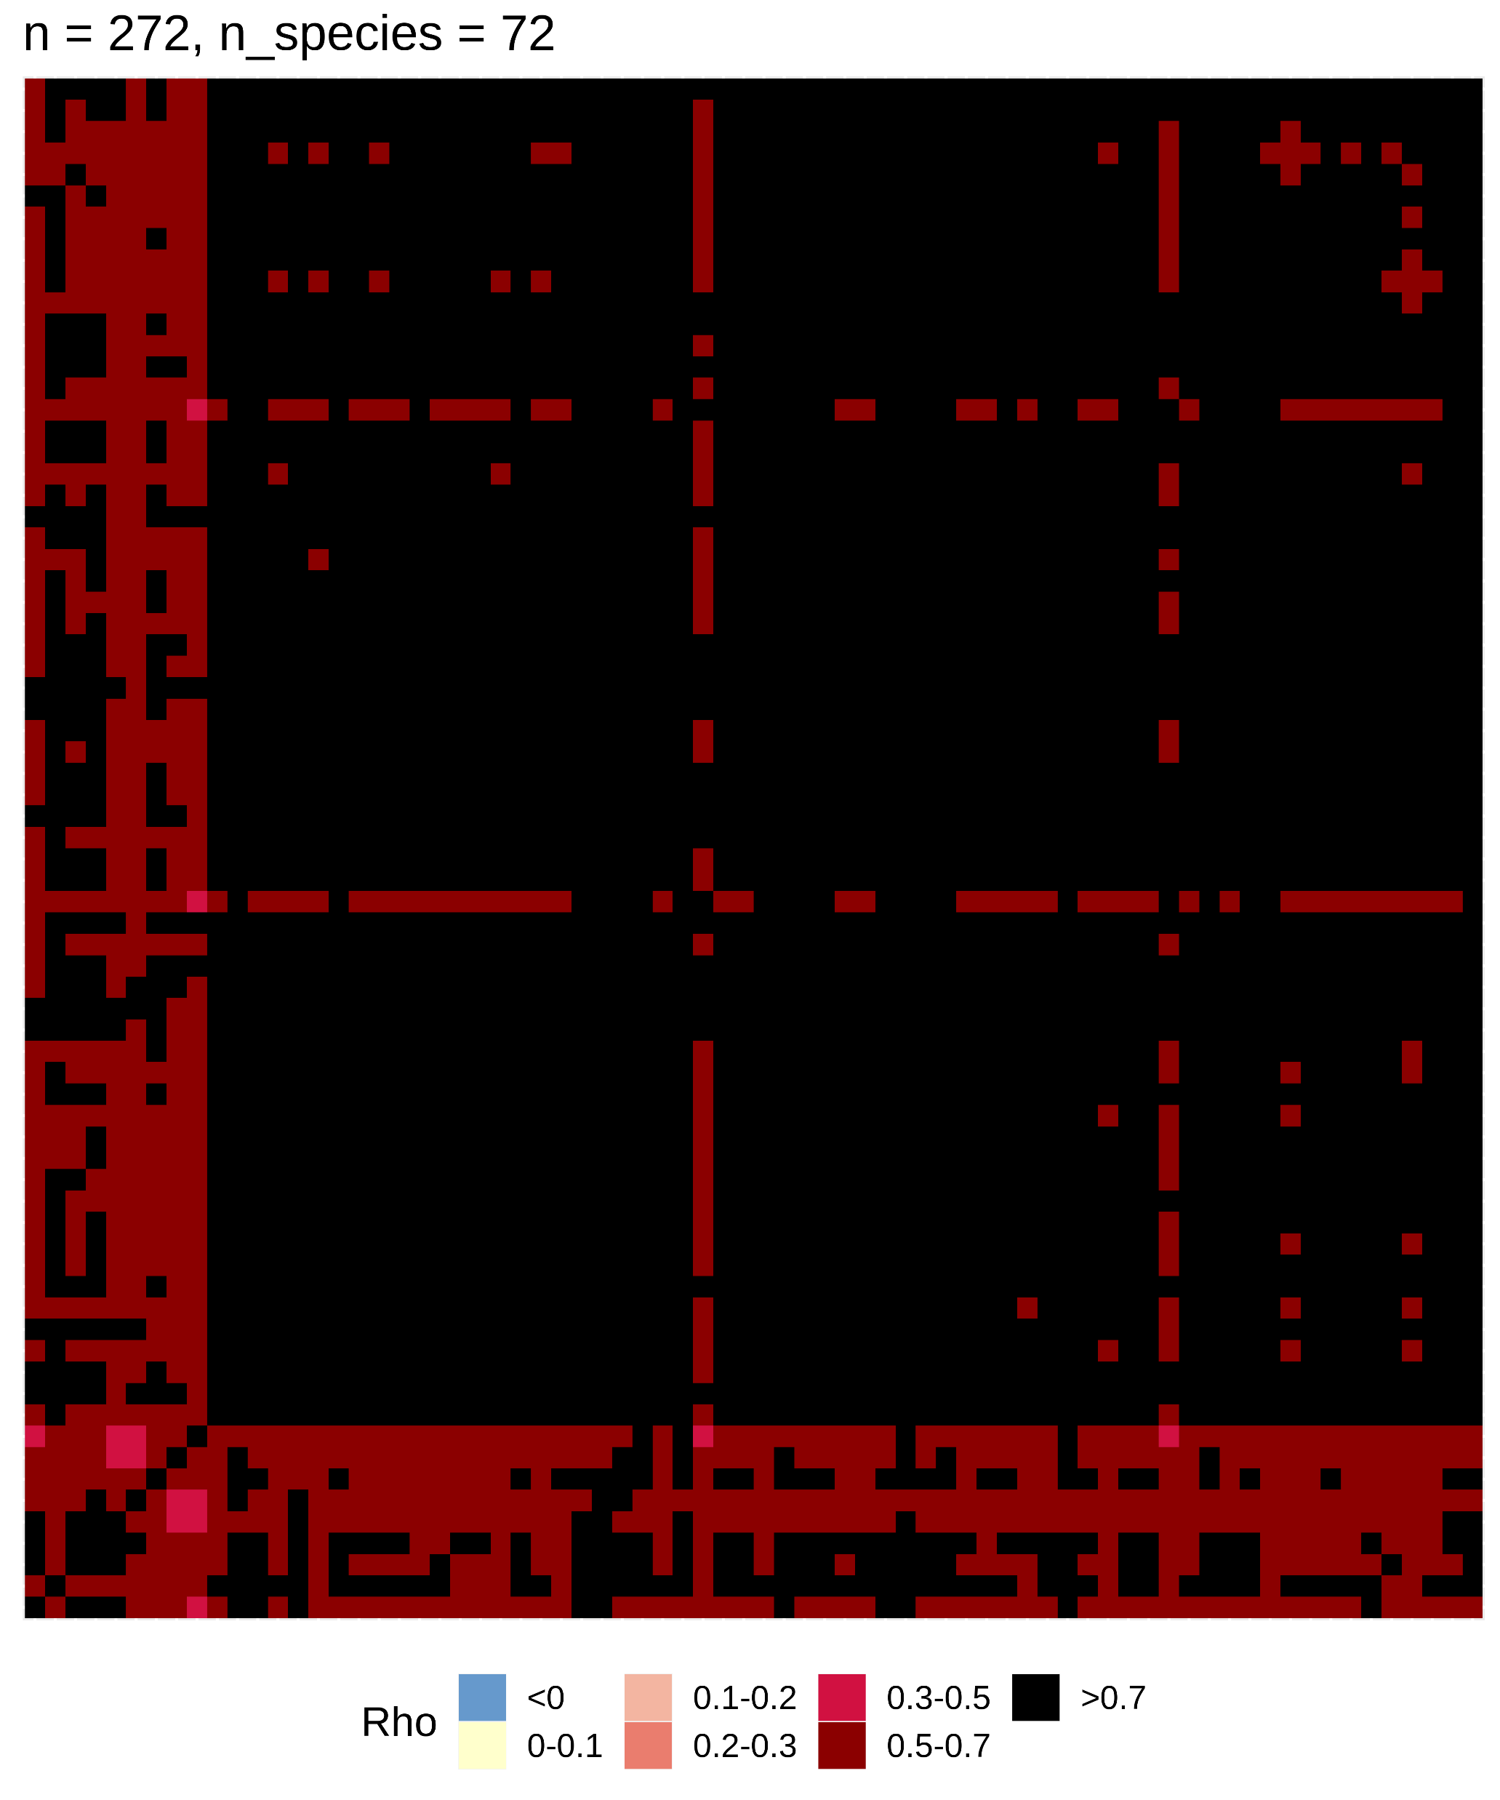
a
Sphingobium sp. YG1
b
Contaminants in flow cell lot 20367079
Prevalence (%)
Contaminants (n = 72)
Flow cell lot number
Contaminants (n = 72)
Notes:
Supplementary Fig. 5

Slide 14
DRAFT FIGURES

Slide 15
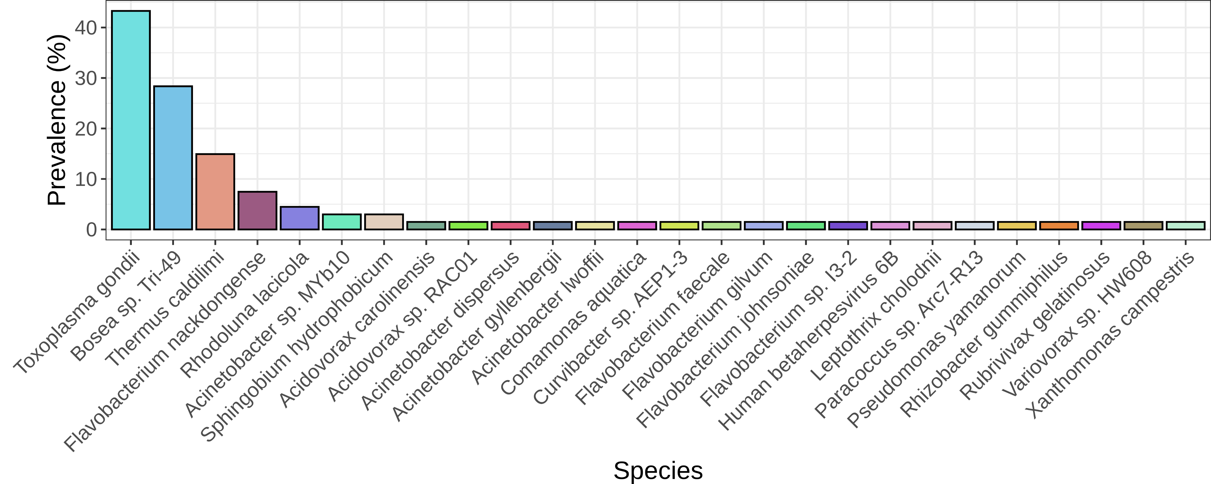
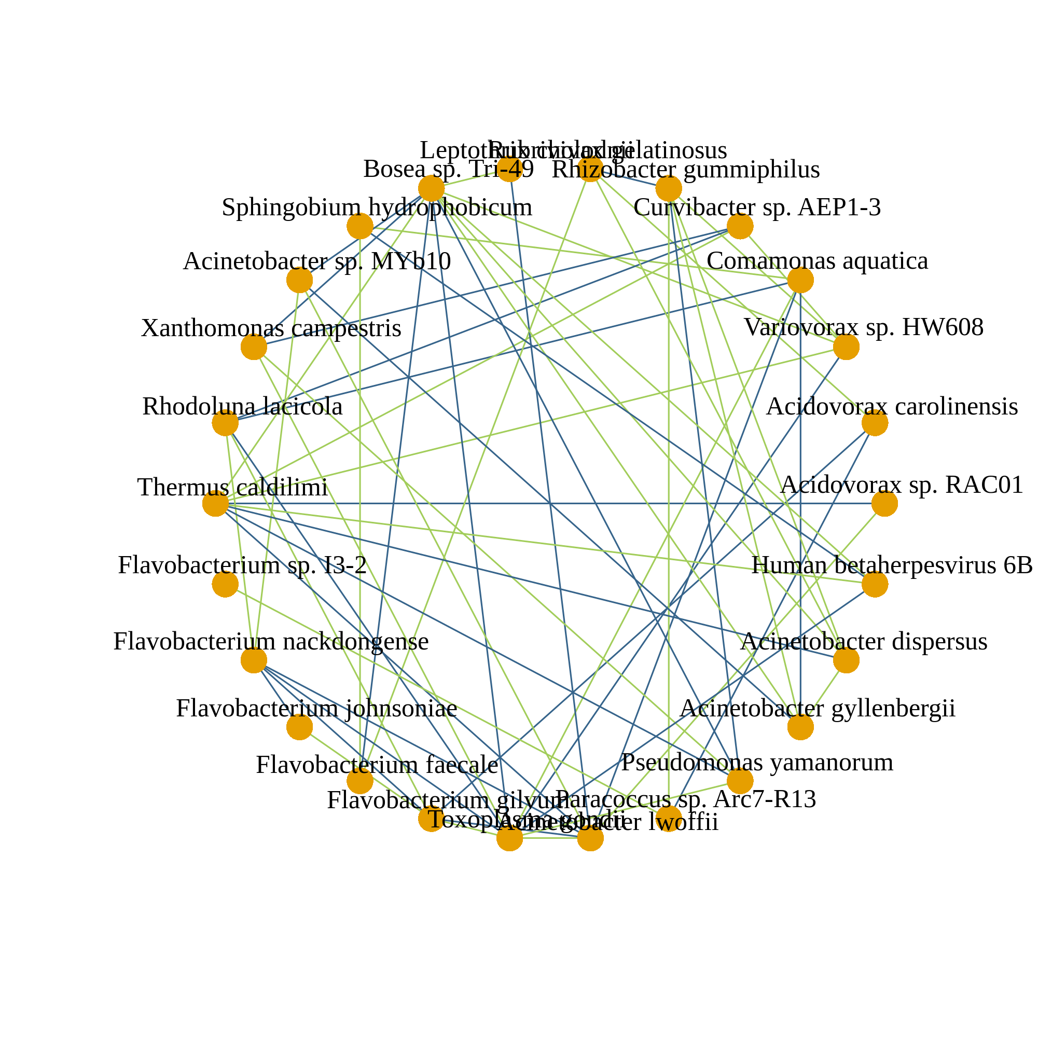
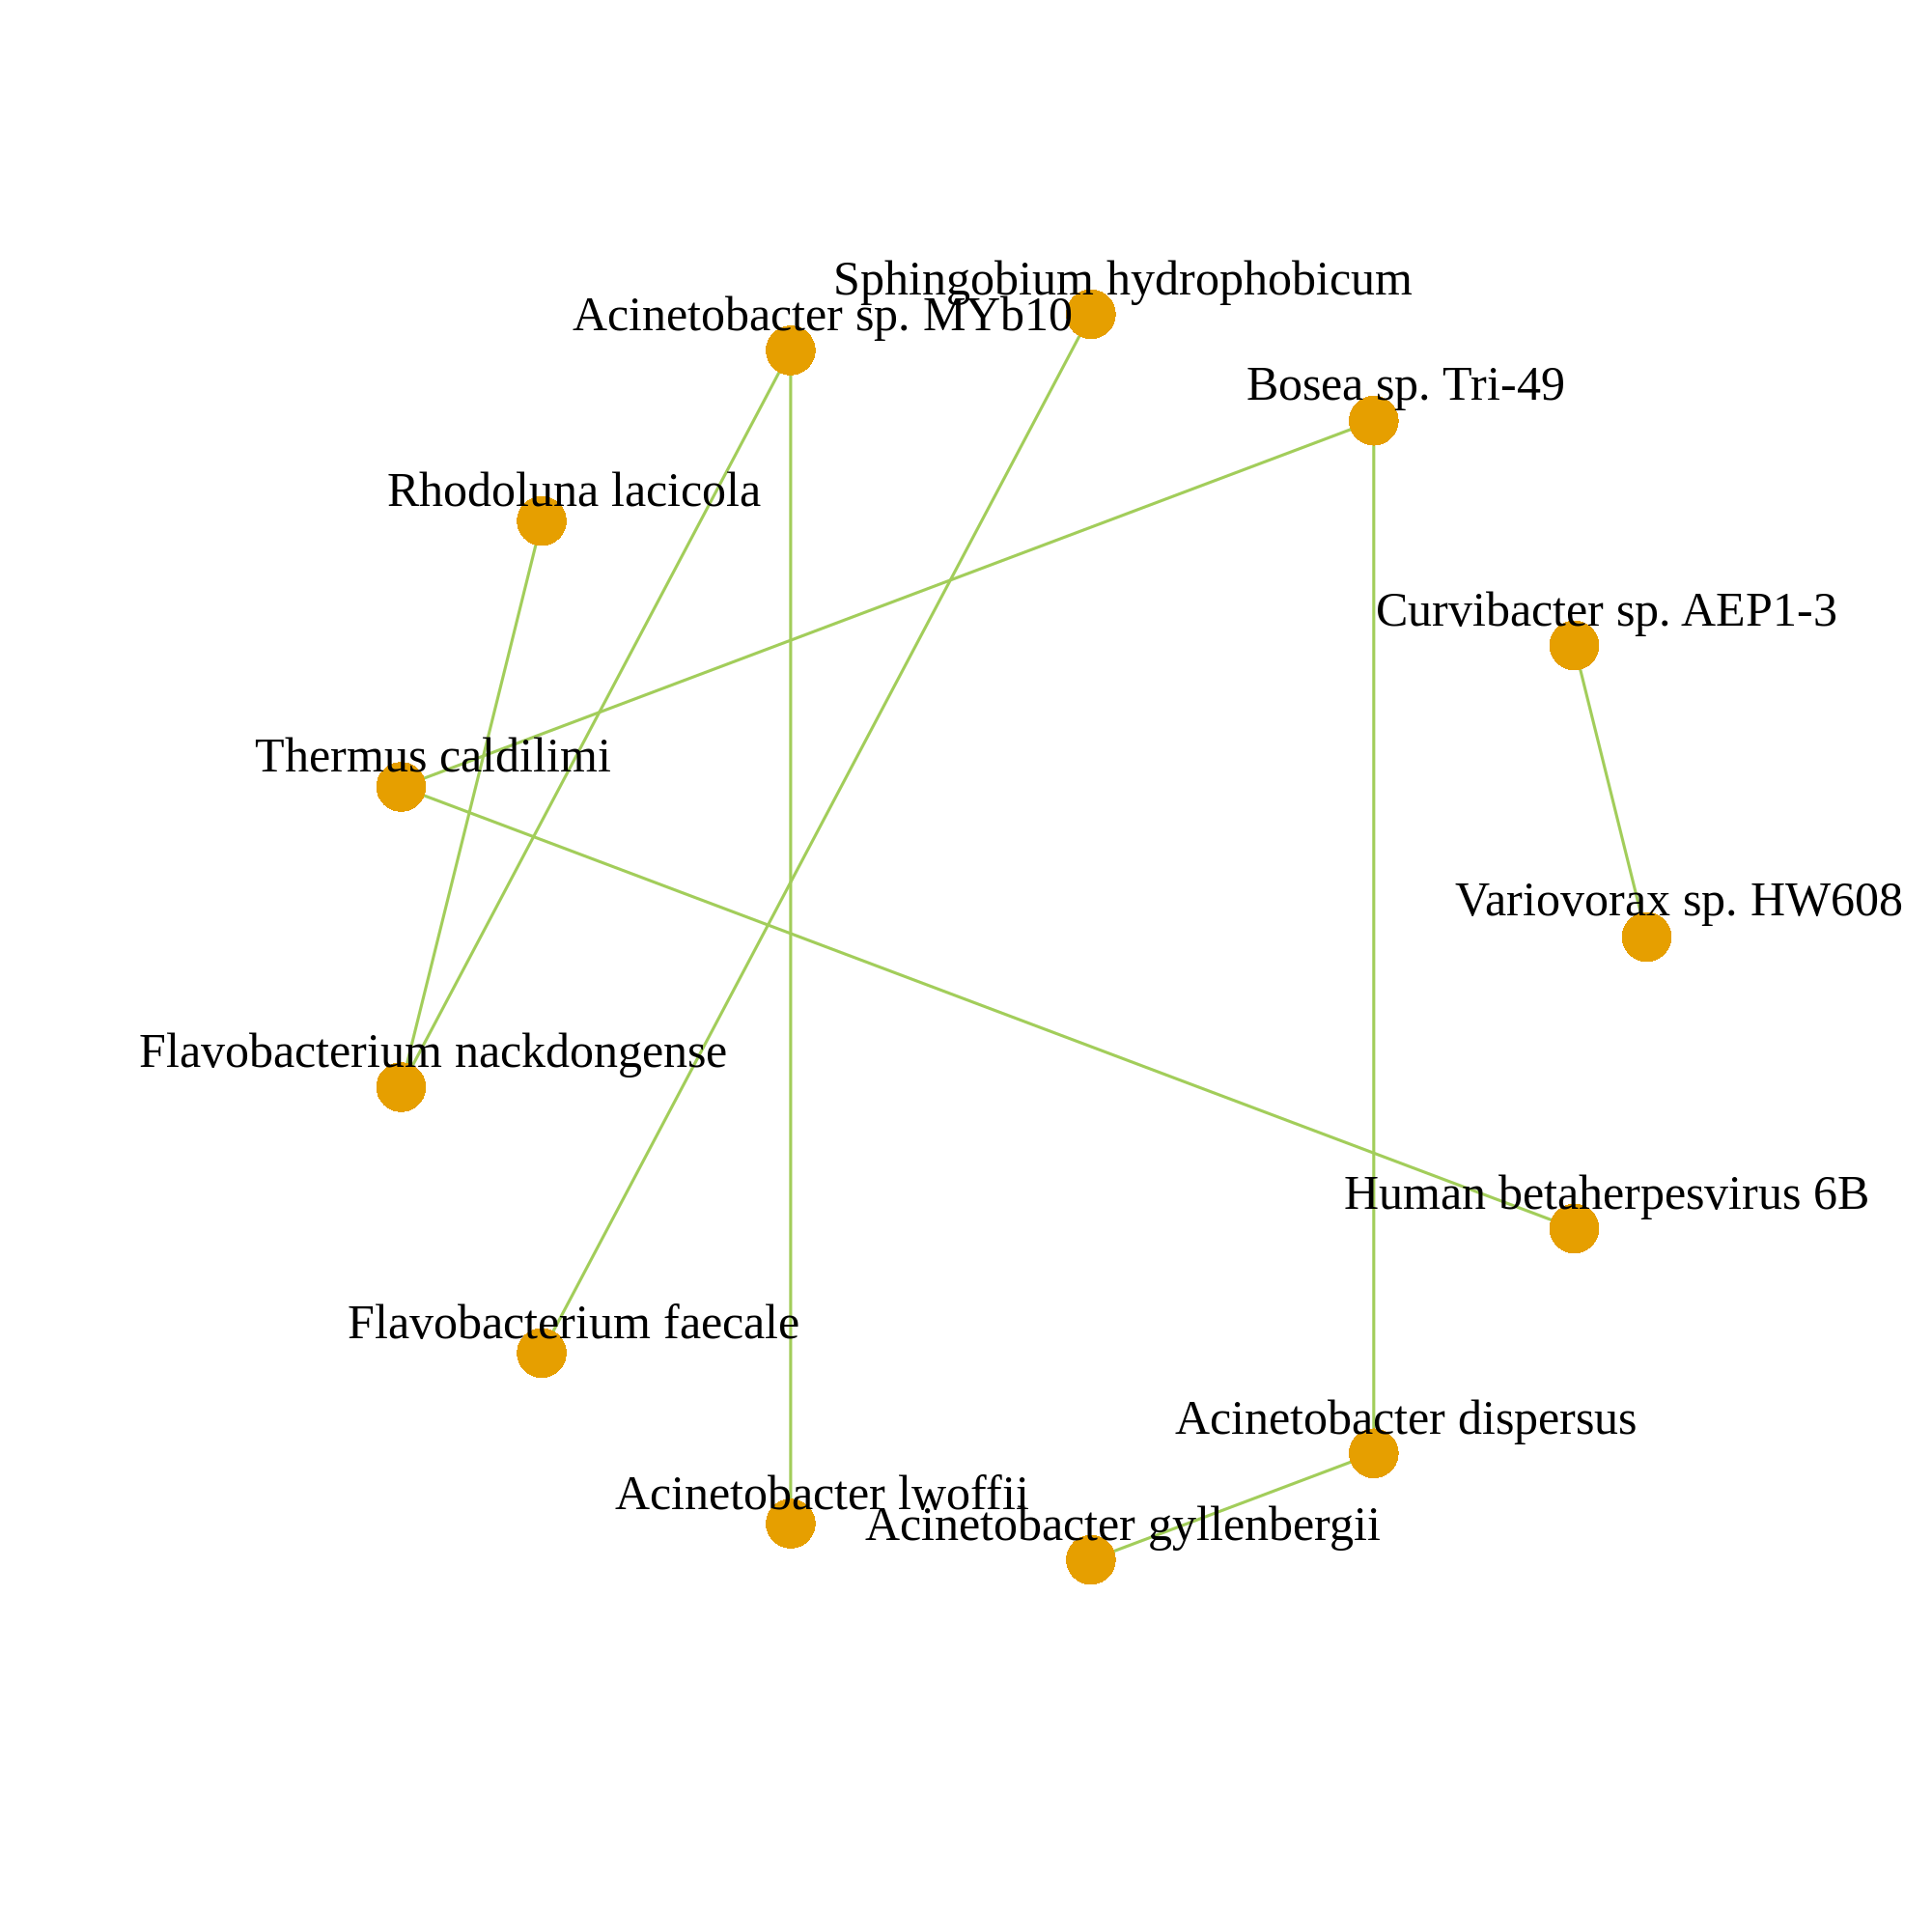

a
b
Corr. > 0.05
Corr. > 0.1
Corr. > 0.2
Legend
n = 67
Microbial species
Co-occurrence
Co-exclusion
Notes:
Supplementary Fig. 3: External validation using a published dataset. (a) Bar chart of all 26 putatively non-contaminant microbial species ranked by their prevalence in the 67 healthy plasma samples of the Poore dataset (26). These species were not present in at any of the accompanying negative control samples. (b) Microbial co-occurrence networks computed from all 67 healthy plasma samples of the Poore dataset (26) at different SparCC correlation thresholds (0.05, 0.1, 0.2). Only species absent in at any of the accompanying negative control samples were considered for these analysis. Associations with SparCC correlations of magnitude greater than the respective thresholds are retained. Each node represents a single microbial species, and each edge a single association between a pair of microbial species. Edge thickness is scaled by the magnitude of correlation. The number of samples used to compute each network and the correlation thresholds used are annotated. Positive and negative SparCC correlations are indicated in green and blue respectively.

Slide 16
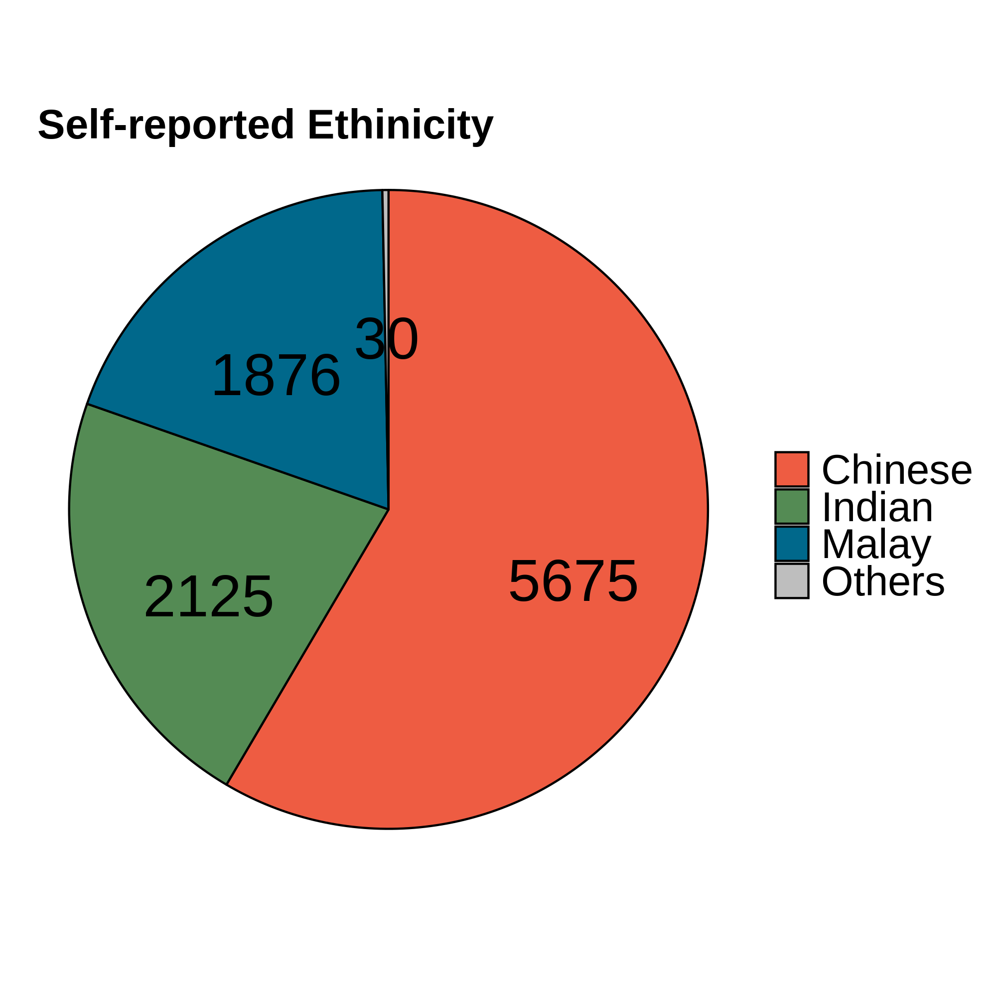
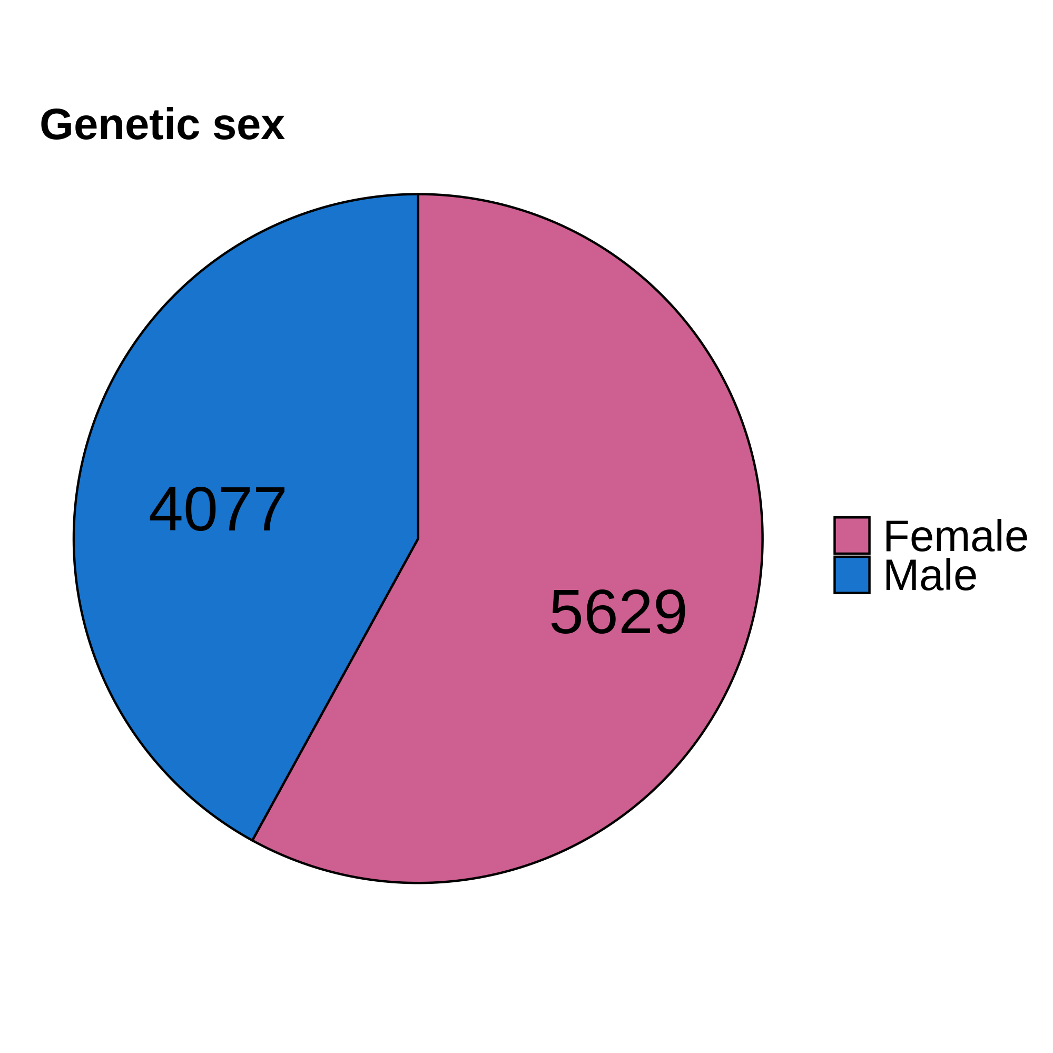
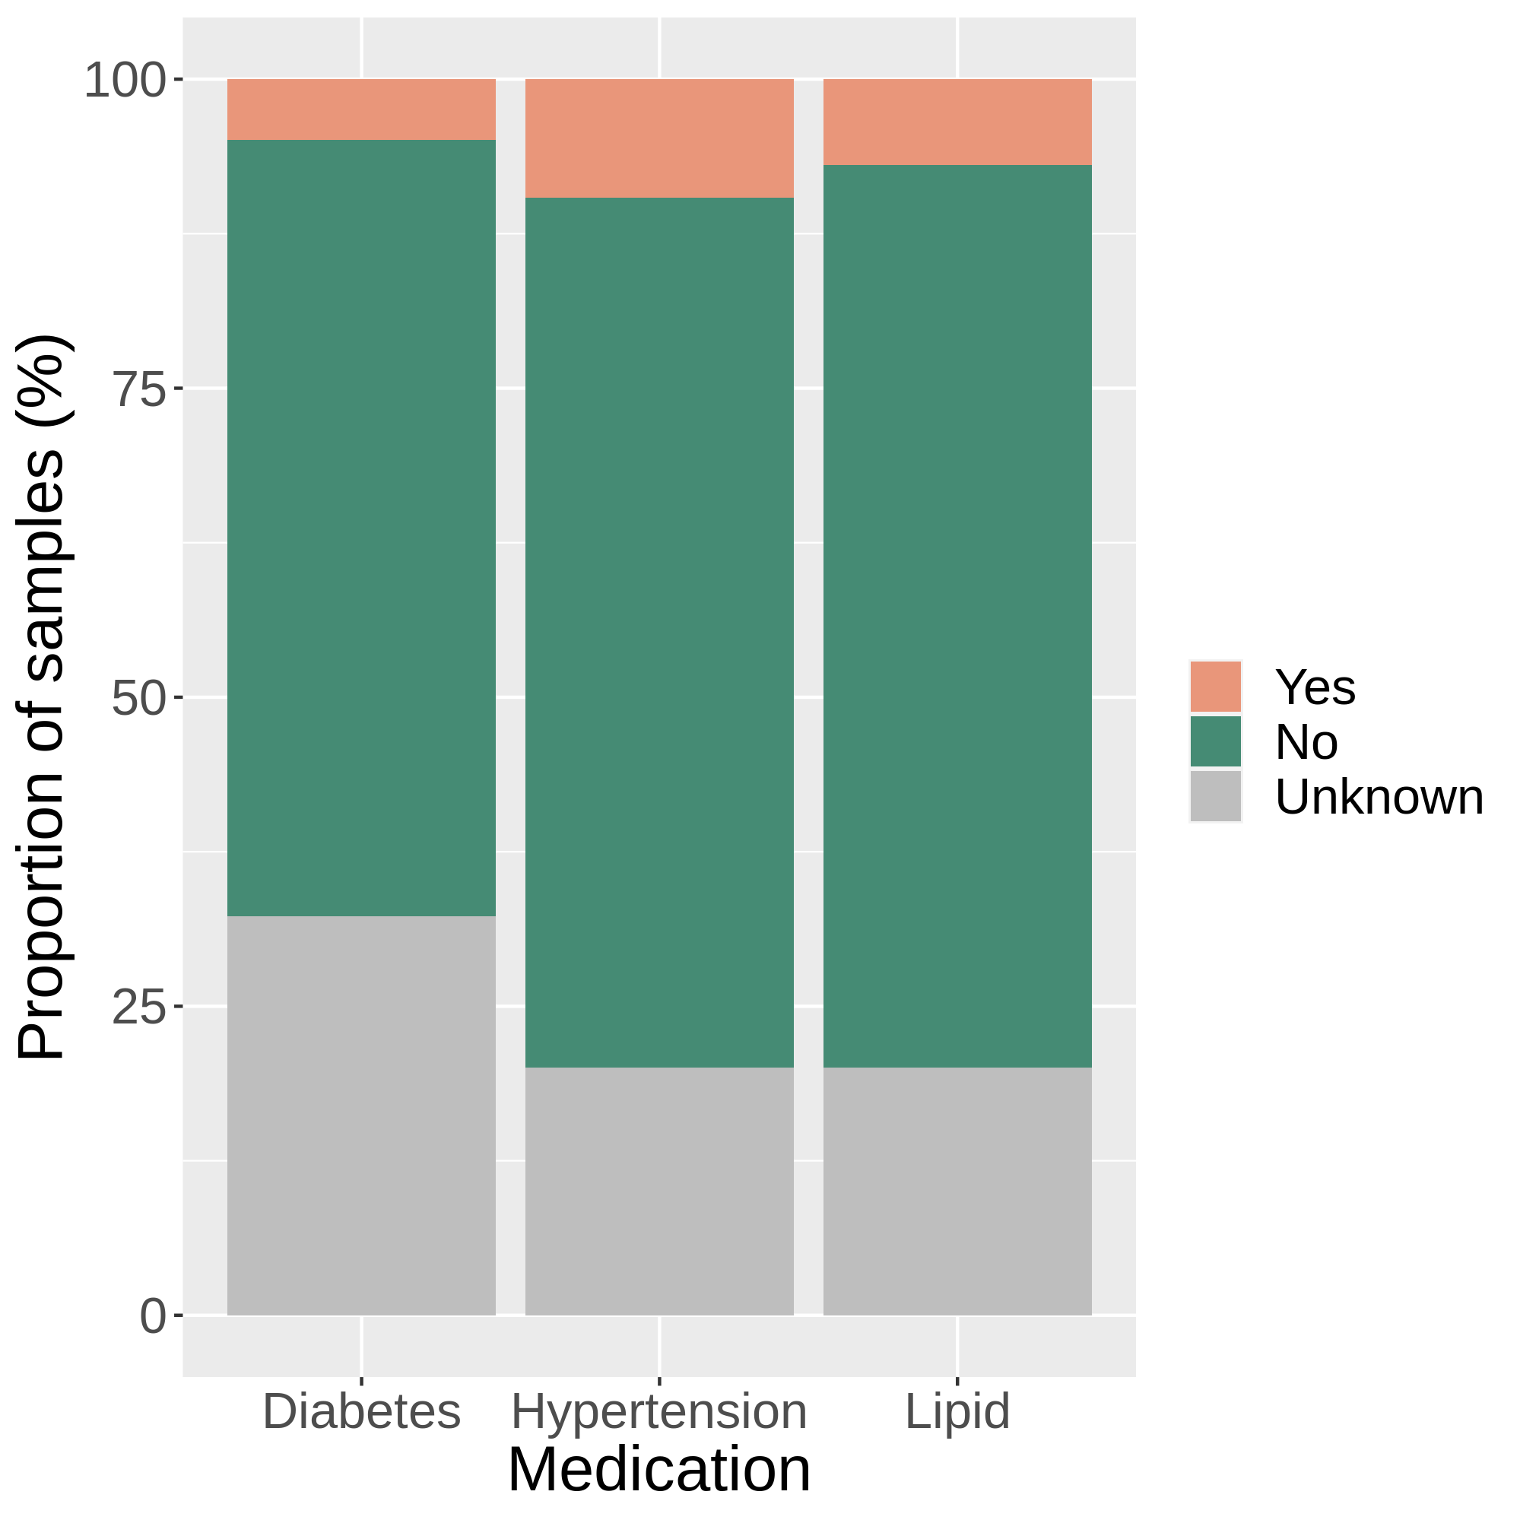
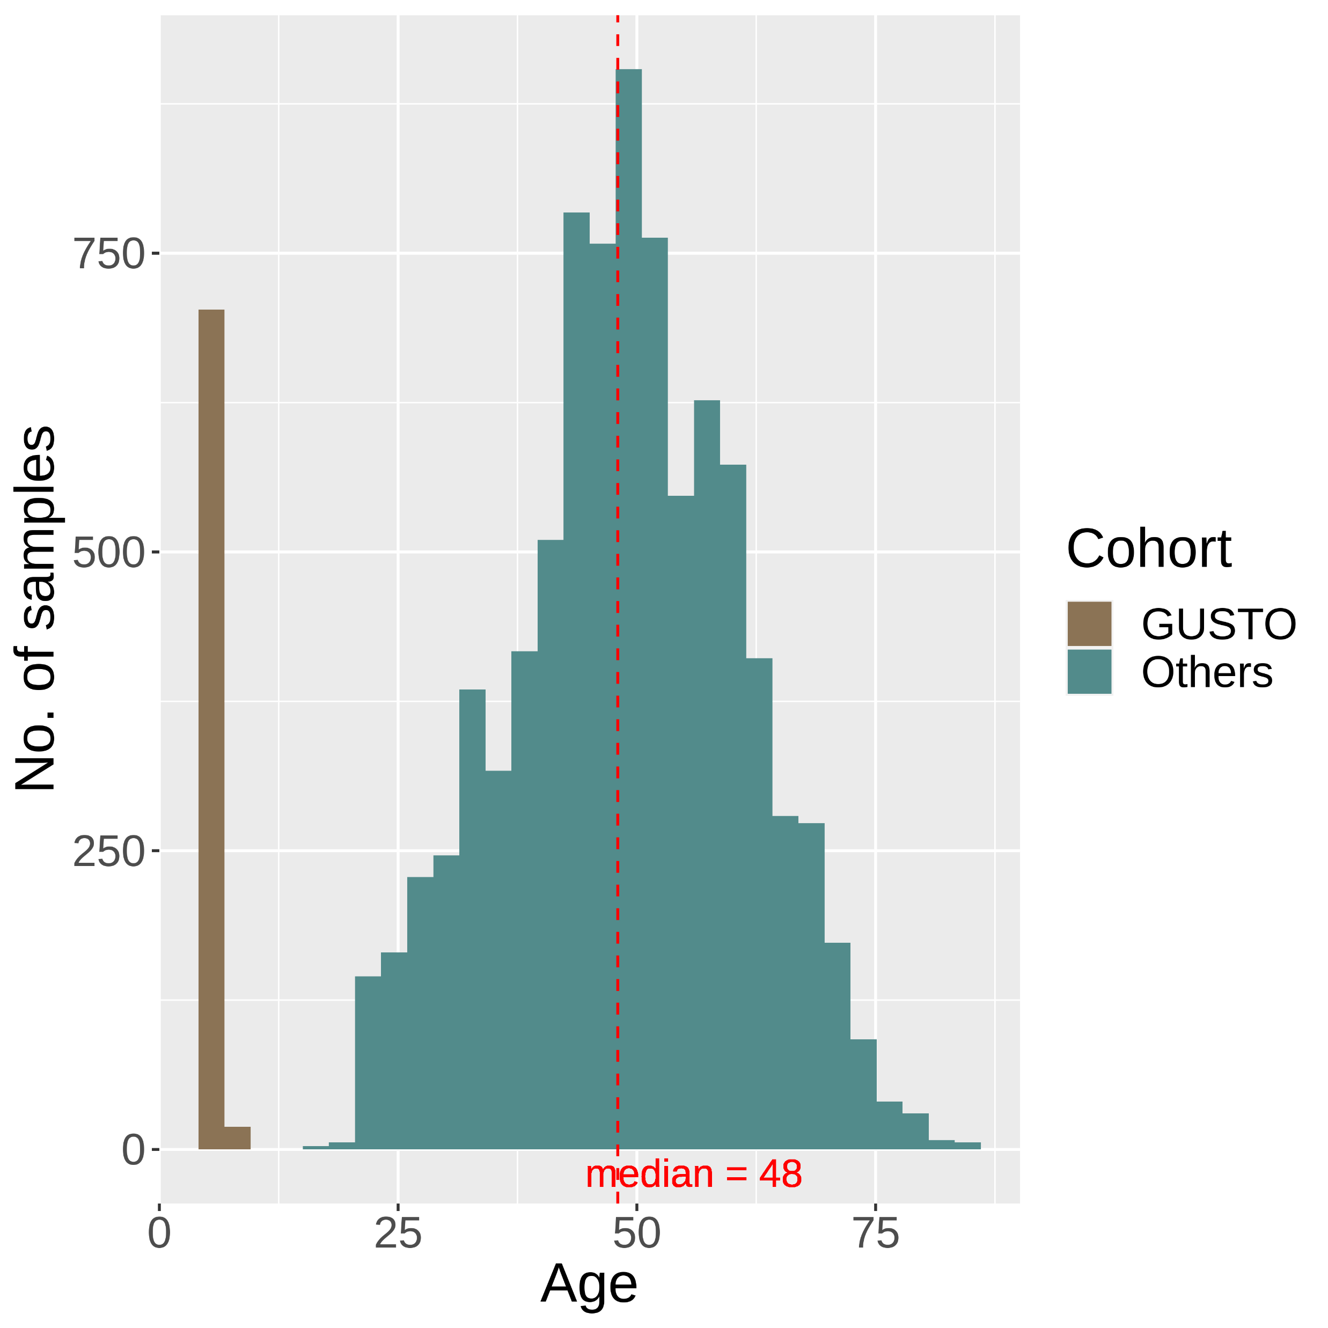
(a)
(b)
(c)
(d)
Notes:
Figure S1

Slide 17
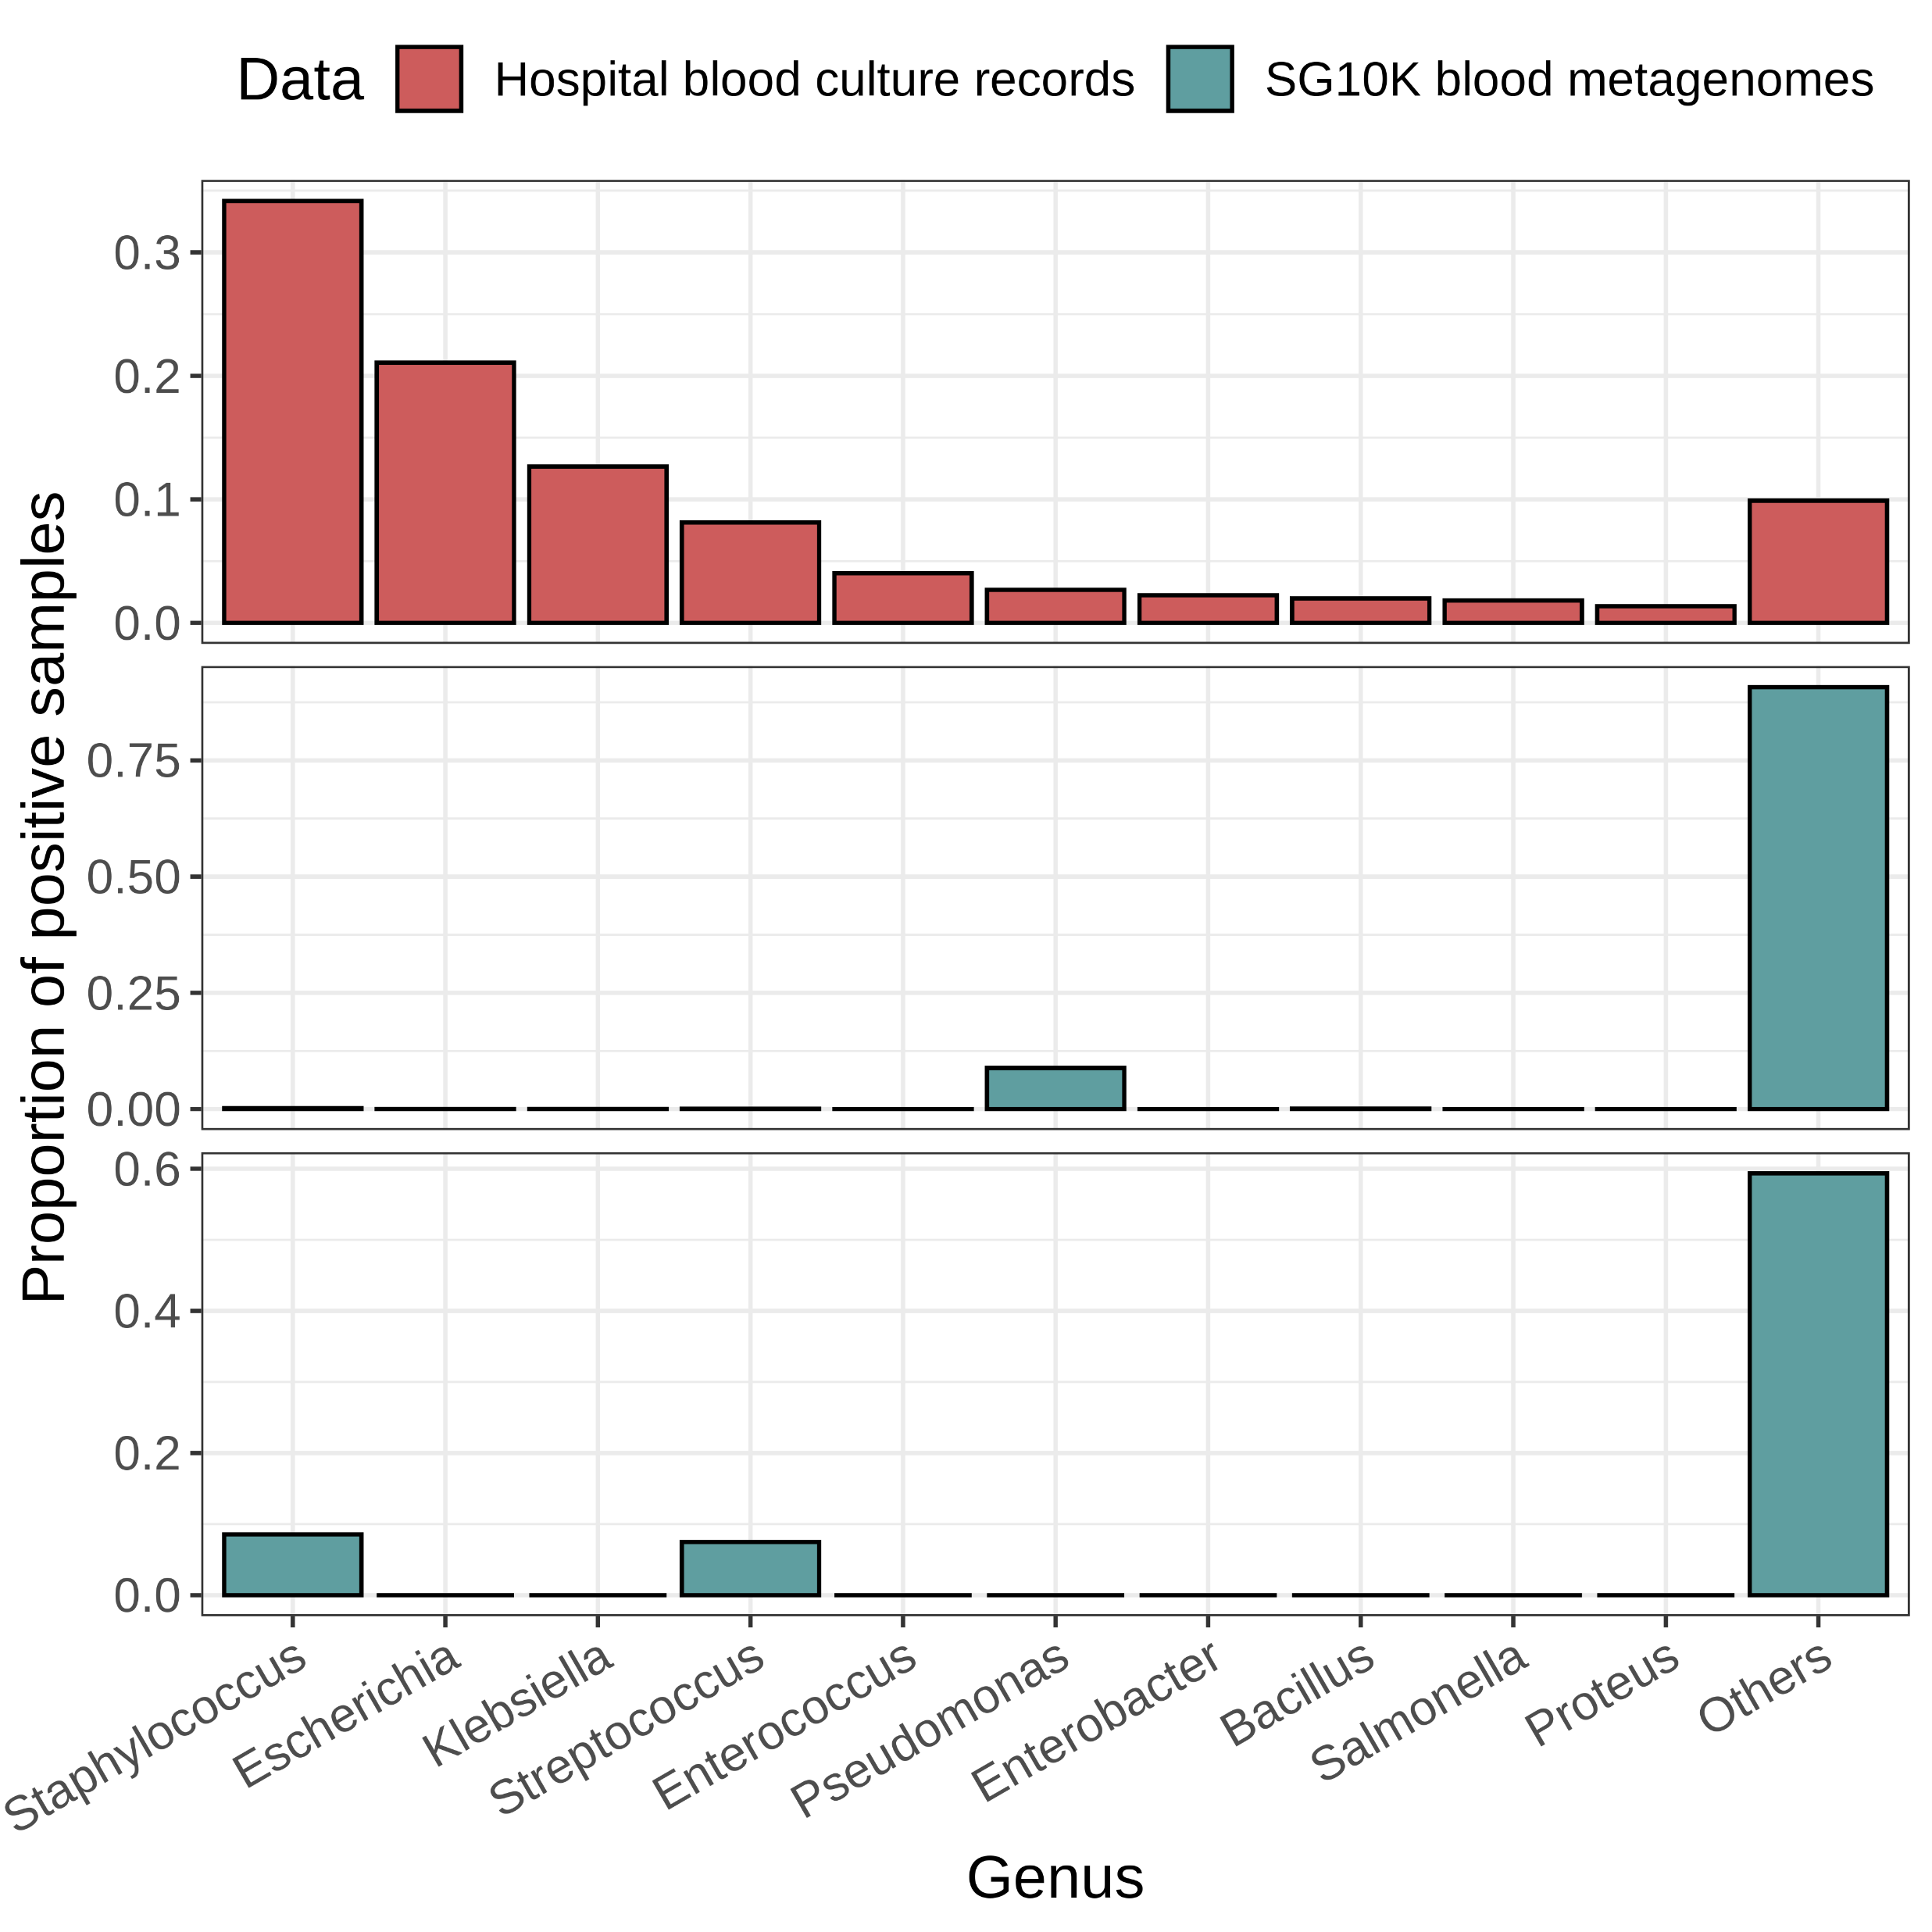
a
Prop. of positive cultures
b
Prop. of microbes detected
(before decontamination)
c
Prop. of non-contaminant species

Slide 18
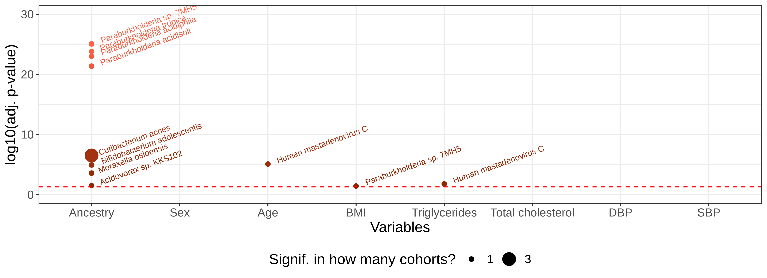
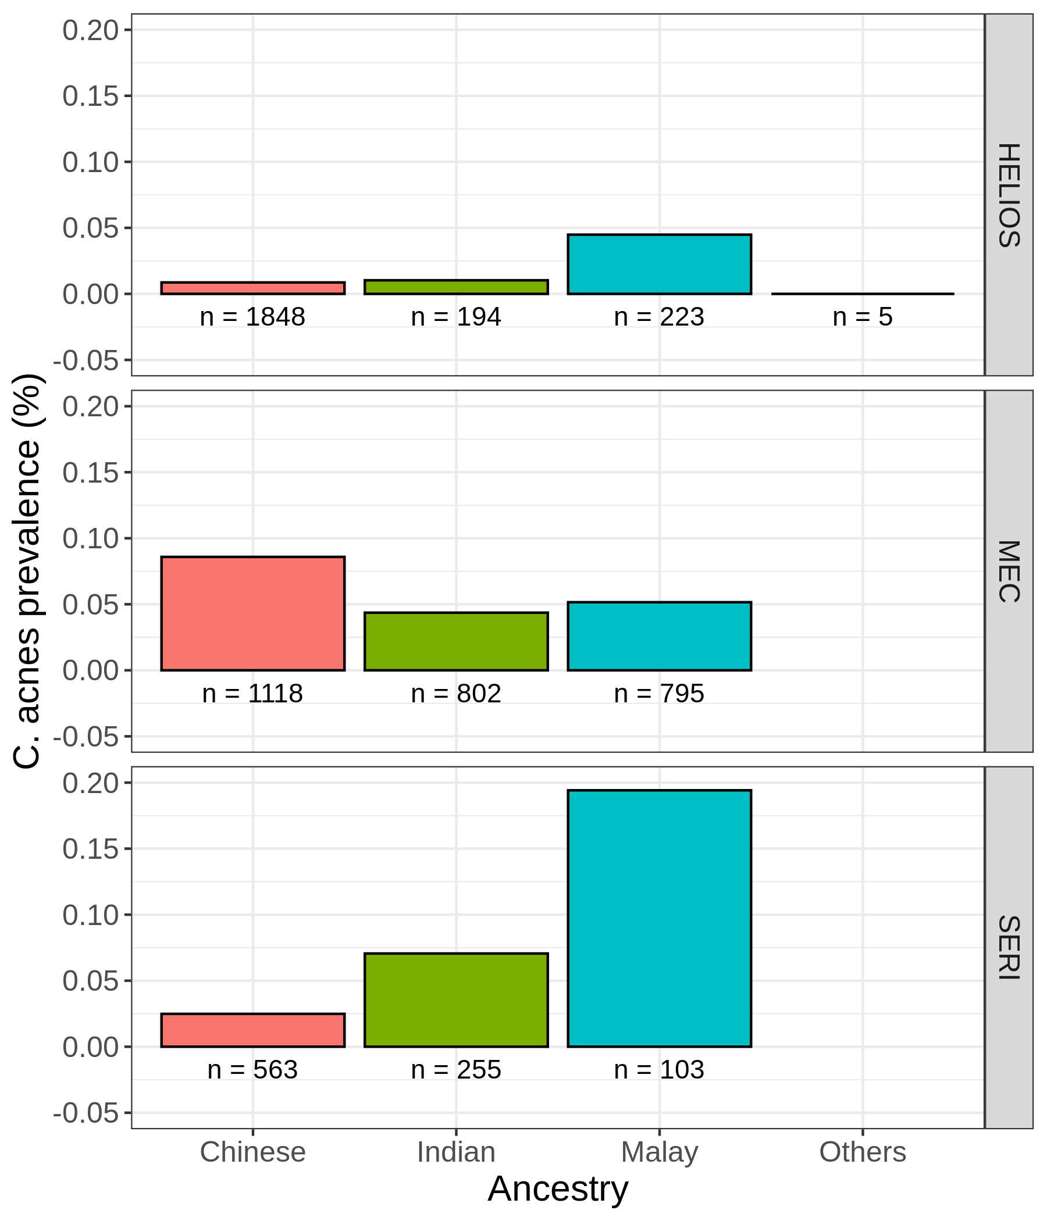
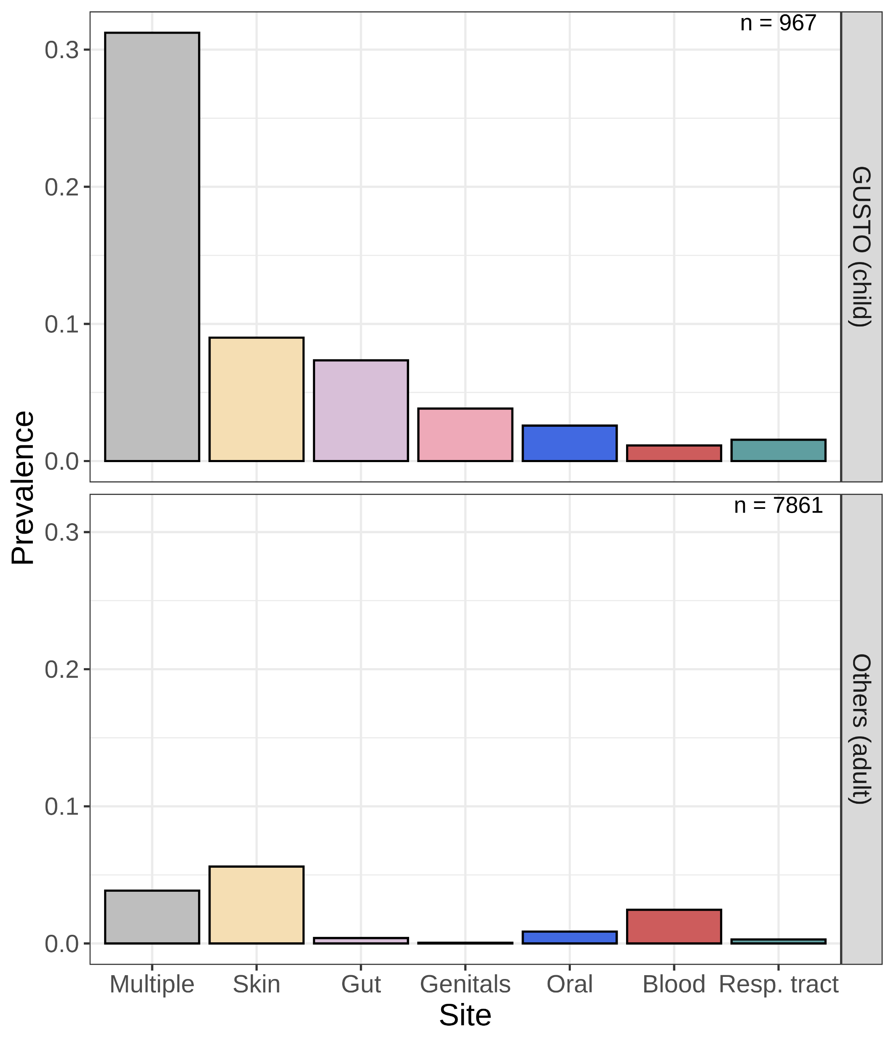
a
b
c
Notes:
Figure 4
Check paraburkholderia
Check bias of each column with cohorts
Substratify species

Slide 19
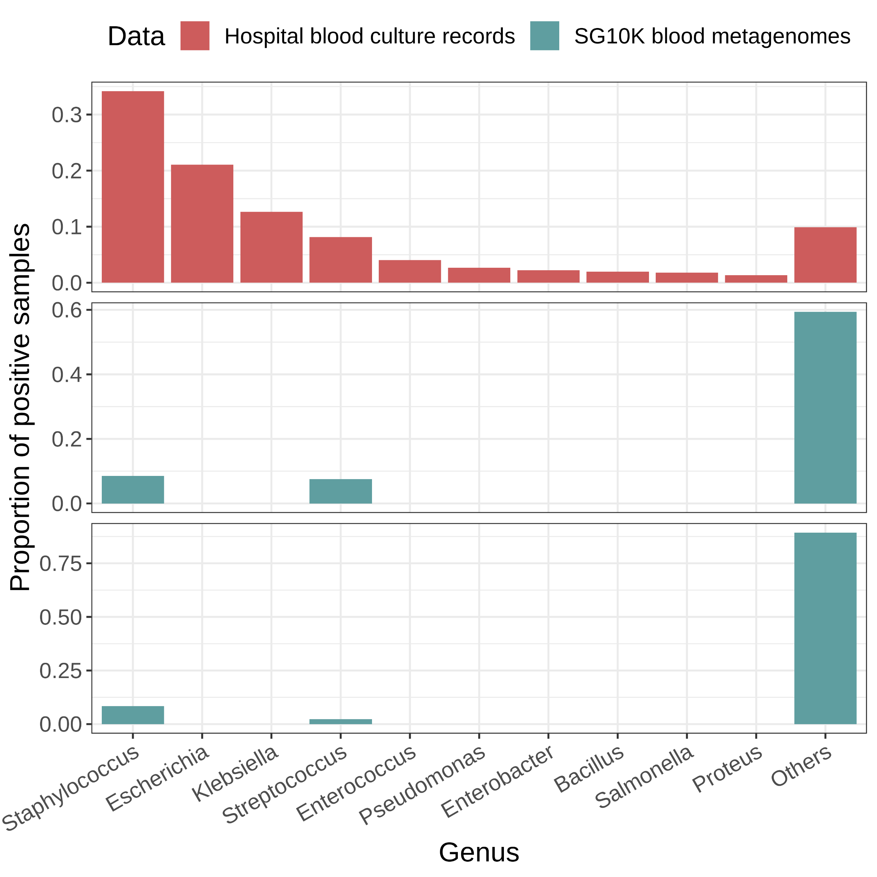
a
Prop. of positive cultures
b
Prop. of microbes detected
c
Prop. of non-contaminant species

Slide 20
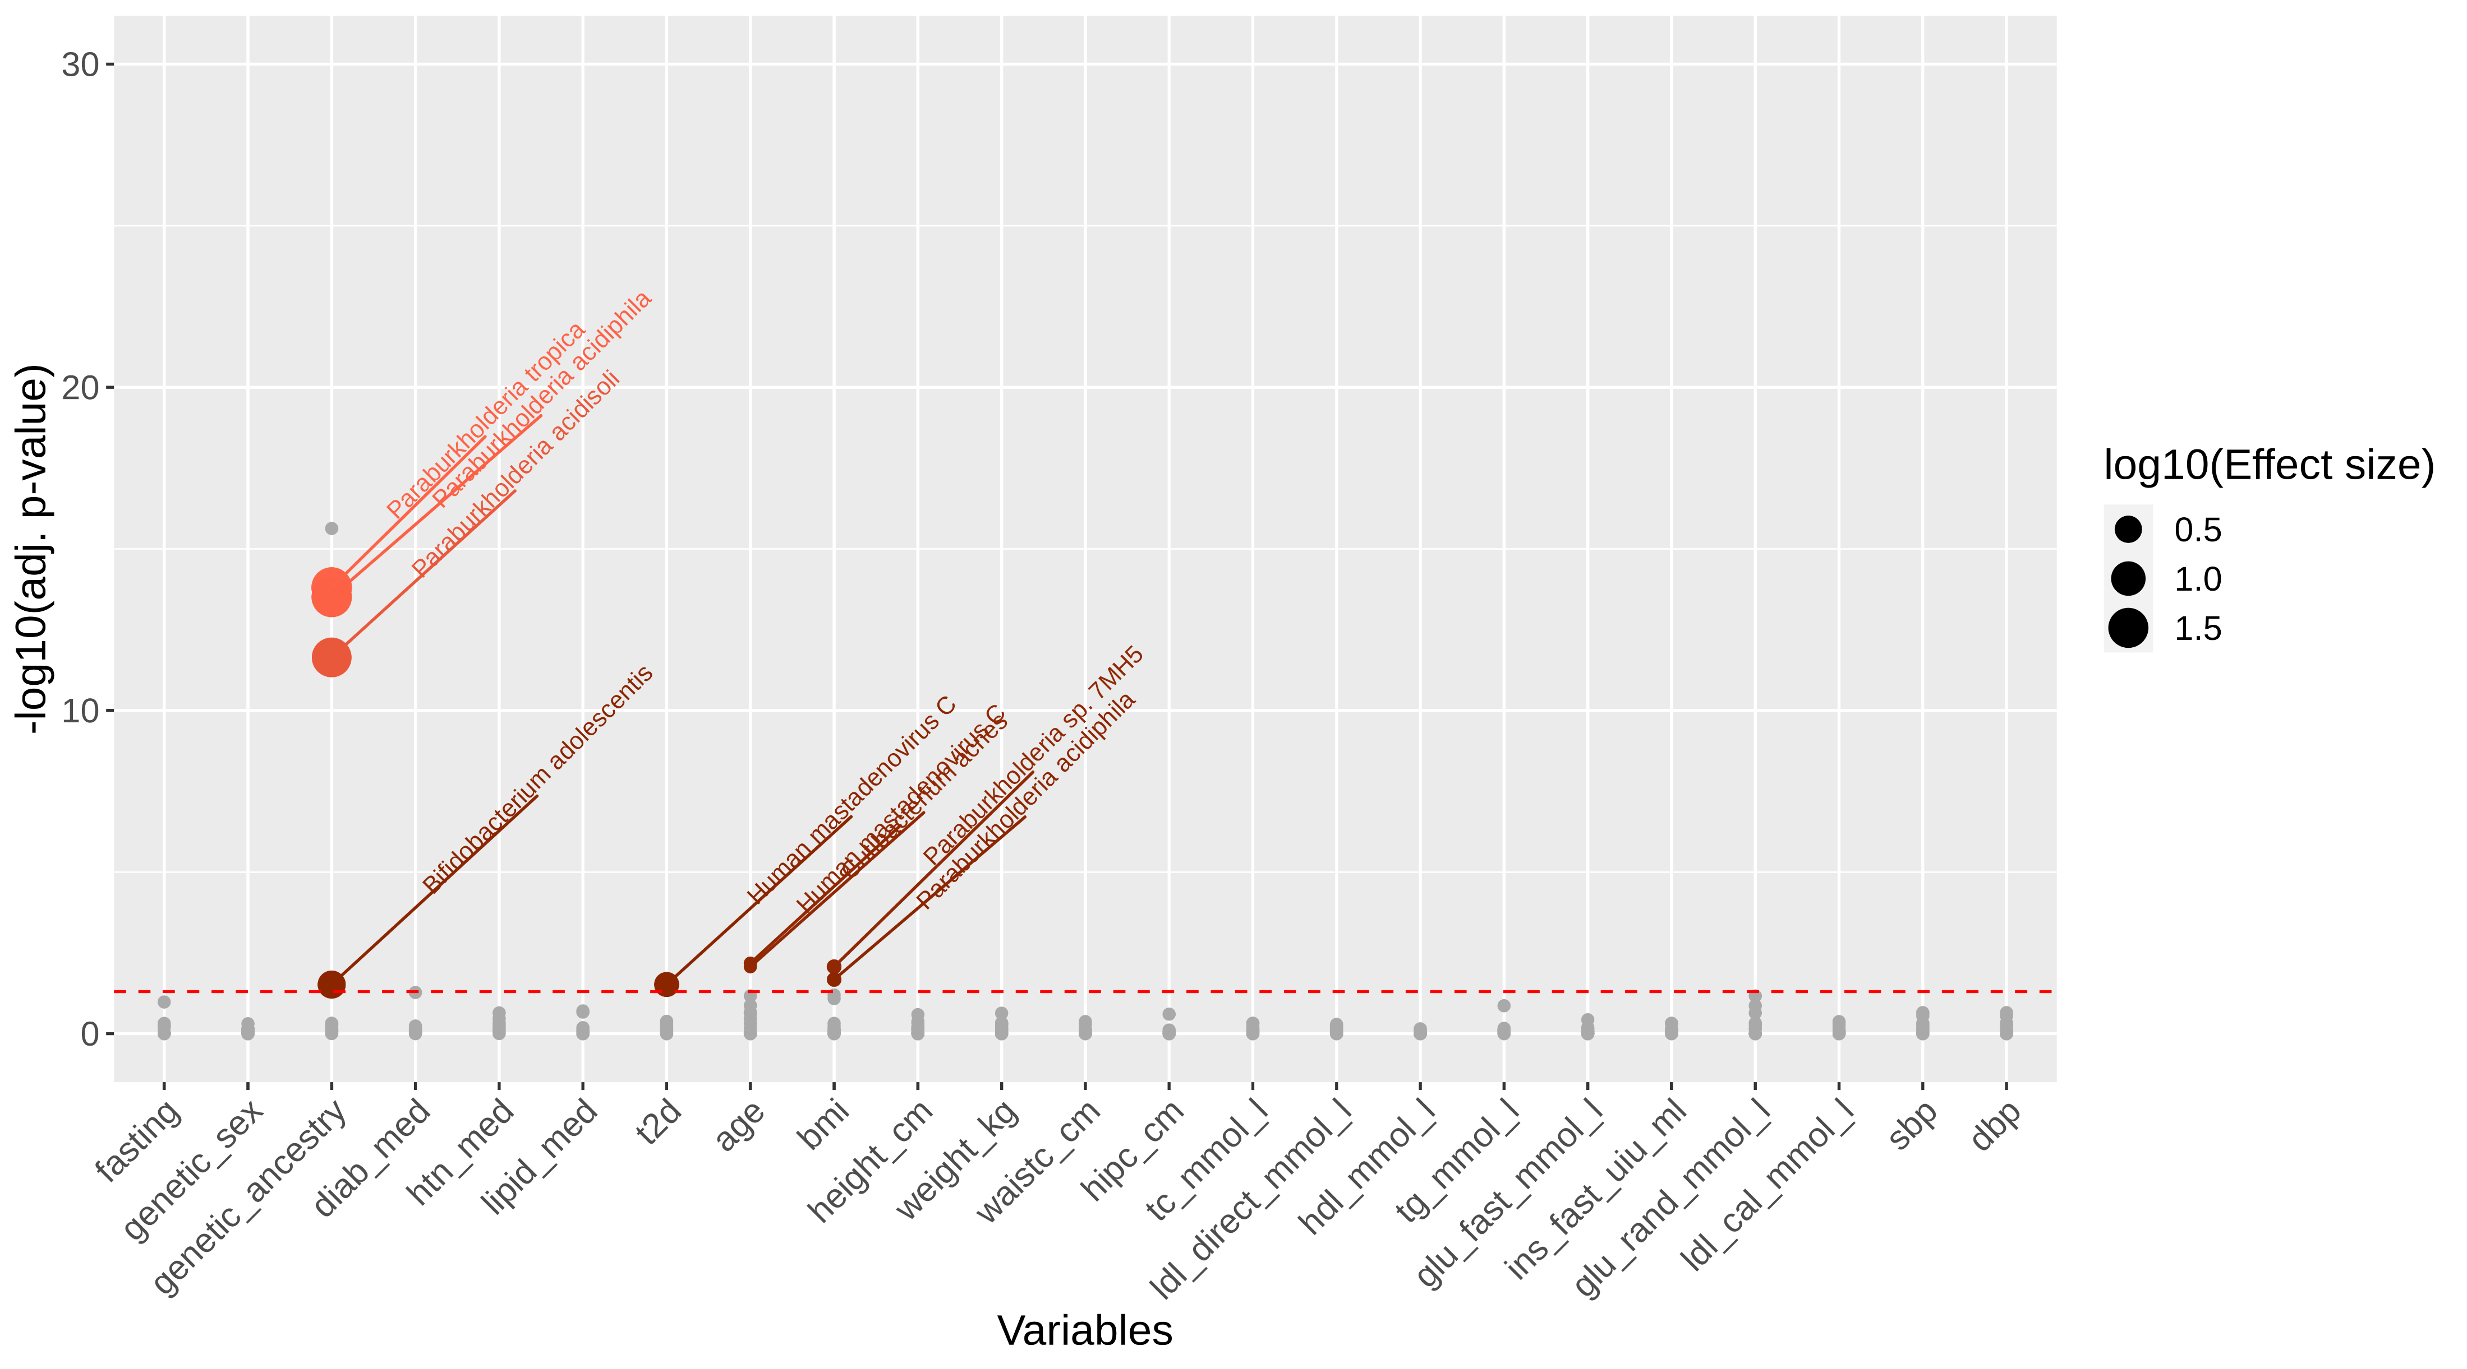
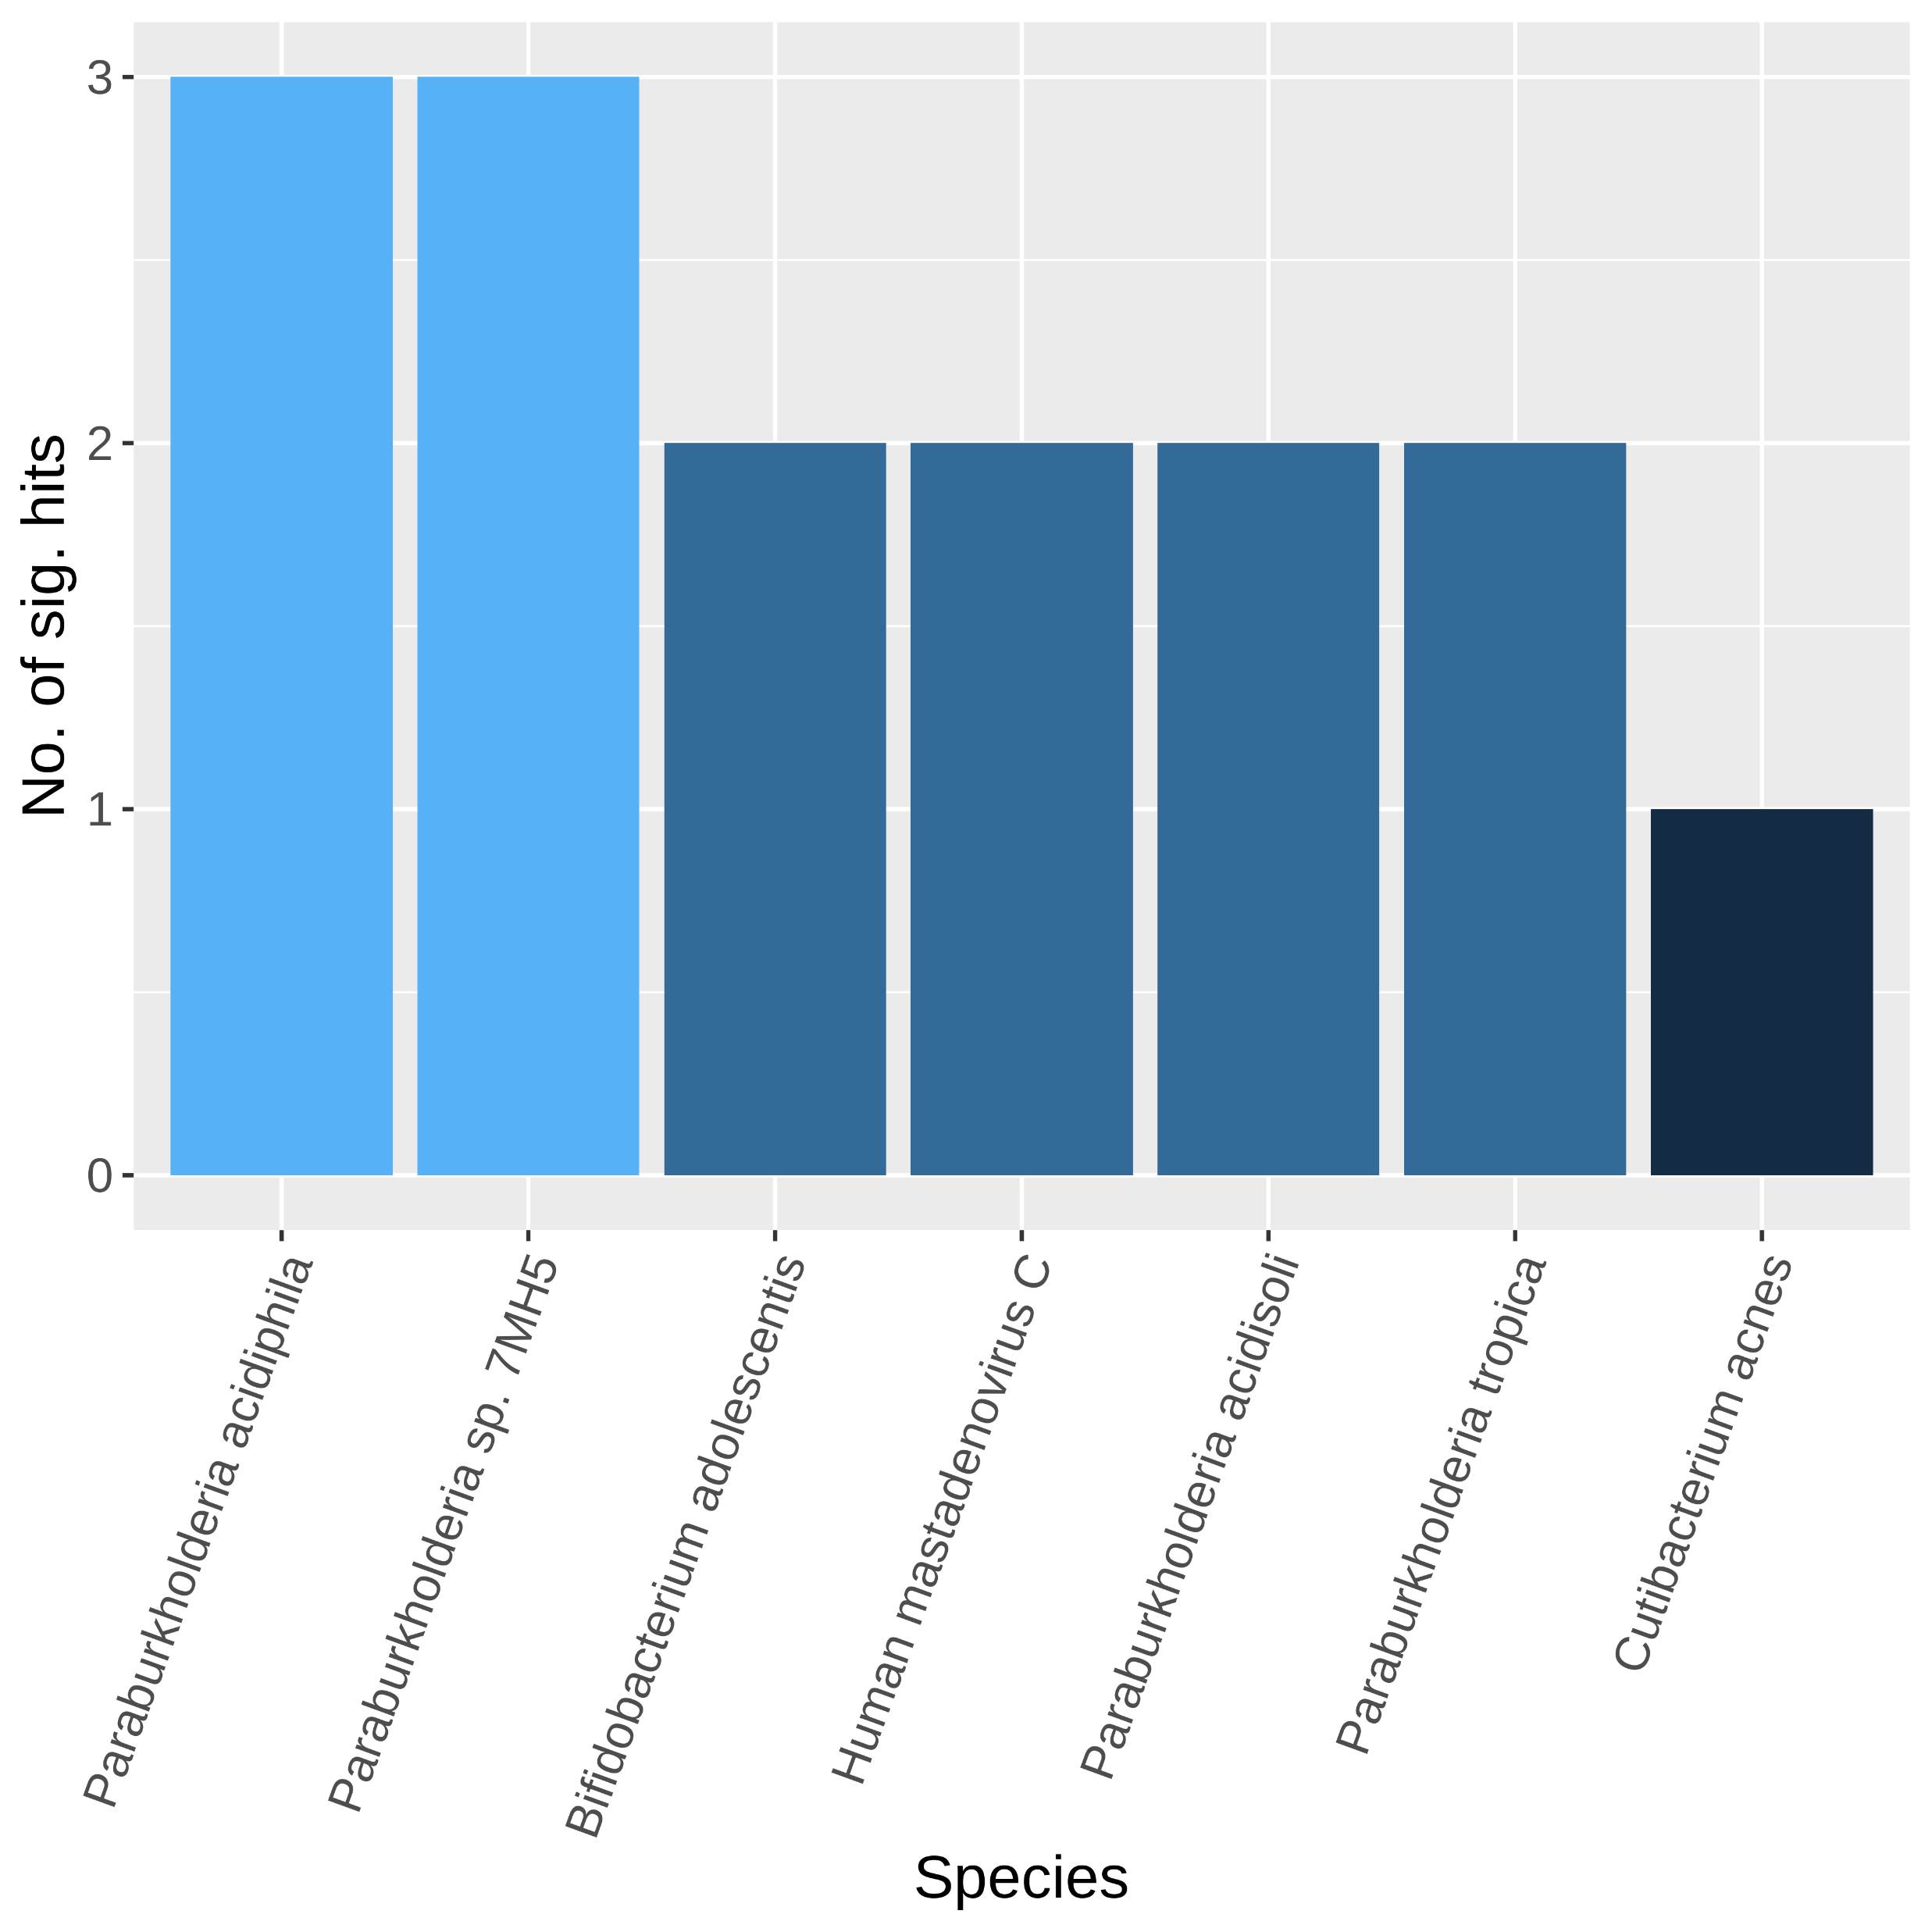

Effect of host phenotype
(a)
Presence of species, S
$ln⁡(odds({Presence}_{S}))=β_{0}+α_{cohort}+ γ_{variable}$ $+$ ε
Effect of cohort as covariate
(b)
(c)
Notes:
Figure 4
Check paraburkholderia
Check bias of each column with cohorts
Substratify species

Slide 21






Before decontamination
After decontamination
(a)
(b)
(c)
(d)

Slide 22


5199 species
(a)
Pre-processed Fastqs (n = 9706)
Kraken2 classification
Apply abundance thresholds
564 species
(b)
Contaminant
Non-contaminant
Filter 1
> 2-fold
Differential prevalence
478 species
(c)
Filter 2
Correlation
434 species
Filter 4
Filter 3
Downstream analyses
Max read count filter
Batch filter
176 species
125 species

Slide 23








(a)
Pre-processed fastqs (n = 9706)
Kraken2 classification
Apply abundance thresholds
5199 species
564 species
Filter 1
Filter 4
Filter 2
Filter 3
Differential prevalence
Correlation
Batch filter
Max read count filter
Downstream analyses
478 species
434 species
176 species
125 species
(b)
(c)
Contaminant
Non-contaminant
> 2-fold
Before decontamination
After decontamination
(d)
(e)
(f)
(g)

Slide 24












(a)
Non-contaminants
F. nucleatum
M. osloensis
M. osloensis
N. subflava
H. parainfluenzae
F. vaginae
S. epidermidis
L. crispatus
A. baumannii
N. flavescens
(b)
Contaminants
A. xylosoxidans
P. mendocina
A. faecalis
Notes:
Figure 3 GROUPED
Median smoothing
Multiplot this (2x2)
We have helios skin data

Slide 25




Notes:
Figure 2
Check blood transfusion literature
Max. number of cells for contaminants vs. nc
Compare ranks of BC records with our ranks
Add average relative abundance

Slide 26





a
b
c
All species
n = 8828
n = 8828
Non-contaminants
d
e
Notes:
Figure 2

